Slide 1
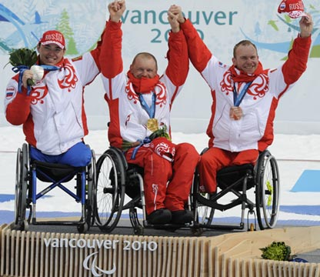
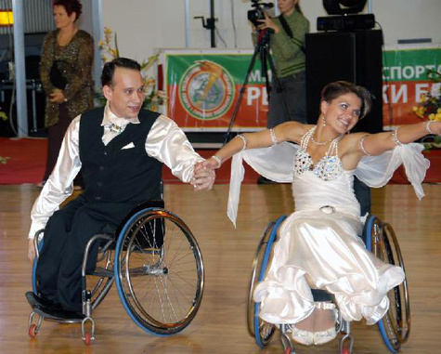
Never Give Up!

Slide 2
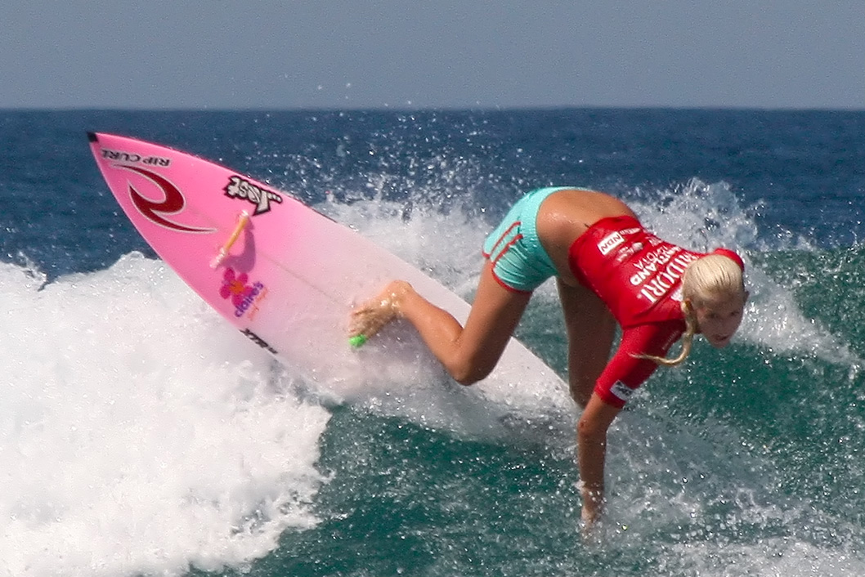
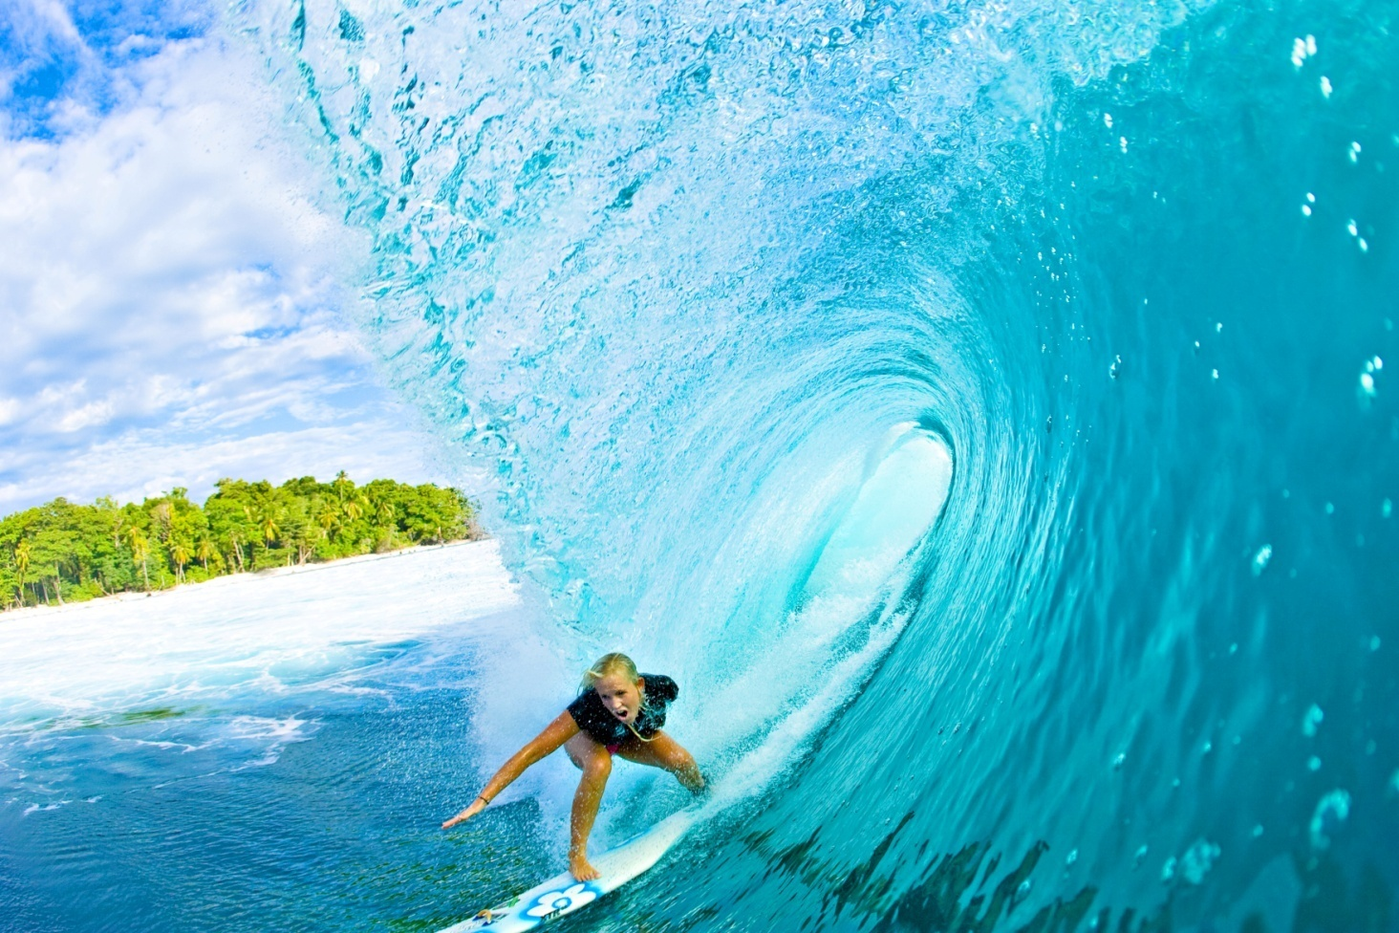
1. What challenge do you think this girl faced?
2. What do you think her life was like after the tragedy?
3. What was one of the biggest difficulties?

Slide 3
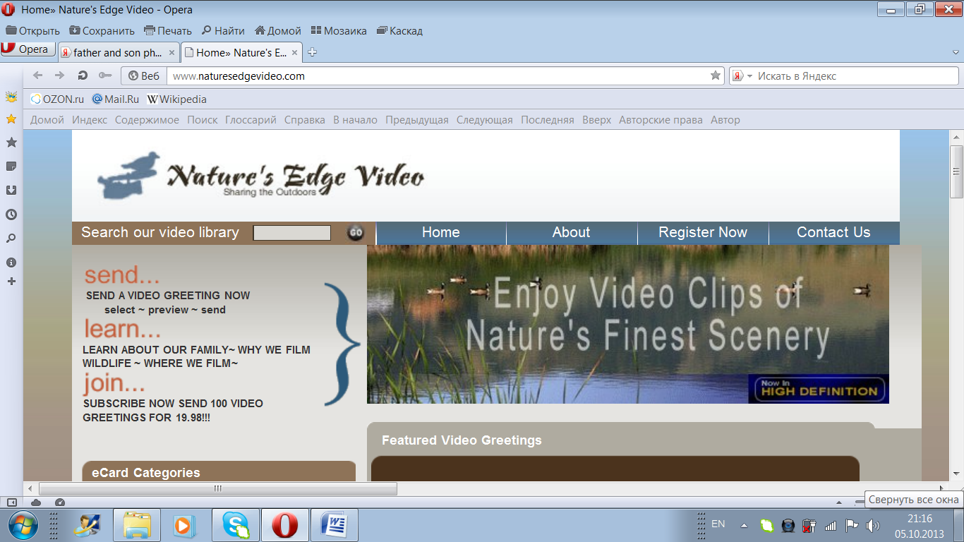
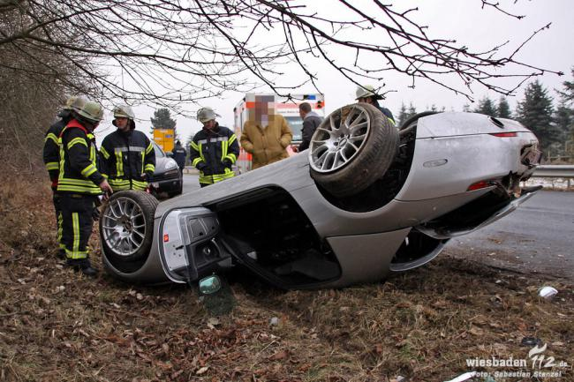
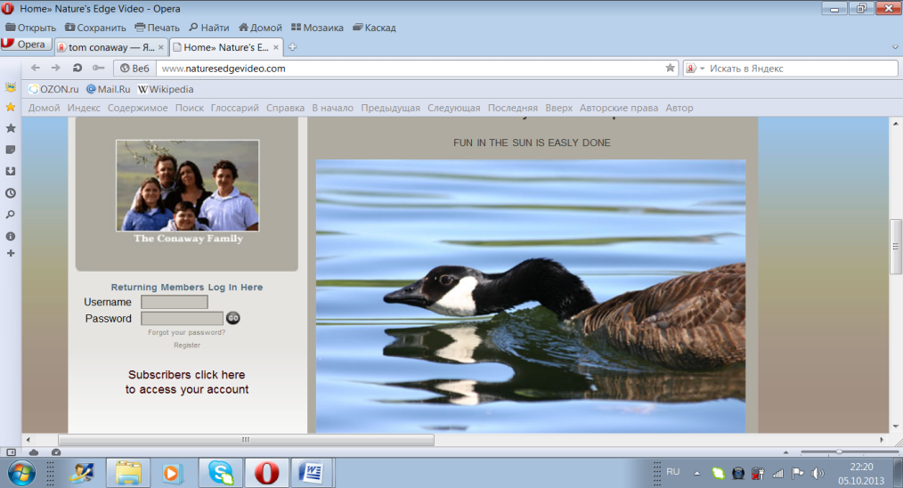
1. What do you think happened to the boy?
2. How does he deal with his problems?
3. What does he feel about being in a wheelchair?

Slide 4
Read the text and mark the sentences T (true), F (false), or NS (not stated). Correct the false sentences.
1. Bethany was a professional surfer by 2003.
2. Bethany didn’t see the shark before it attacked her.
3. People were surprised when Bethany started surfing again soon after her accident.
4. Bethany doesn’t worry about sharks any more.
5. Bethany never questions why she lost her arm.
6. Tom can’t move his arms or legs.
7. Tom’s dad has always loved film making.
8. Tom’s dad controls the camera for him.
9. Tom believes that his disability gives him an advantage when filming.

Slide 5
Match the words/phrases from the text to their meanings.
1. gigantic
- huge
2. plant
- place firmly
3. keep smb’s mind on
- concentrate on
4. inspiration
- encouragement
5. quit
- give up
6. perfectly still
- without moving at all
7. come into sight
- appear
8. before long
- soon
9. realised
- understood
10. scaring them off
- frightening them away
11. deal with
- face

Slide 6
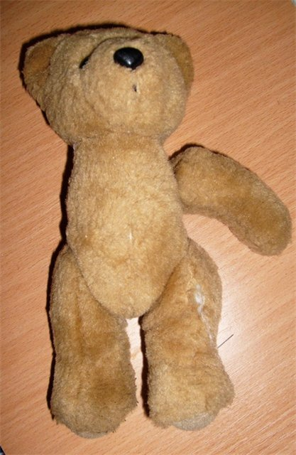
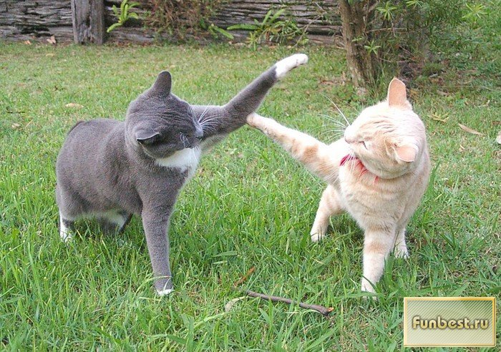
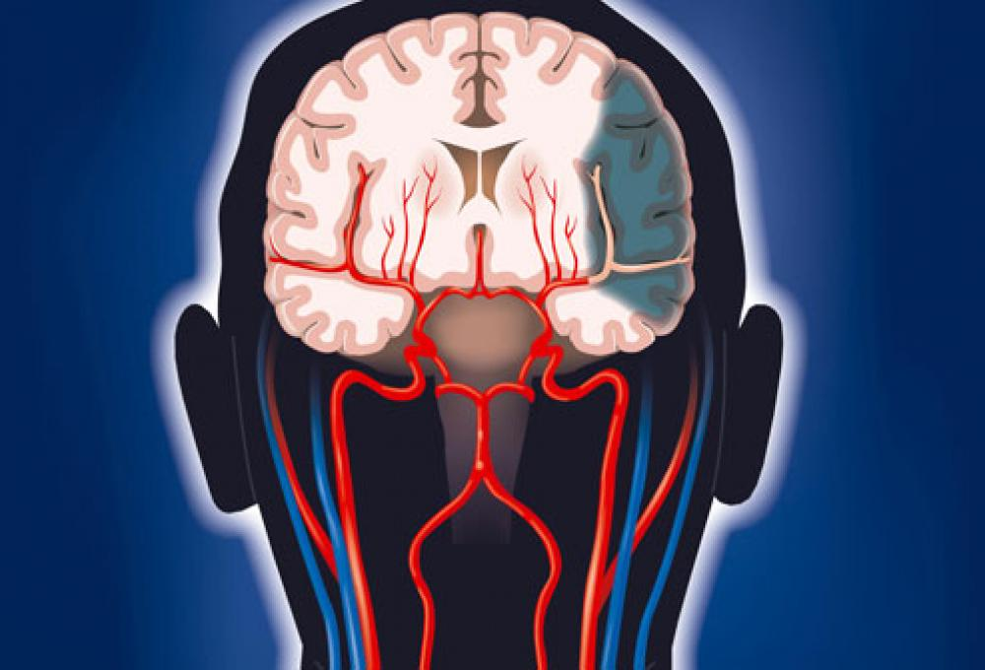
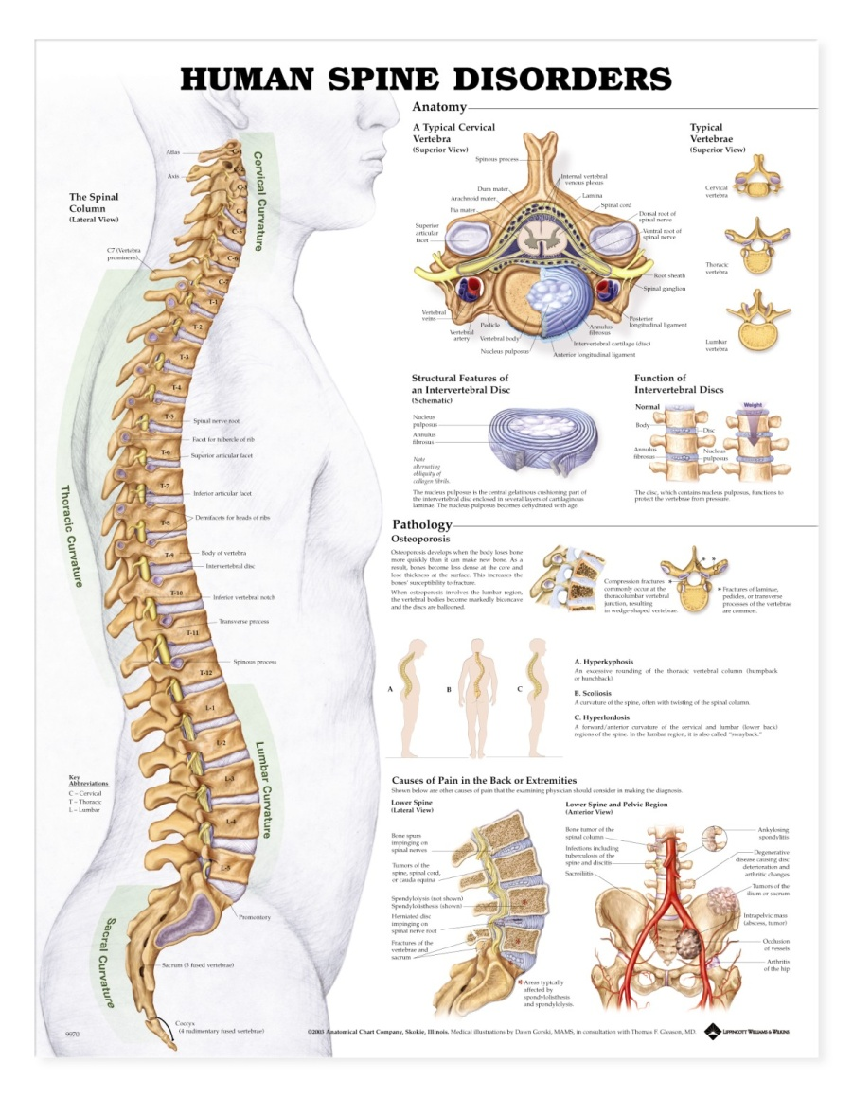
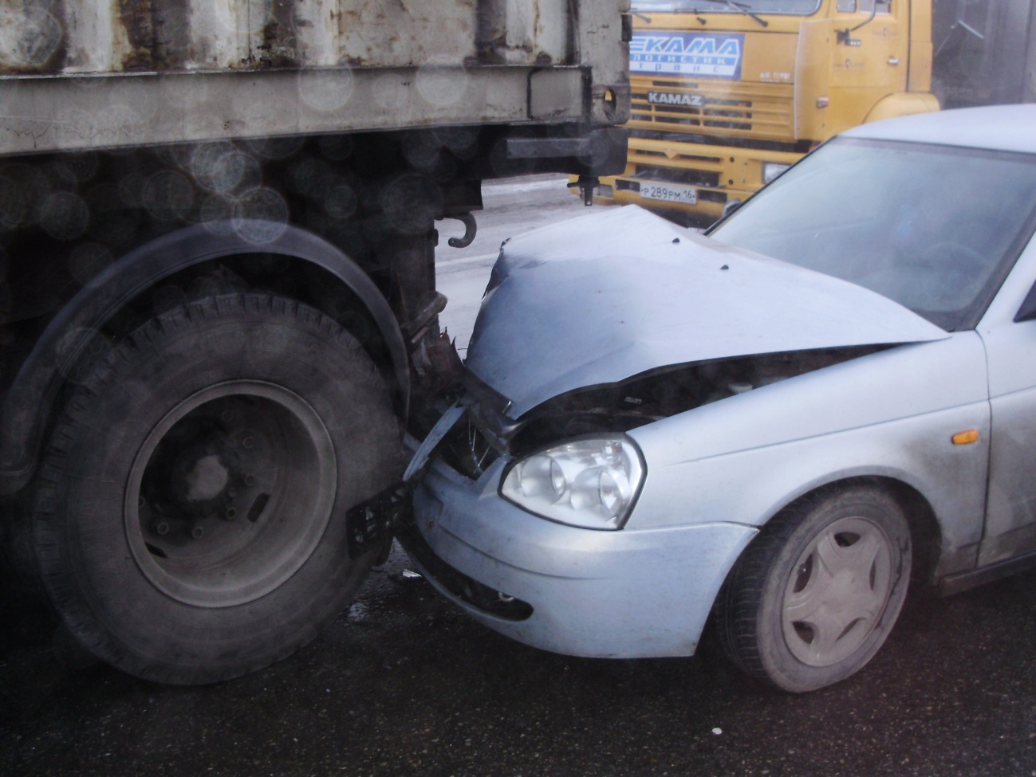
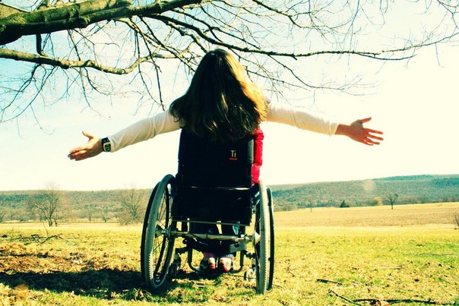
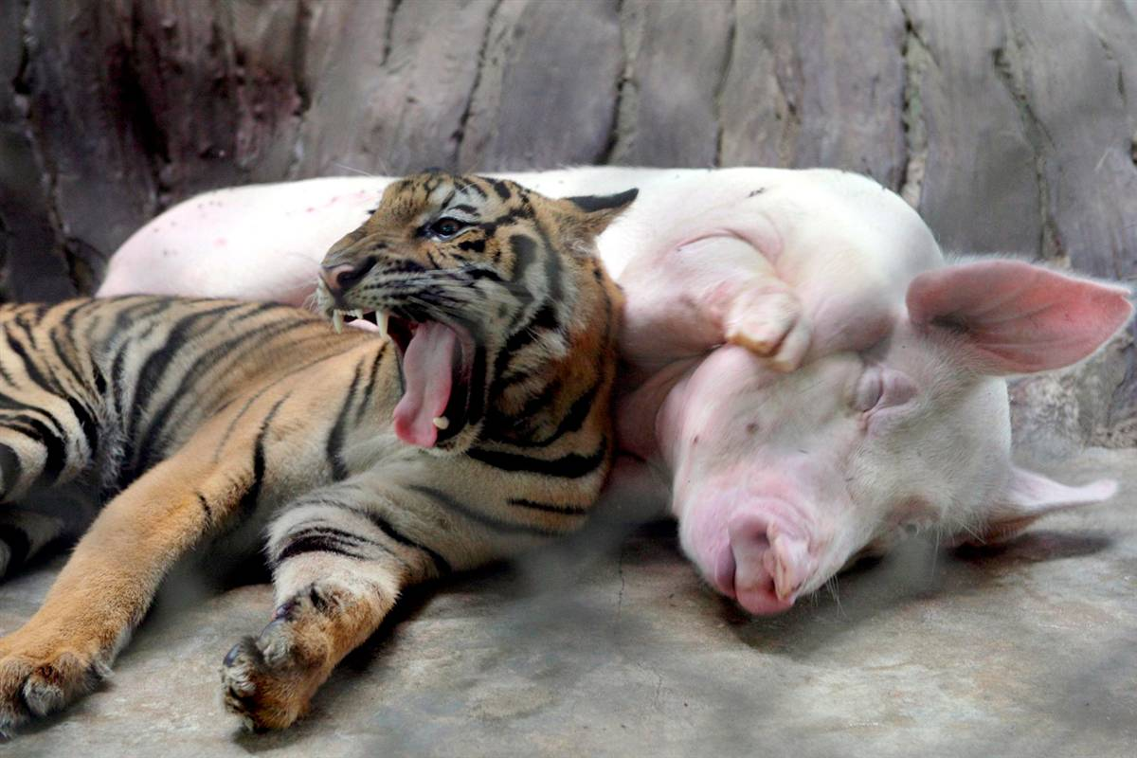
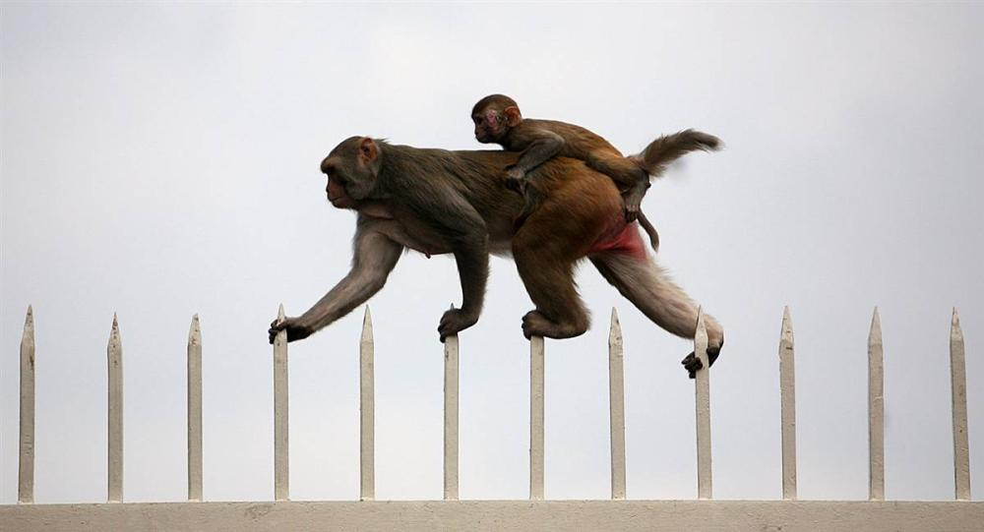
Use the words in bold from the text in the sentences based on the pictures.
Furiously, carefully, rip off, spine, brain damage, share, disability, motto, bump.

Slide 7
Fill in: total, positive, seriously, win, race, face, experience, feel, terrifying, brain, survive.
_____ challenges
to ______ a competition
______ miracle
_________ experience
________ attitude
to ___________ a disaster
_________ bruised
to _____ sorry for smb
________ damage
to _______ an accident
face
win
total
terrifying
positive
experience
seriously
feel
brain
survive

Slide 8
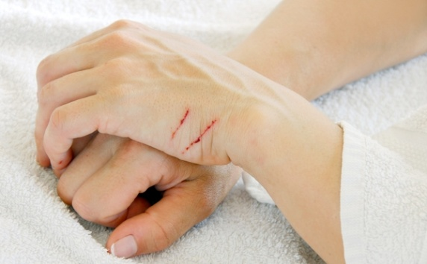
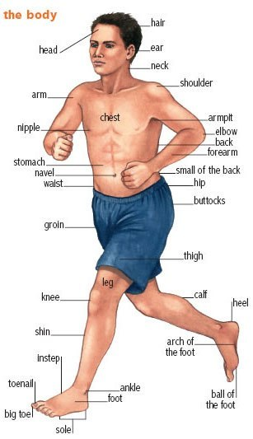
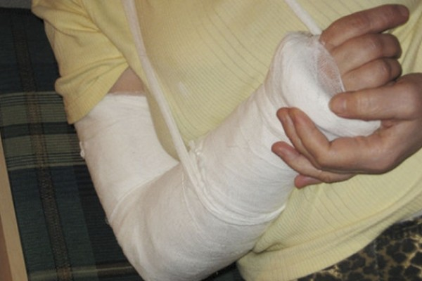
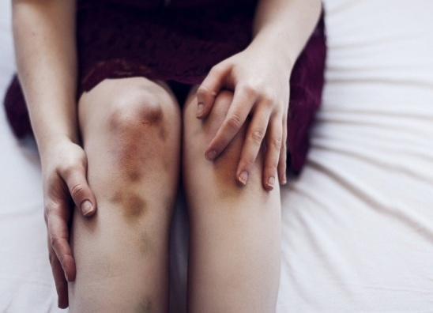
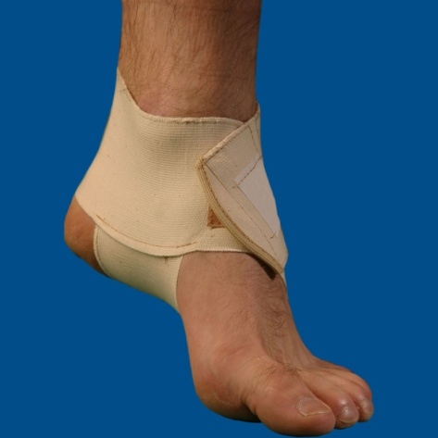
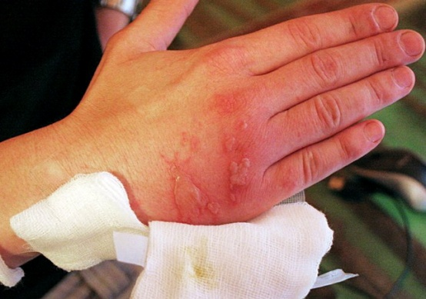
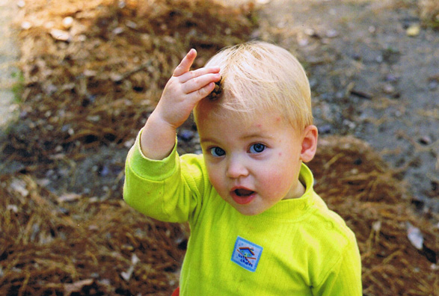
Parts of the body - Injuries
scratch
break
bruise
sprain
burn
bump

Slide 9
Imagine you are a radio interviewer. Your partner is either Bethany or Tom. Act out your interview.
Ask you partner:
how the disaster happened
what he/she felt soon after the disaster
what difficulties he/she faced
how he/she managed to overcome the difficulties
what he/she feels about his/her disability now

Slide 10
HOMEWORK
Упр. Стр.122 – 123 прочитать текст; записать краткое содержание текста (письменно)
Стр. 122 упр. 3 подобрать к словам синонимы из текста (письменно)
Д/з: стр. 123 упр.9 (письменно); стр. 122 упр. 4 (письменно)
At home you are to watch this http://www.youtube.com/watch?v=13N6gAlhAqg&feature=player_detailpage

