Slide 1
My Family

Slide 2
Members of the Family
Mother
Father
Sister
Brother
Aunt
Uncle
Grandmother
Grandfather
Son
Daughter

Slide 3
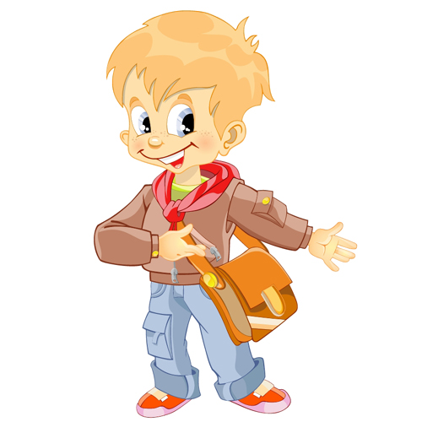
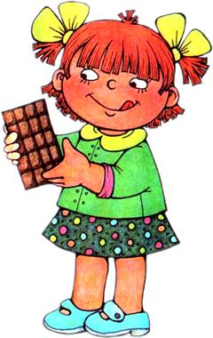
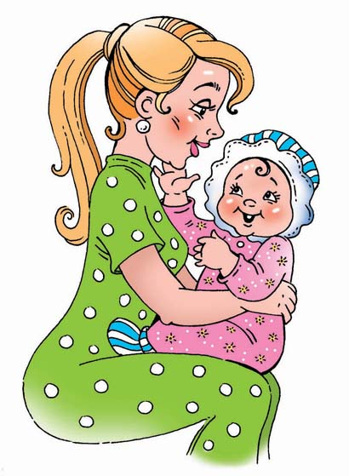
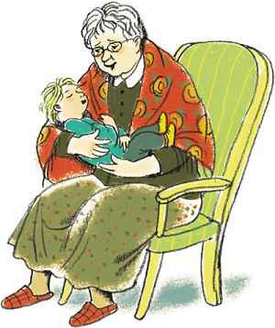
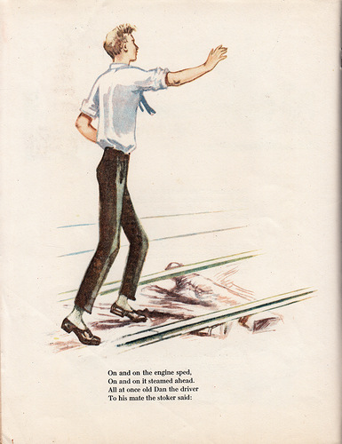
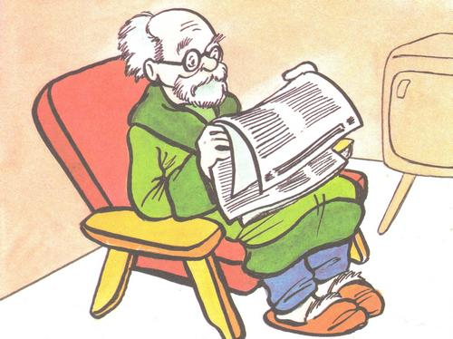
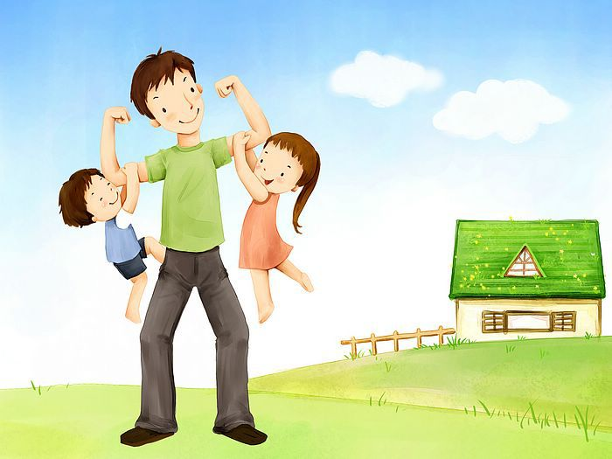
Who Are They?

Slide 4
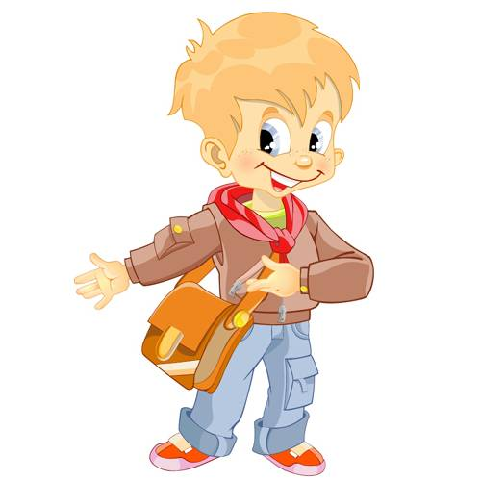
Who is the First

Slide 5
Guess Who It Is
… is very hard working, beatiful,intellegent, gentle.Her thick hair, brown eyes and small lips.
…likes play football and table tennis. Sometimes we play computer games together.
… likes to play with me. I help… with h/w.
… helps mother to wash the dishes and to clean the flat.
…makes tasty cakes and give me a lot of sweets.
…teaches me to work and helps our granny.

Slide 6
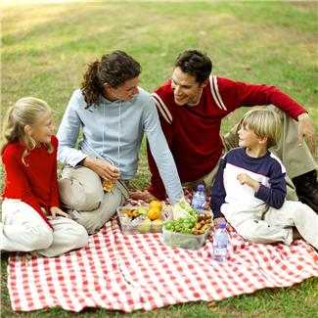
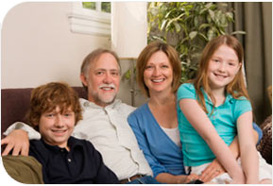
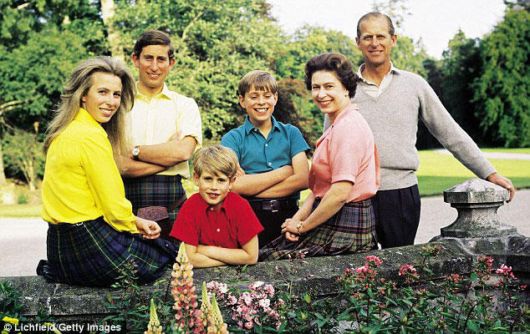
Did You Know?

Slide 7
For Example

