Slide 1
The Russian Village of Shuvalovka

Slide 2
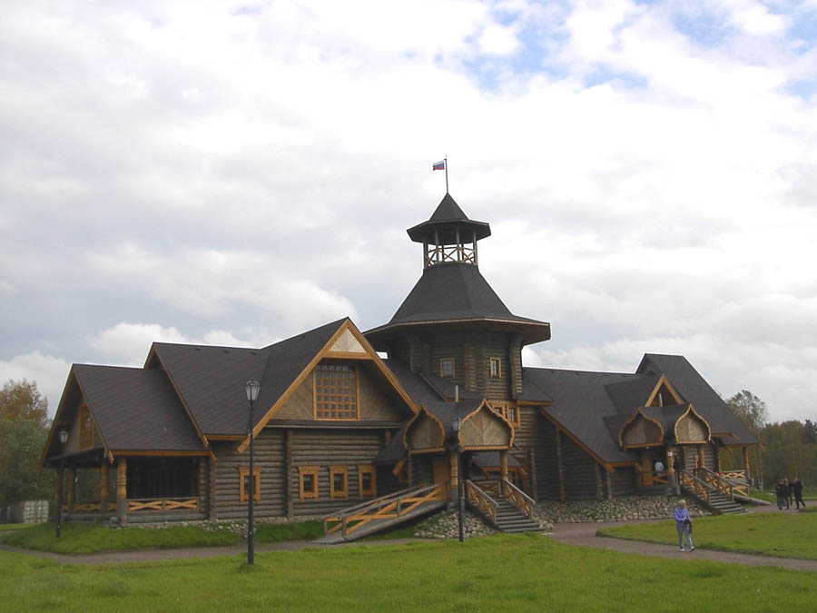
The Russian village of Shuvalovka
The Russian village of Shuvalovka is located in a 30 minute drive from St. Petersburg on the road to Peterhof not far from Konstantinovsky Palace.

Slide 3
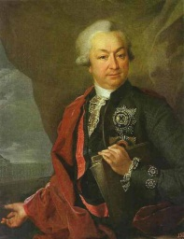
Owners
A few centuries ago, in 1714, according to the order of Peter I this land on the coast of the Finland Gulf was handed over for the use. There were five settlements in here, one of which was the village with a Finnish name “Korkuli”. As time passed, the famous owners of the estate changed and one of them was Count Ivan Shuvalov.

Slide 4
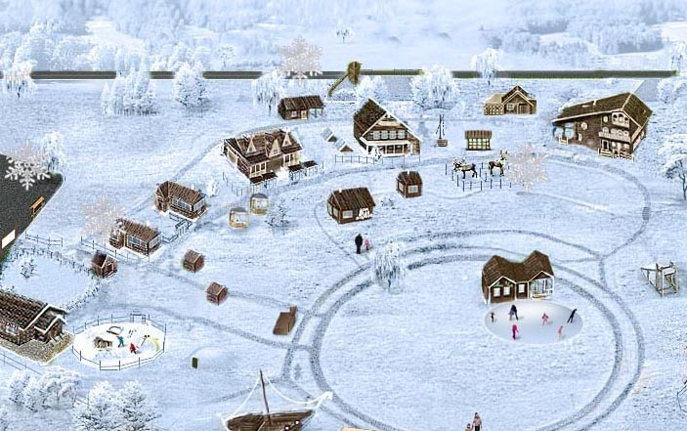
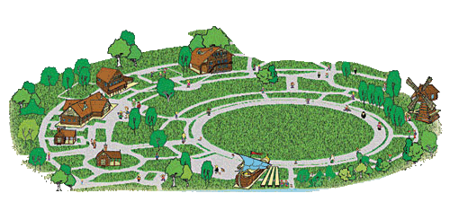
Reconstruction
Nowadays there is not only the name of the estate and the land itself which remind us of the past glory of the place but the full reconstruction has been done on the site.
Lately, the project of the village of Shuvalovka has been found in the archives and today the village can be seen in its almost original state.

Slide 5
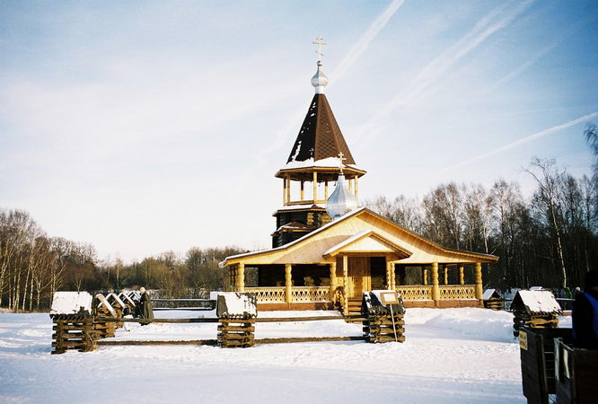
Main attractions
Masliany Lug (Butter Meadow). Masliany Lug is the perfect site for active recreation, hosting costumed festivals, popular sports tournaments, fairs and music events all year round. On coming to Shuvalovka at Christmas, New Year's Eve or Shrove-Tide, a skating rink, sledding hills, Trojka and horseback riding, and a round dance around Christmas tree are to be enjoyed. Here there are skates and sledges to hire.

Slide 6
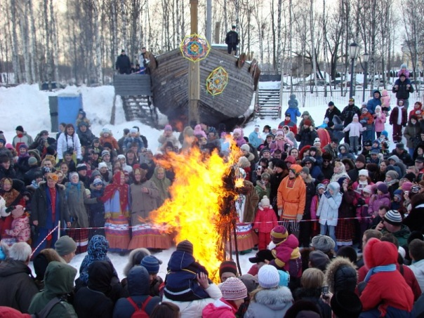
Shrove-Tide

Slide 7
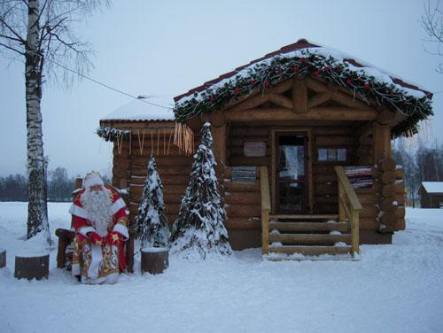
New Year’s Day

Slide 8
A round dance around Christmas tree

Slide 9
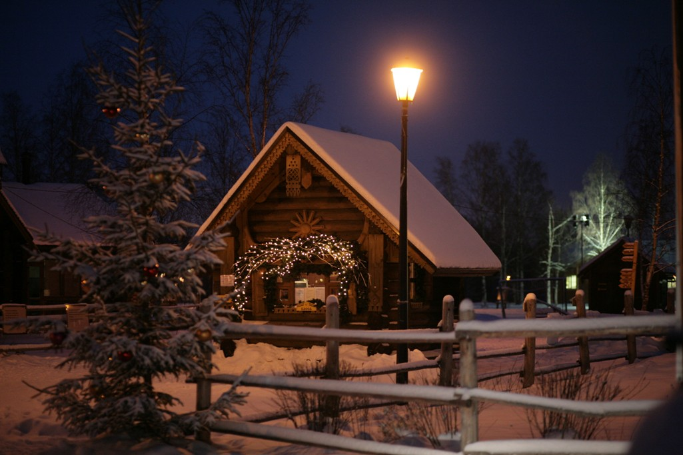
A skating rink

Slide 10
Trojka and horseback riding

Slide 11
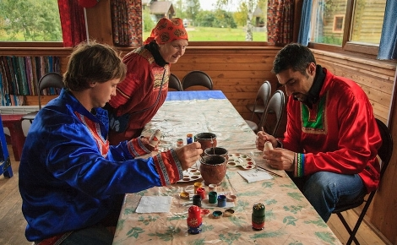
Traditional Russian crafts
The Crafts Center has all the arts and crafts of Russia on display. Such traditional Russian crafts connected with Orthodox religious holidays like making rustic toys, jewelry, or talismans from bast, birch bark, willow twigs, or beads are to be learned here.

Slide 12
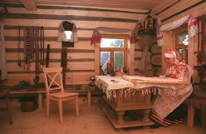
Traditional Peasant Hut
The Traditional Peasant Hut is a true copy of the peasant’s house of the Novgorod province of the late 17 century. The interior was fully reconstructed to all small details together with the Russian Ethnography Museum.

Slide 13
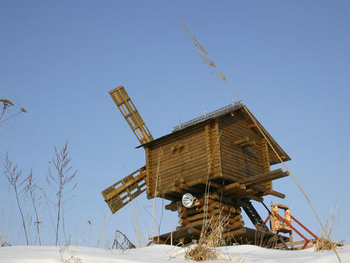
The Windmill
The Windmill, built according to an old drawing of the mid XVIII century (from Count Shuvalov's archives). Its traditional name is “stolbovka” (i.e. windmill on the pillar).

Slide 14
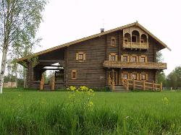
The Koshel Hotel
The Koshel Hotel. The hotel building is a very copy of the Russian log of the north-west regions of Russia of the early 18 century. There are more than 20 double rooms and suites as well in here.

Slide 15
‘Stinging Nettle’(‘Krapiva’) Restaurant (opened in 2010)

Slide 16
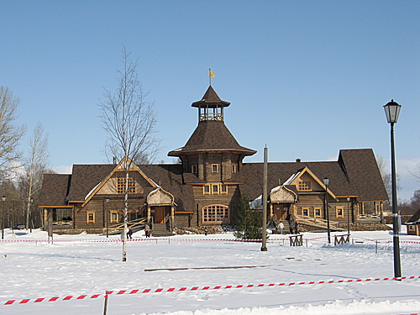
A former restaurant ‘Assembly’(burnt in 2009)

Slide 17
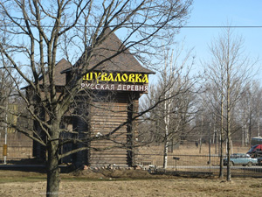
Hours of operation
Open:
From 10.00 to 22.00 daily

