Slide 1
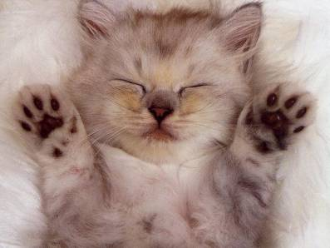
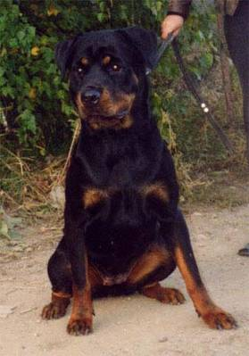
My pet
Автор: Алексеева Виктория Константиновна
Учитель английского языка
МОУ СОШ №12 г. Усолье-Сибирское Иркутской области

Slide 2
ears
tail
teeth
eyes
face
neck
nose
big
long
strong
sad
funny
black
little

Slide 3
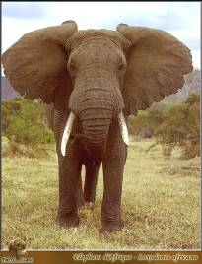
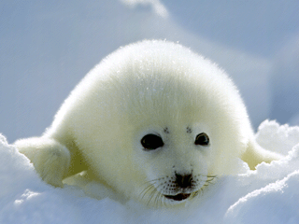
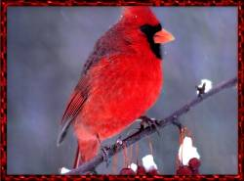
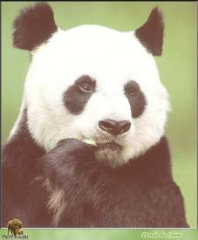
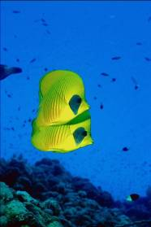
It is …

Slide 4
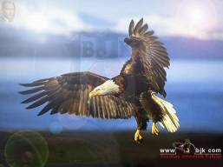
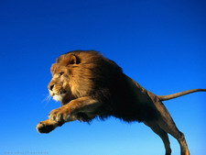
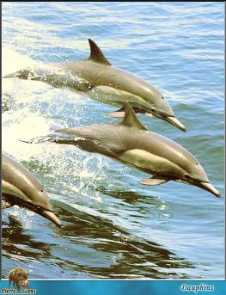
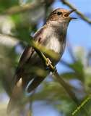
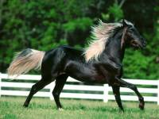
It can…

Slide 5
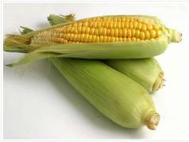
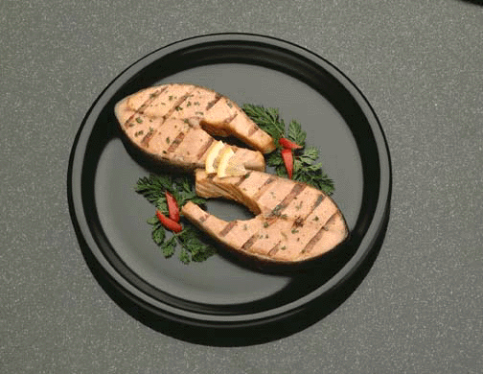
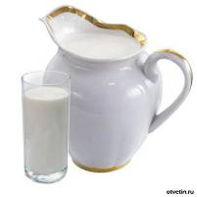
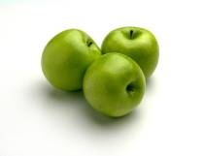
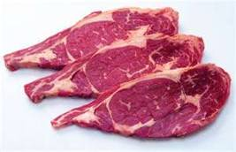
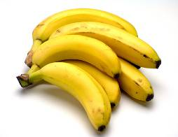
It likes…

Slide 6
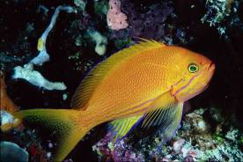
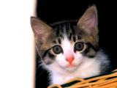
I have got a pet.
It is …( a cat/a fish/a parrot)
It is … (white/black/red)
It has …(a long tail/big eyes/a funny face)
It can … (jump/swim/fly)
I like my pet.

Slide 7
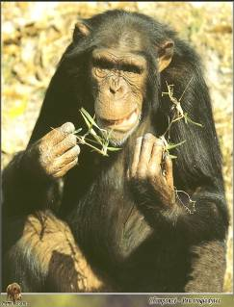
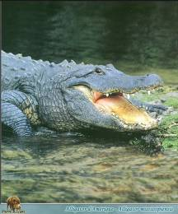
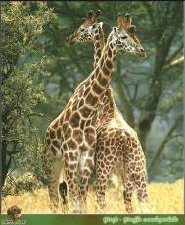
I have got a pet.
It is …( a giraffe/a crocodile/a monkey)
It is … (brown and yellow/…/…)
It has …(funny ears/a long…/a … tail)
It can … (walk/…/…)
It likes … (oranges/…/…)
I like my pet.

Slide 8
Thank you
for your work!

