Slide 1
English Banknotes

Slide 2
What money do they use in England?
The British currency is the pound sterling. The sign for the pound is £
GBP = Great British Pound
They do not use the Euro. Although a few of the big shops will accept Euro, it is rarely used across Britain.
The singular of pence is "penny". The symbol for the penny is "p"; hence an amount such as 50p is often pronounced "fifty pee" rather than "fifty pence".

Slide 3
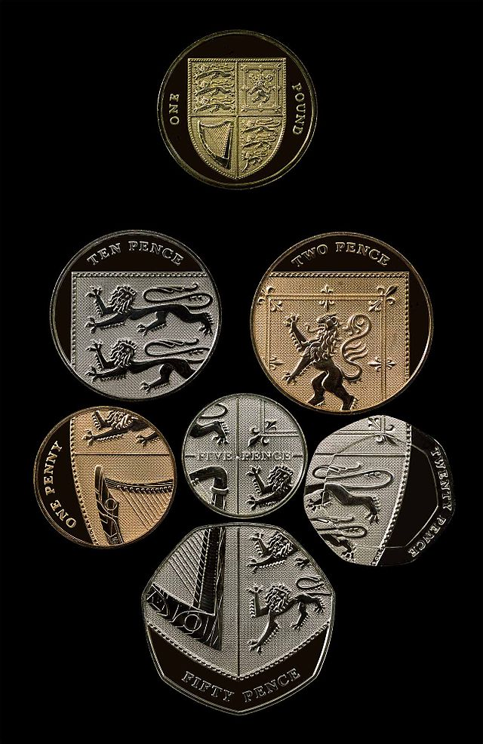
In Great Britain they have both coins and banknotes.
Current coins are:
1 penny, 2 pence, 5 pence, 10 pence, 20 pence, 50 pence, 1 pound, and 2 pounds.

Slide 4
Banknotes
The Bank of England has been issuing banknotes for over 300 years. During that time, both the notes themselves and their role in society have undergone continual change. From today's perspective, it is commonly accepted that a note that costs a few pence to produce is worth five, ten, twenty or fifty pounds.
Maintaining confidence in the currency is a key role of the Bank of England and one which is essential to the proper functioning of the economy.

Slide 5
Sterling banknotes are the banknotes of the United Kingdom and British Islands, denominated in pounds sterling (GBP).
£5 (five pounds)
£10 (10 pounds)
£20 (twenty pounds)
£50 (fifty pounds) each denomination has its own size and colour.

Slide 6
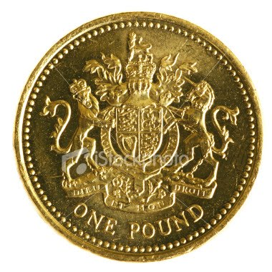
The slang term for a British Pound is Quid. One pound sterling is referred to as "A QUID", five pound sterling as "Five Quid" and ten pound sterling as "Ten Quid". Other names for a pound coin include a smacker, or smackeroon.
The two Banknotes with other names are the "Fiver" (£5) or the "Tenner" (£10) .

Slide 7
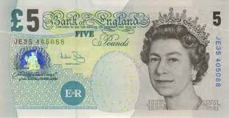
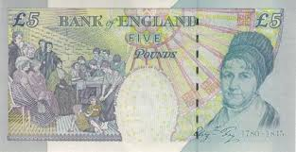
£5 Note (Elizabeth Fry)
All bank notes bear HM The Queen's head on one side and a famous historical person on the other side.
Queen Elizabeth ll is the first monarch to have her portrait printed on a bank note. It was first done in 1960 as a way of helping to prevent forgeries.
The reverse side of £5 note features Elizabeth Fry, who made her name fighting for improved living conditions for women in European jails.

Slide 8
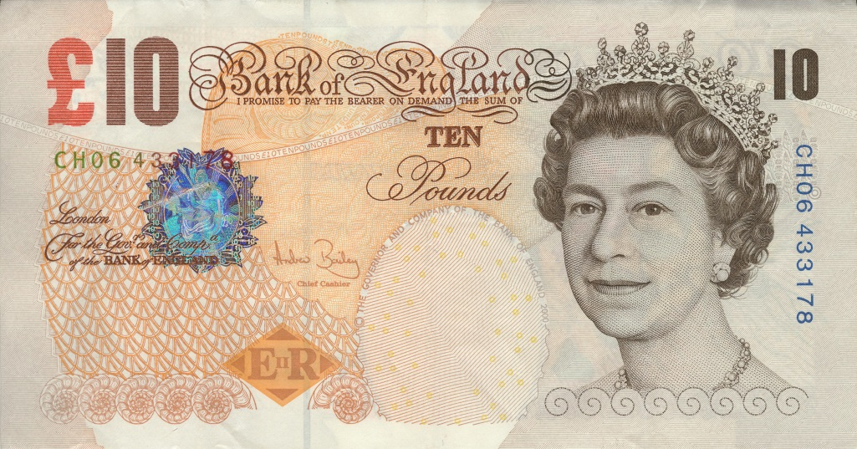
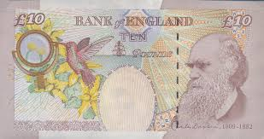
£10 Note (Charles Darwin)
The current £10 note features Charles Darwin, the Victorian naturalist who developed the theory of evolution. Also pictured is an illustration of Darwin 's own magnifying lens and the flora and fauna that he may have come across on his travels.

Slide 9
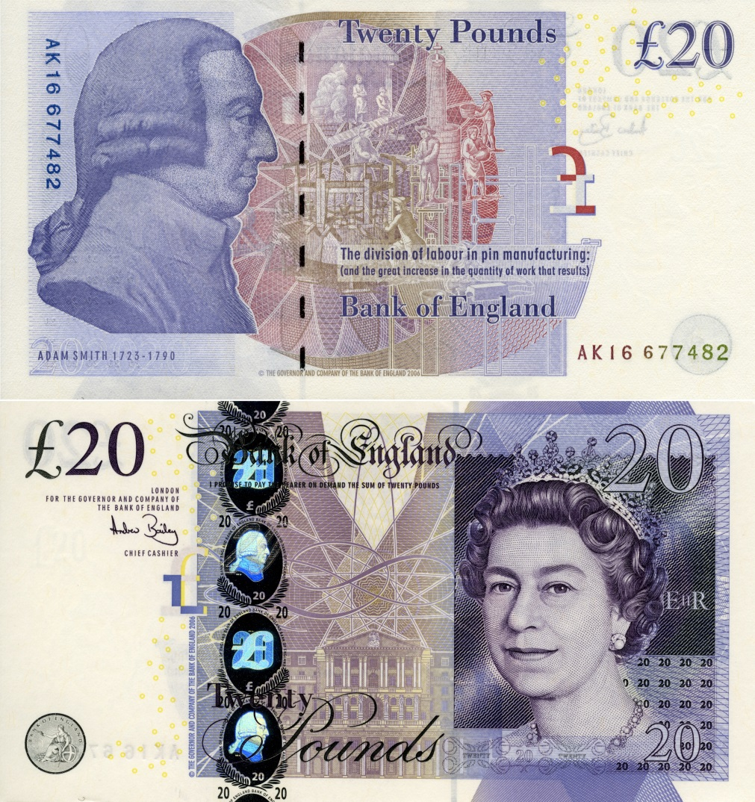
£20 Note (Edward Elgar)
The current £20 note features Sir Edward Elgar, a British composer whose orchestral works include Enigma Variations (1896) and five Pomp and Circumstance marches (1901–1930).

Slide 10
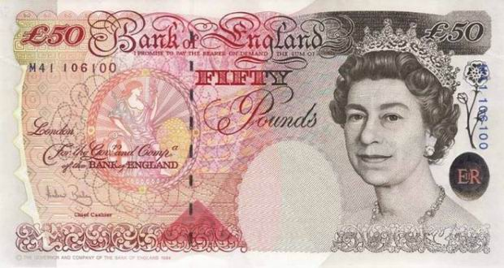
£50 Note (Matthew Boulton and James Watt)
Matthew Boulton and James Watt
Matthew Boulton and James Watt were responsible for accelerating the progress of manufacturing steam engines during the 18th and 19th centuries. Their inventions and improvements to this technology made a significant contribution to the progress of the Industrial Revolution. In 1775 the two men entered a partnership to develop and market steam engines.

