Slide 1
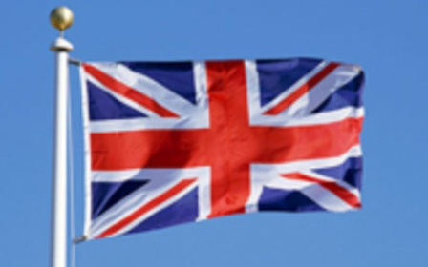
Traditional Costumes in the British Isles.

Slide 2
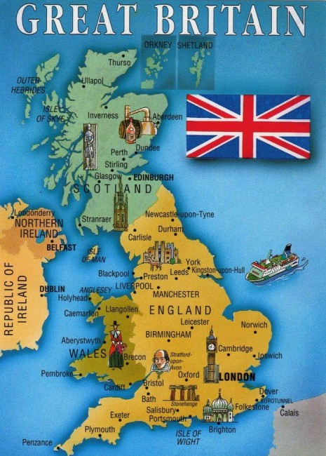
Traditional costumes in:
Ireland
Scotland
Wales
England

Slide 3
Vocabulary
a long-sleeved dress
knee-high white socks black shoes pleated woollen skirts a goatskin bag (a sporran) a pin a cloak a tall black hat a lace cap a long full skirt a white apron stockings a basket white trousers a loose white shirt a pad of bells ribbons handkerchiefs

Slide 4
Vocabulary. a long-sleeved dress –платье с длинными рукавами knee-high white socks –белые носки по колено black shoes- чёрная обувь pleated woollen skirts- плиссированные шерстяные юбки a goatskin bag (a sporran)-мешок из кожи козы a pin- булавка a cloak- плащ a tall black hat-высокая чёрная шляпа a lace cap-кружевная шапочка a long full skirt-длинная пышная юбка a white apron-белый фартук stockings-чулки a basket-корзина white trousers- белые брюки a loose white shirt- свободную белую рубашку a pad of bells- подушка из колокольчиков ribbons-ленточки handkerchiefs-платки

Slide 5
Ireland. Irish Traditional costume.

Slide 6
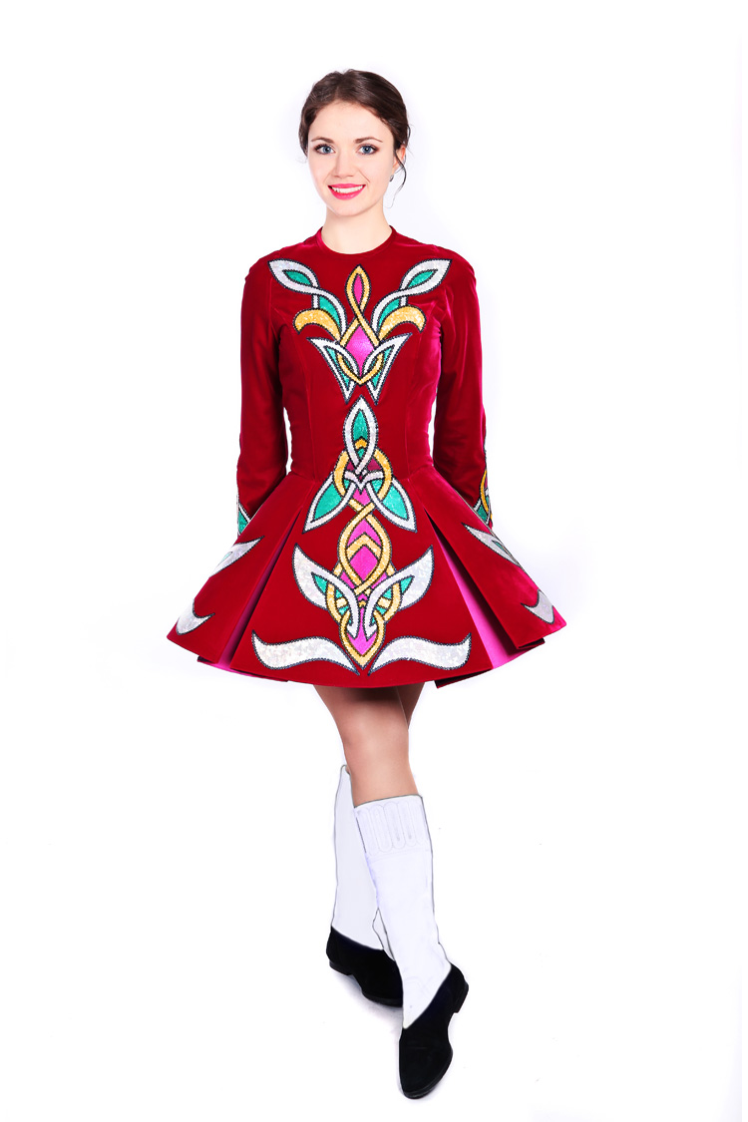
Irish traditional costume.
Irish traditional costumes make you think of Irish folk dancing. Female dancers wear a long sleeved dress, knee-hight white socks and black shoes. The colourful patterns on the dresses are based on Celtic designs.

Slide 7
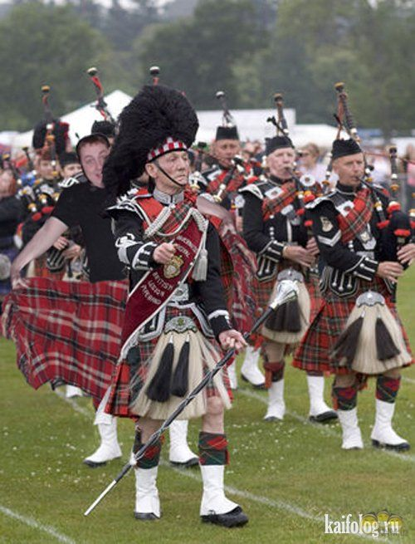
Scotland. Scottish Traditional costume.

Slide 8
Scottish Traditional costume.
Probably the best known traditional costume in the UK is the Scottish kilt with its distinctive tartan pattern.
Kilts were pleated woolen skirts, worn only by men, and fastened in front with a special pin. A goatskin bag called sporran was worn around the waist and a cloak was draped over one shoulder. Each clan or family had its own tartan design. The kilt is still worn on special occasions today.

Slide 9
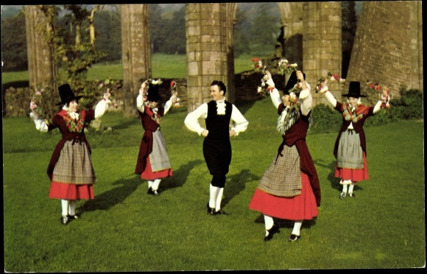
Wales. Welsh Traditional costume.

Slide 10
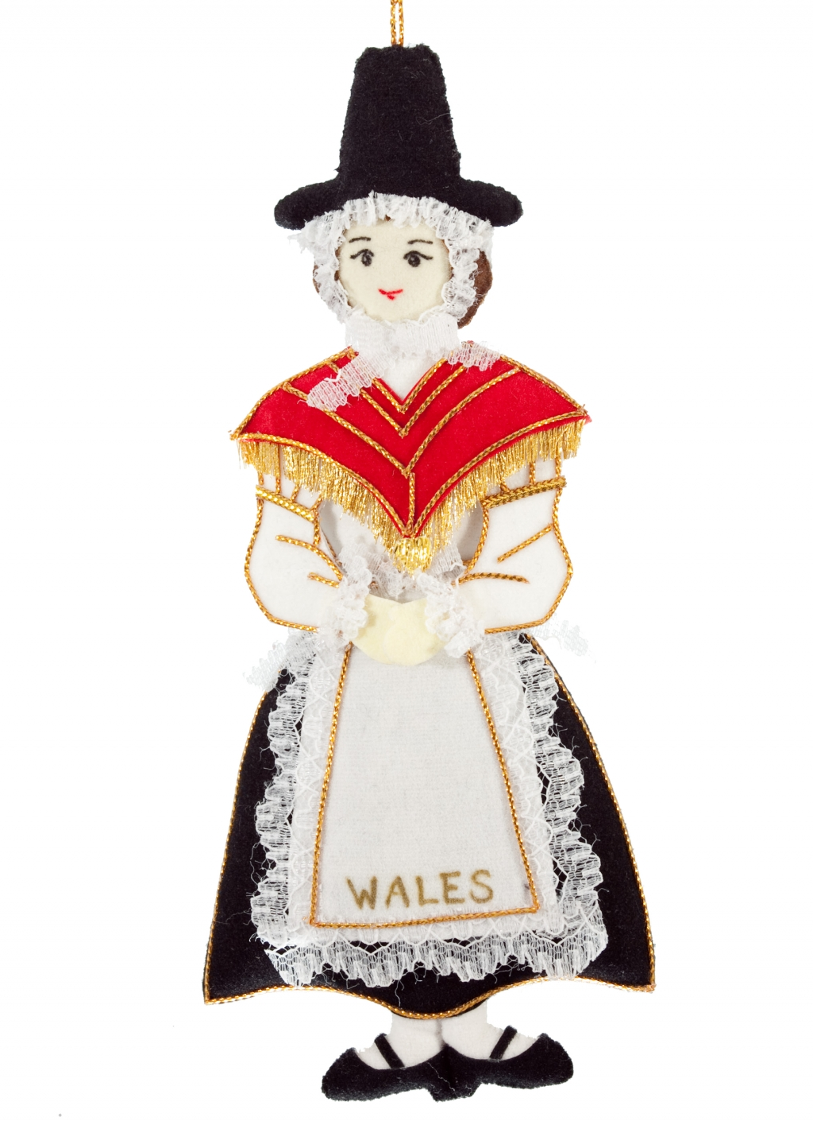
Welsh Traditional costume.
What everyone recognises about the Welsh costume is its tall black hat or beaver hat , worn over a lace cap. Women in the past wore it with a long full skirt and a white apron. A shawl, usually red, was worn around the shoulder. The outfit was complete with black shoes and stockings, and ladies carried a basket.

Slide 11
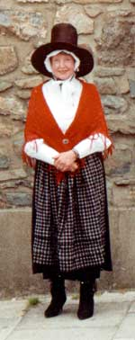
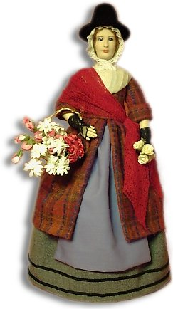
Find 7 parts of the Welsh costume in the pictures.

Slide 12
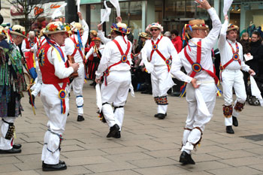
England. Morris Dancing

Slide 13
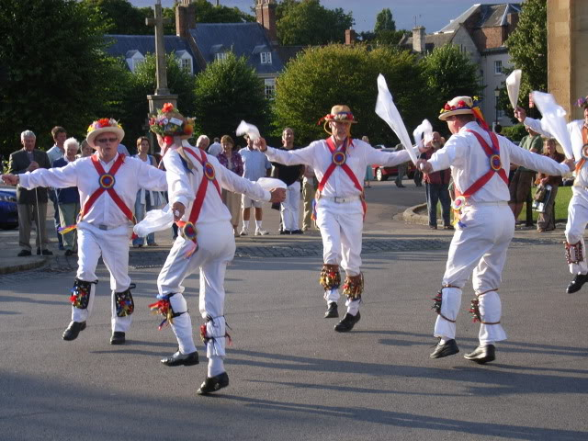
Morris dancing with its traditional costumes is a familiar sight in England.
These dance are performed outdoors in country villages during the summer. The dancers wear white trousers, a loose white shirt and a pad of bells around the bottom half of the leg. Their hats are decorated with ribbons and flowers, and they wave handkerchiefs in the air as they dance.

Slide 15
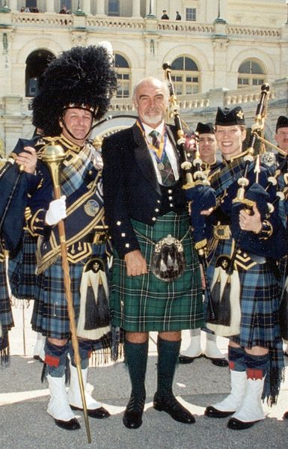
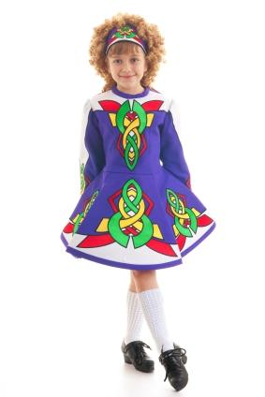

Slide 16
Thank you for your attention.

