Slide 1
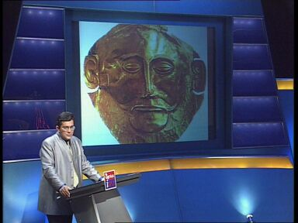
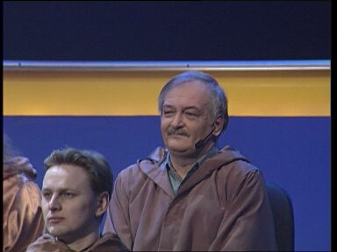
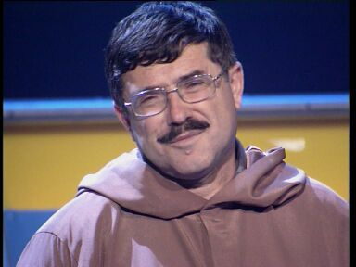
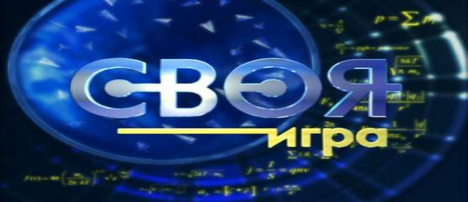
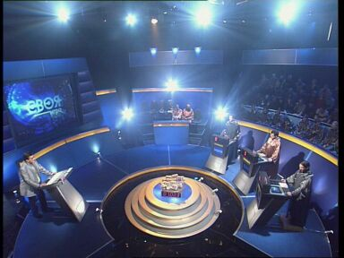
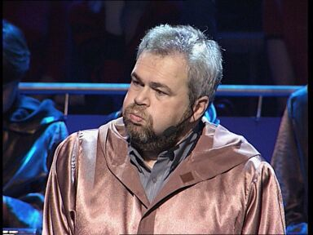
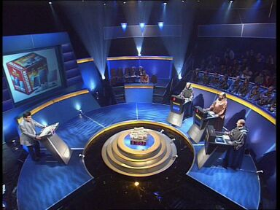
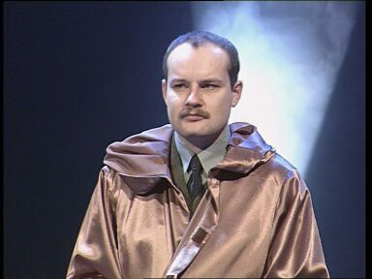
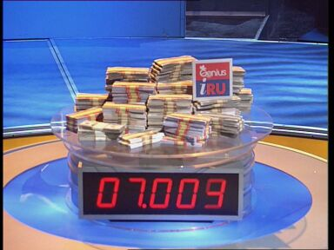
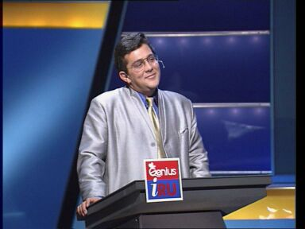
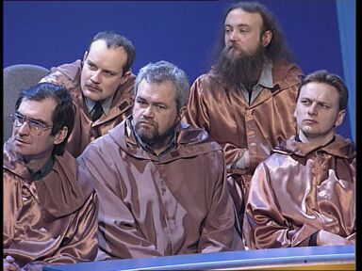
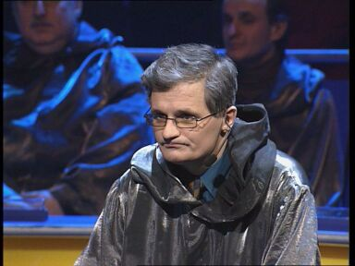
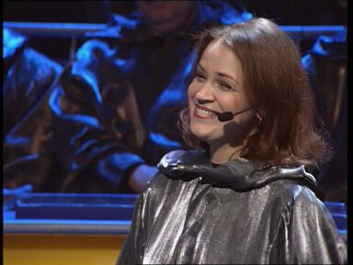
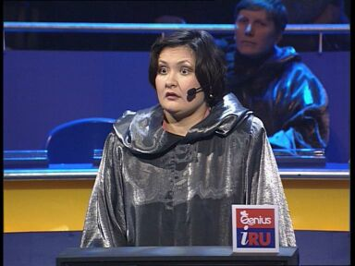
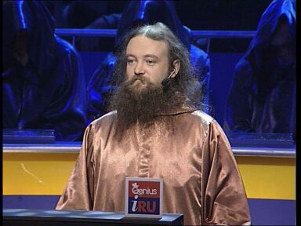
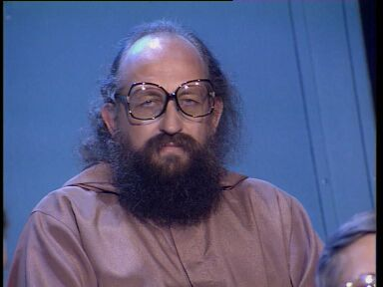
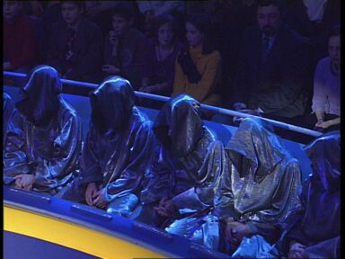
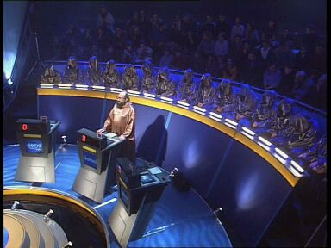
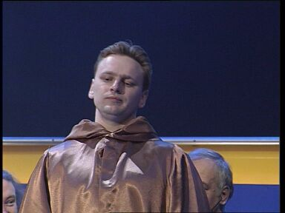
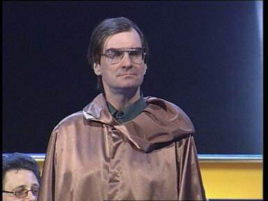
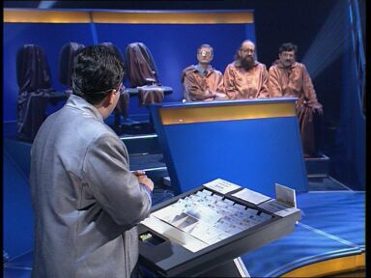

Slide 2
Stage 1. Famous People in Russia
Sport | 100 | 200 | 300 | 400 | 500
Music | 100 | 200 | 300 | 400 | 500
Arts | 100 | 200 | 300 | 400 | 500
Space | 100 | 200 | 300 | 400 | 500
Exit

Slide 3
Sport 100
Who is the best Russian goal-keeper
in hockey?
Answer

Slide 4
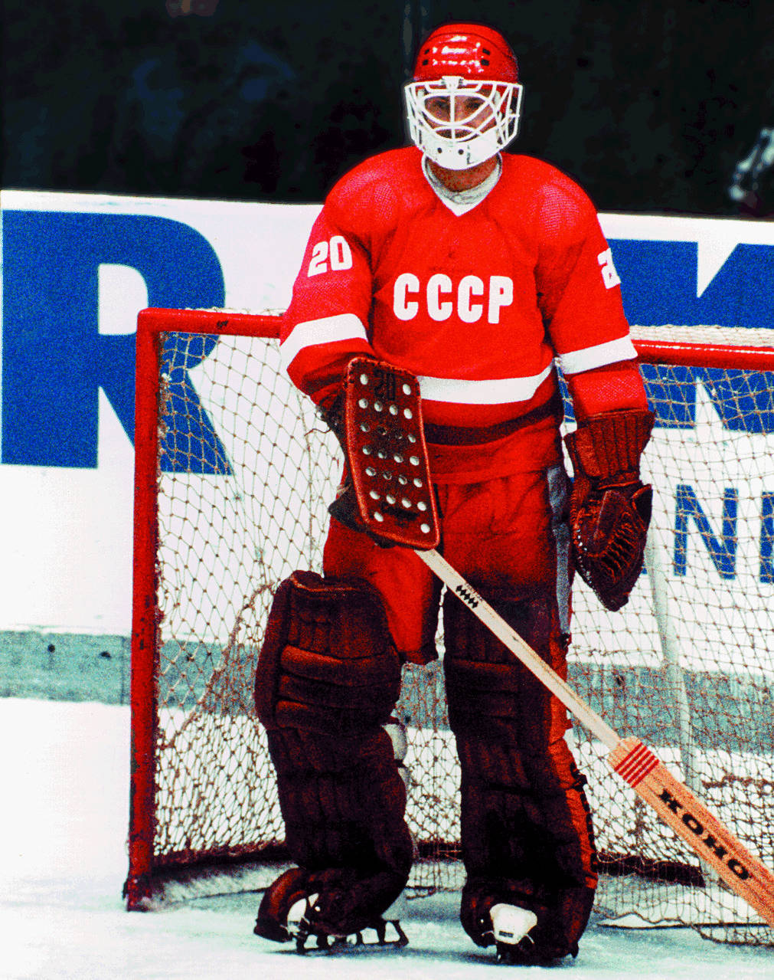
The best Russian goal-keeper is
Vladislav Tretyak
Back

Slide 5
Sport 200
What kind of sport was Kharlamov
good at?
Answer

Slide 6
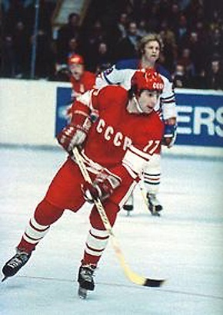
He was good at hockey
Back

Slide 7
300
Sport
Who was the partner of Alexander Zaitsev in figure skating?
Answer

Slide 8
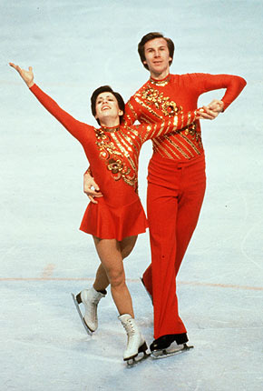
It was Irina Rodnina
Back

Slide 9
Sport 400
He is a three-time champion of the Olympic Games, a nine-time world champion, an eleven-time champion of Europe in Greco-Roman wrestling.
Answer

Slide 10
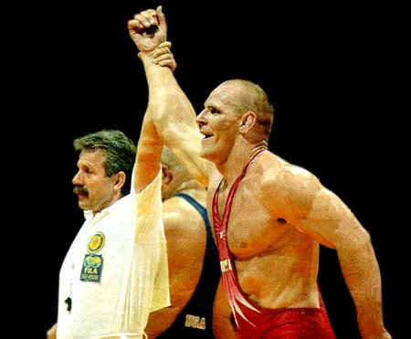
It is Alexander Karelin
Back

Slide 11
500
Sport
His achievements are fantastic. More than 20 times he renewed his own records. He is the world and Olympic champion and world record-breaker in pole-vault.
Answer

Slide 12
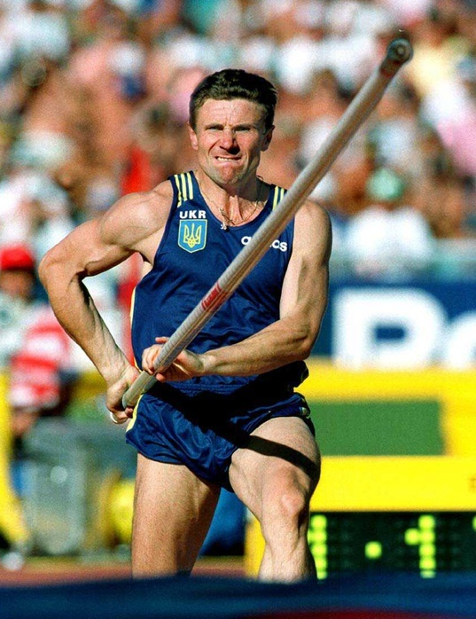
It is Sergei Bubka
Back

Slide 13
100
Music
Who created the music for the ballets "The Swan Lake", "The Sleeping Beauty" and "The Nutcracker"?
Answer

Slide 14
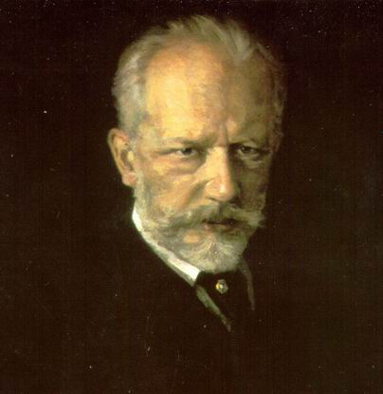
Peter Tchaikovsky did
Back

Slide 15
200
Music
Who is the composer of the first Russian opera "Ivan Susanin"?
Answer

Slide 16
It's Michael Glinka
Back

Slide 17
300
Music
Who is the composer of the song "Moscow Subuit Nights"?
Answer

Slide 18
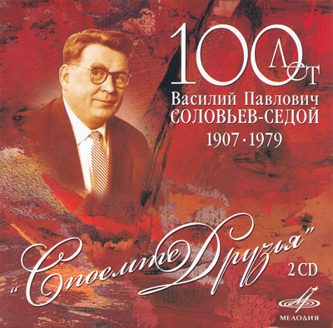
It's Soloviov-Sedoy
Back

Slide 19
400
Music
He had an ability of combining satire and lyricism in the same line in his songs. His first collection of poems "Songs of the Russian Bards. Texts“ appeared after he had died
Answer

Slide 20
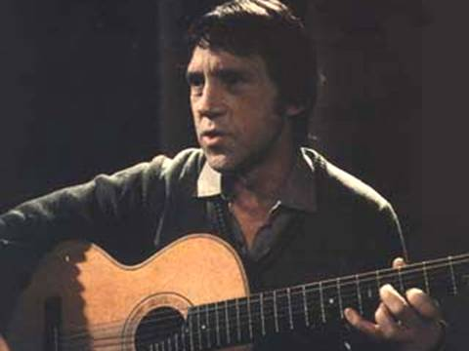
It's Vladimir Vysotsky
Back

Slide 21
500
Music
Who created the music for the opera "Boris Godunov"?
Answer

Slide 22
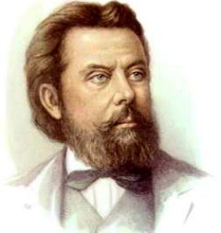
Modest Musorgsky did
Back

Slide 23
100
Arts
Who was the famous Russian
monastic painter?
Answer

Slide 24
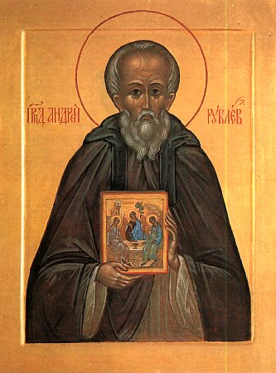
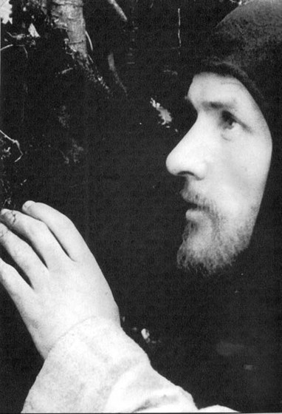
It was Andrei Rublyov
Back

Slide 25
200
Arts
He published his first poem "Ruslan and Lyudmila“ in 1820 and became famous
Answer

Slide 26
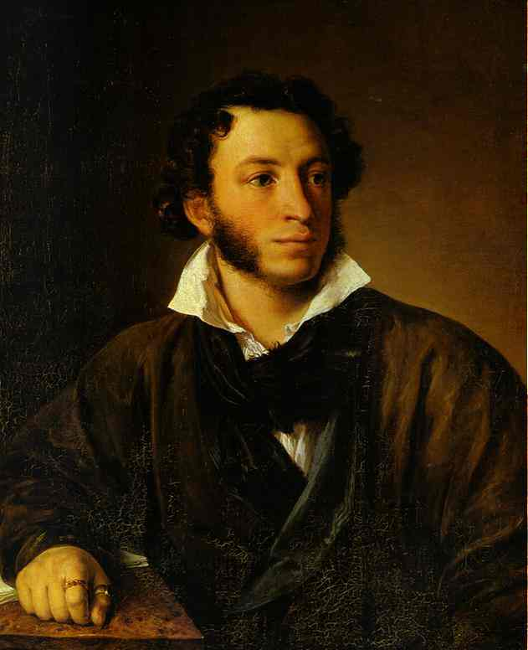
It's Alexander Pushkin
Back

Slide 27
300
Arts
She was the Russian ballet dancer.
She was born in 1910 and died in 1998. She danced in the Kirov Theatre and in the Bolshoi Theatre.
Answer

Slide 28
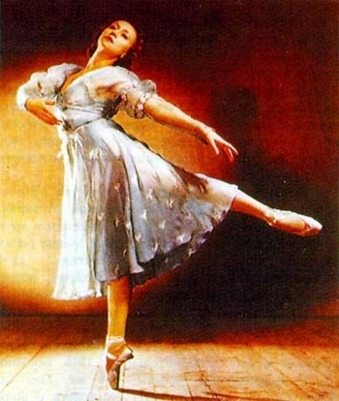
It's Galina Ulanova
Back

Slide 29
400
Arts
His famous works are "In the Plain Valley" 1883, "Pine Forest" 1872,
"Oaks" 1887
Answer

Slide 30
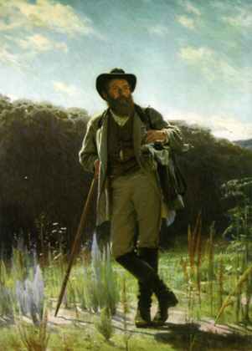
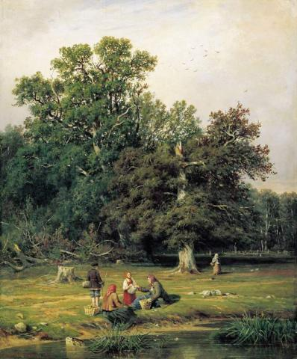
It's Ivan Shishkin
Back

Slide 31
500
Arts
A. Chekhov called him "The best landscape painter of Russia"
Answer

Slide 32
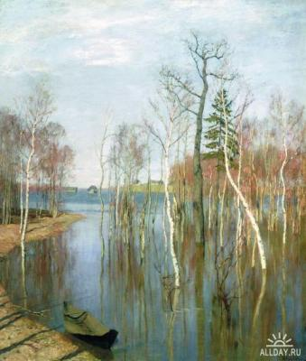
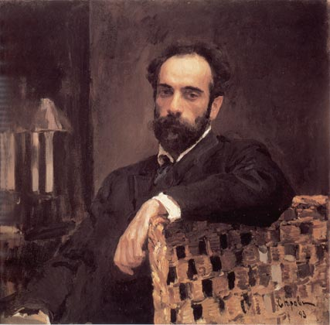
It's Isaak Levitan
Back

Slide 33
100
Space
He flew into the space on the 12th of April, 1961, on the board of the spaceship "Vostok"
Answer

Slide 34
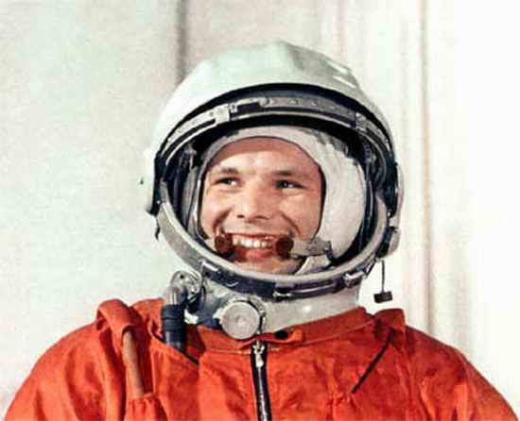
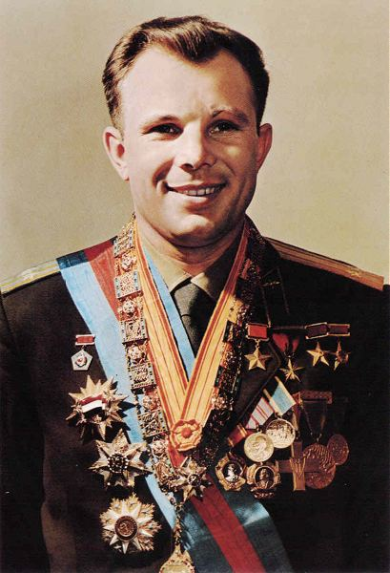
It's Yuri Gagarin
Back

Slide 35
200
Space
Who was the first man who entered the open space?
Answer

Slide 36
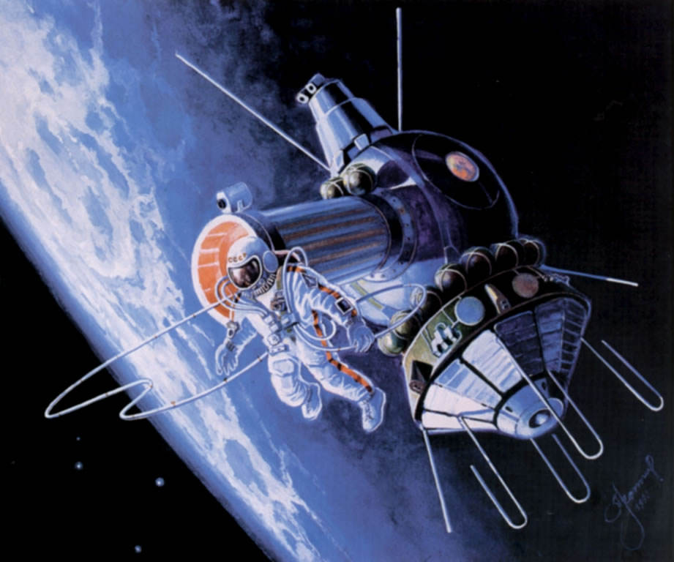
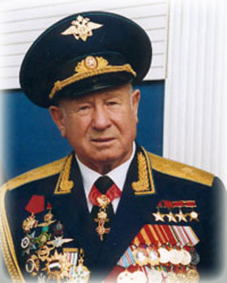
It was Alexey Leonov
Back

Slide 37
300
Space
He was a Soviet aeronautical engineer, who designed rockets, missiles, and spacecrafts. He was born in 1906 and died in 1966.
Answer

Slide 38
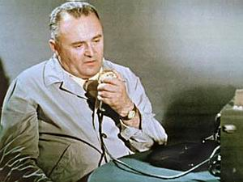
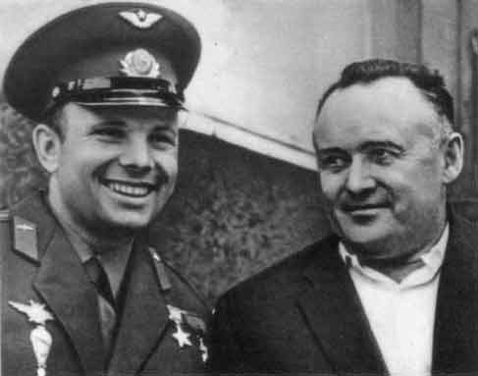
It's Sergei Korolev
Back

Slide 39
400
Space
The first Russian woman who flew into the space.
Answer

Slide 40
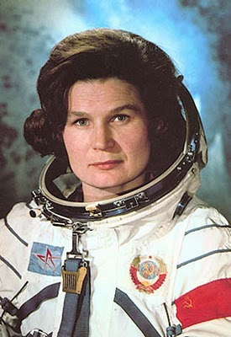
It's Valentina Tereshkova
Back

Slide 41
500
Space
Who is called "the father of the space technology"?
Answer

Slide 42
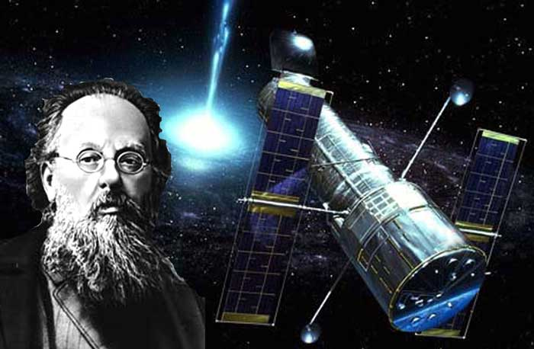
Konstantin Tsiolkovsky is called "the father of the space technology"
Back

Slide 43
Stage2. Famous American and British People
Inventors | 200 | 400 | 600 | 800 | 1000
Writers | 200 | 400 | 600 | 800 | 1000
Politics | 200 | 400 | 600 | 800 | 1000
Cinema | 200 | 400 | 600 | 800 | 1000
Exit

Slide 44
Inventors 200
Who published his first book "Principia" setting
out the laws of mechanics in 1687?
Answer

Slide 45
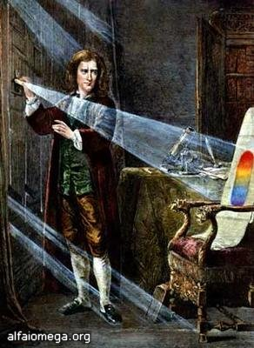
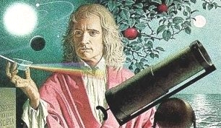
Sir Isaac Newton did
Back

Slide 46
Inventors 400
He invented the first telephone in 1876 and became
a citizen of the United States in 1882
Answer

Slide 47
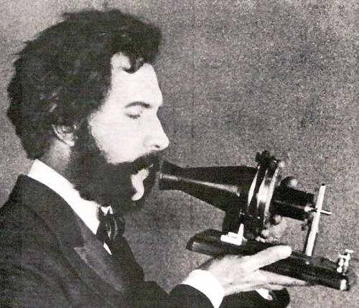
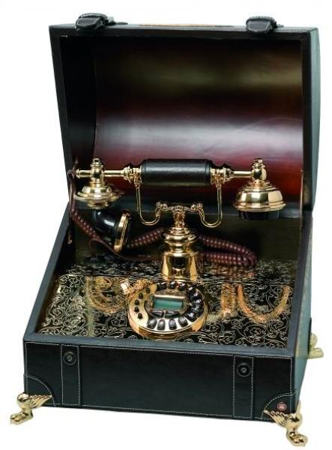
It was Alexander Graham Bell
Back

Slide 48
Inventors 600
He was a man who transformed the world.
In 1896 he succeeded in building an automobile powered by a gasoline engine.
Answer

Slide 49
It was Henry Ford
Back

Slide 50
Inventors 800
Name the only woman-scientist in the world who
became a Nobel Prize winner twice.
Answer

Slide 51
Marie Curie became a Nobel Prize winner in physics and chemistry
Back

Slide 52
Inventors 1000
These brothers invented, built, and flew on the first
airplane on the 7th of December in 1903 at Kitty
Hawk, North Carolina.
Answer

Slide 53
It is about Orville and Wilbur Wright
Back

Slide 54
Writers 200
Who acted at the London theatre called "The
Globe" and wrote during the golden age of the
English literature?
Answer

Slide 55
William Shakespeare did
Back

Slide 56
Writers 400
He lived in Alaska for some years and wrote 152
stories about the North
Answer

Slide 57
It was Jack London
Back

Slide 58
Writers 600
He was a short-story writer and the greatest
American humorist. He was fond of collecting
things which nobody had
Answer

Slide 59
It was Mark Twain
Back

Slide 60
Writers 800
What famous doctor and writer wrongly believed
that drugs stimulated the brain activity?
Answer

Slide 61
Sir Arthur Conan Doyle did
Back

Slide 62
Writers 1000
He was born in London in 1906. He began to write
in 1939 and became famous. He wrote 78 books.
Answer

Slide 63
It was James Hadly Chase
Back

Slide 64
Politics 200
He was the first President of the United States
Answer

Slide 65
It was George Washington
Back

Slide 66
Politics
400
She ruled for the longest period in the English
history, that is for 64 years
Answer

Slide 67
It was Queen Victoria
Back

Slide 68
Politics
600
In 1863 this American president signed the
Emancipation Proclamation, the document that
made all the slaves free.
Answer

Slide 69
It was Abraham Lincoln
Back

Slide 70
Politics 800
This monarch is known for saying "I know I have
a body of a weak and feeble woman, but I have the
heart and stomach of a King.
Answer

Slide 71
It is Queen Elizabeth I
Back

Slide 72
Politics
1000
He was a very important monarch. Under his reign
Britain became independent of the Roman Catholic
Church, it got richer and more powerful.
Answer

Slide 73
It was King Henry VIII
Back

Slide 74
Cinema
200
He was an American artist and film producer, who
was famous for his animated cartoons?
Answer

Slide 75
It was Walt Disney
Back

Slide 76
Cinema
400
What American actor is known as "Terminator"?
Answer

Slide 77
It is Arnold Schwarzenegger
Back

Slide 78
Cinema
600
This American actor was born on the 6th of April
in 1889. He made his first film "Making a Living"
in 1914
Answer

Slide 79
It is Charlie Chaplin
Back

Slide 80
Cinema
800
He is regarded as the most successful director in Hollywood today. He is well-known for his
imaginative movie making and has helped to create
a new generation of filmmakers.
Answer

Slide 81
It is Stephen Spielberg
Back

Slide 82
Cinema
1000
She is an American singer and actress. Her Broadway
performance in the musical "Funny Girl" in 1964
made her a major star.
Answer

Slide 83
It is Barbara Streisand
Back

Slide 84
Final
His songs started a new period in the American music. He brought together the musical sounds of the blacks in America and of the country people. He was known as "The King of rock 'n' roll".
Answer

Slide 85
Elvis Presley
Back

Slide 86
ВОПРОС

Slide 87
вопрос
аукцион
ВОПРОС

Slide 88
ВОПРОС

Slide 89
вопрос
аукцион
ВОПРОС

Slide 90
вопрос
аукцион
ВОПРОС

Slide 91
ВОПРОС

Slide 92
Спасибо Вам за участие в игре!
Надеюсь, что Вам понравилось!

Slide 93
Игра состоит из трёх раундов по 30 вопросов в раунде и финального раунда из 1 вопроса. Вопросы первого, второго и третьего раундов сгруппированы в 6 тем по 5 вопросов. Стоимость вопросов: 100, 200, 300, 400, 500 рублей - в первом раунде; 200, 400, 600, 800, 1000 рублей - во втором; 300, 600, 900, 1200, 1500 - в третьем. Игроки имеют право, но не обязаны отвечать на заданный вопрос. Право ответа получает игрок, первым нажавший кнопку после сигнала. Игрок, нажавший кнопку до сигнала, наказывается "фальстартом", при этом его кнопка блокируется на 2 секунды. Правильный ответ приносит игроку сумму, равную стоимости вопроса на игровом табло, неправильный ответ лишает игрока указанной суммы. В первых трёх раундах вместо любого вопроса игроку могут выпасть "кот в мешке" или "аукцион". Количество "котов в мешке" и "аукционов" в каждом раунде и их расположение не регламентируется. "Кот в мешке" - вопрос, тема и стоимость которого изначально не объявляется. Игрок, выбравший "кота", обязан отдать его любому из своих соперников. После этого называется тема вопроса и его стоимость. "Аукцион" - вопрос разыгрывается с игроком, назначившим за него наибольшую цену на торгах. Очерёдность подачи заявок определяется ведущим игры. Ставка "ва-банк" перебивается только большим по сумме "ва-банком". Если сумма на счету игрока меньше начальной стоимости вопроса, следует автоматическая ставка, равная номиналу вопроса. Ставки на "аукционе" кратны 100 рублям. Отсутствие ответа на "кота в мешке" и на "аукцион" приравнивается к неправильному ответу. В финальном раунде из семи предложенных тем игроки выбирают одну. Стоимость вопроса финального раунда определяет для себя каждый игрок, исходя из набранной в предыдущих раундах суммы. Минимальная ставка - 1 рубль, максимальная - "ва-банк". Ставки кратны 1 рублю. При равенстве сумм у двух или трёх игроков проводится "перестрелка" - 5 вопросов одной темы. При сохранившемся равенстве сумм "перестрелка" продолжается до выявления победителя. Победителем игры становится игрок, набравший наибольшую сумму после финального вопроса или после окончания "перестрелки«.

