Slide 1
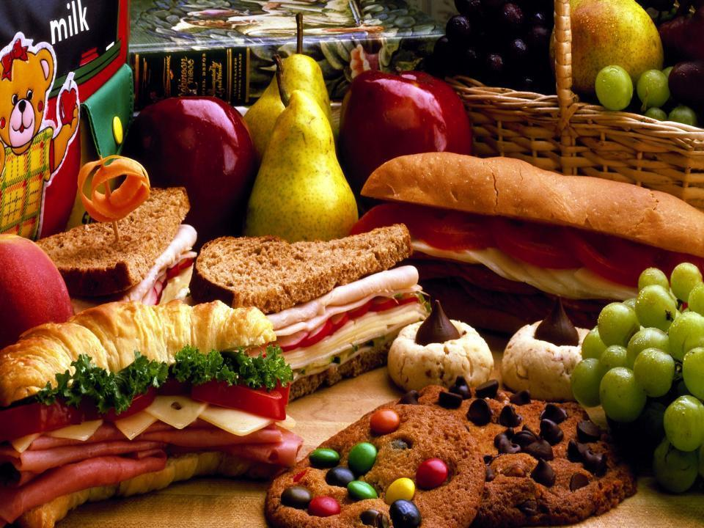
OBENTO A TASTY TRADITION

Slide 2
p.26 Ex.1
What do you eat at school?
a sandwich
soup
Where do you get the food from?
home
the shops
biscuits
salad
the school canteen

Slide 3
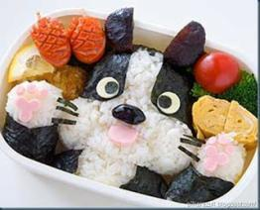
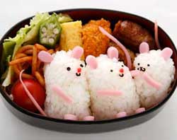
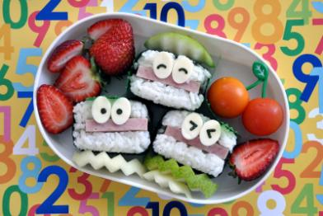
p.26 Ex.3 a
1. An ‘obento’ is…
2. Its origin goes back to…
3. You can buy an obento…
4. To make an obento you need…
5. It is important that obentos look…
6. Obento portions for nursery schools should be..

Slide 4
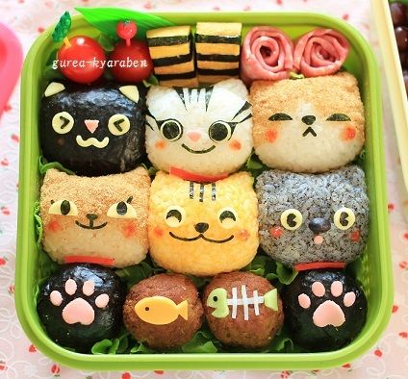
T
F
DS
1 | 2 | 3 | 4 | 5 | 6 | 7 | 8 | 9 | 10

Slide 5
baked
grilled
boiled
steamed
mashed
fried

Slide 6
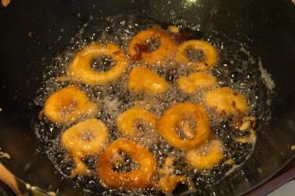
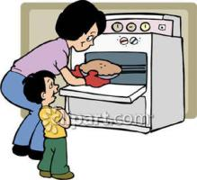
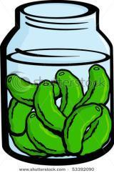
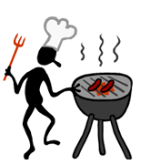
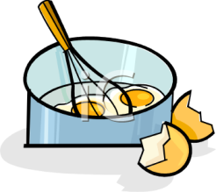
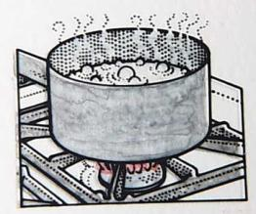
1
2
Boil
Fry
Grill
Bake
Pickle
Scramble
3
4
5
6

Slide 7
to cook meat or vegetables in an oven or over a fire
to cook food with steam
preserved in vinegar or salt water
cooked in hot oil
to be cooked in water that is boiling
to mix together the white and yellow parts of an egg and cook it
to crush something, especially food
to cook an egg without its shell in water that is boiling gently
Boiled
Scrambled
Pickled
Poached
Roast
Fried
Mashed
Steamed

Slide 8
Name of a dish | What is made of? | How do you cook it? | What does it taste like?
okroshka
pelmenis
ukha
Salty
Spicy
Delisious
Tasty
Sweet
Yummy

Slide 9
Homework
p.26-27 Ex. 5 a, b
p. Ex.7

