Slide 1
MY THINGS

Slide 2
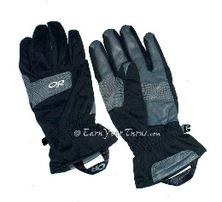
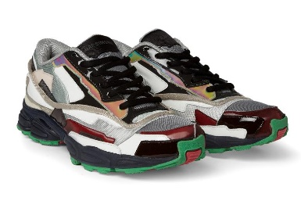
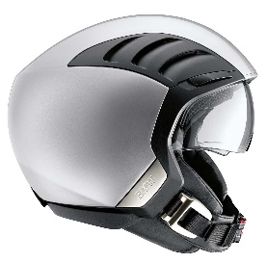
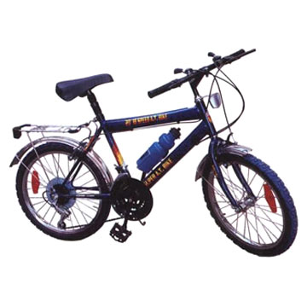
MY THINGS match the words and the pictures
Skateboard
Helmet
Basketball
Gloves
Bicycle
Trainers

Slide 3
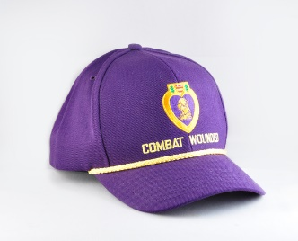
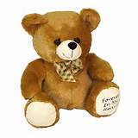
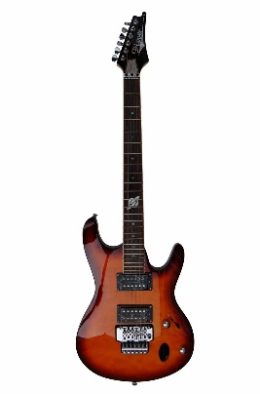
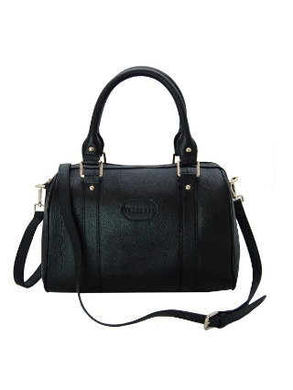
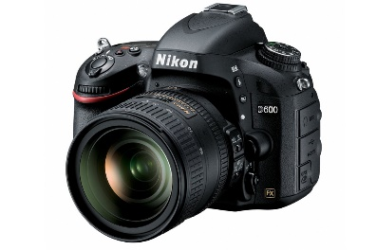
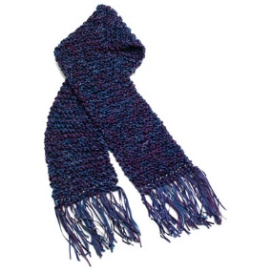
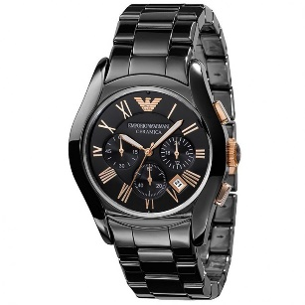
MY THINGS match the words and the pictures
Cap
Guitar
Digital camera
Scarf
Watch
Handbag
Teddy bear

Slide 4
PLURALS
noun + s
example: one doll – two dolls

Slide 5
PLURALS
noun (ending -s, -ss, -sh, -ch,
-x, -o) + es
example: brush – brushes

Slide 6
PLURALS noun (ending consonant + y)→ -ies example: lady – ladies

Slide 7
PLURALS noun (ending -f, -ef) →ves example: leaf – leaves

Slide 8
IRREGULAR PLURALS child – children foot – feet tooth – teeth woman – women man – men mouse – mice

Slide 9
Form plural nouns
Cap
Box
Board
Wife
Glass
6. Watch
7. Helmet
8. Lamp
9. Man
10. Foot

