Slide 1
National costumes of Britain

Slide 2
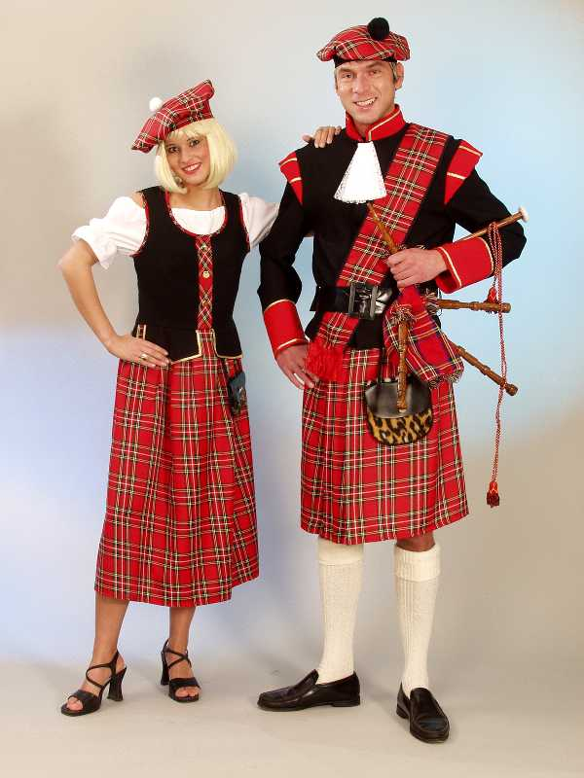
National costumes of Britain
Scottish men's national costume. Its main distinctive feature is the plaid skirt – kilt, which is a special piece of tartan fabric wrapped around the waist. Usually the kilt is worn with a small special bag sporran.

Slide 3
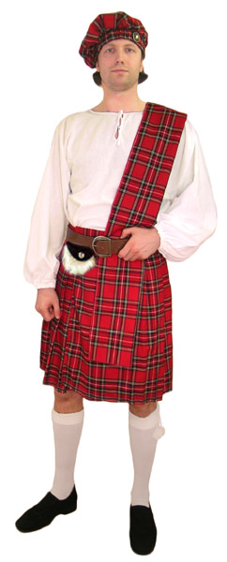
National costumes of Britain
Anglo-Scottish word "kilt" means "to wrap" that actually does the eponymous men's skirt in Scottish national dress. Old Icelandic translation of this word means "fold" and comes from the Vikings, who wore such clothes in folds.

Slide 4
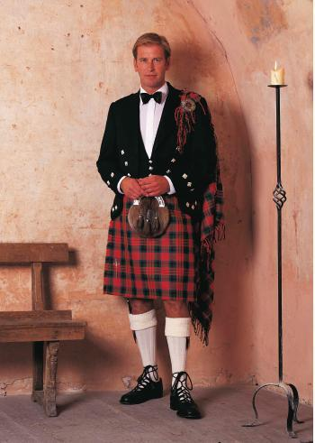
National costumes of Britain
The first mention of such clothing in Scotland referred to as 1594. "Large plaid" was used in the highlands of Scotland for the purpose of shelter in rainy weather and at night as a blanket. They could turn around and throw over the shoulder, hence its modern form of national dress. The kilt was used in the Scottish army as a military uniform.

Slide 5
National costumes of Britain
After the uprising of the Jacobites in 1746, Britain banned the wearing of tartan, including a kilt and plaid. The ban was in force for 36 years, and to preserve the traditional clothes was accomplished by troops of the British army, located in the mountains, which were issued Scottish costumes as a form.

Slide 6
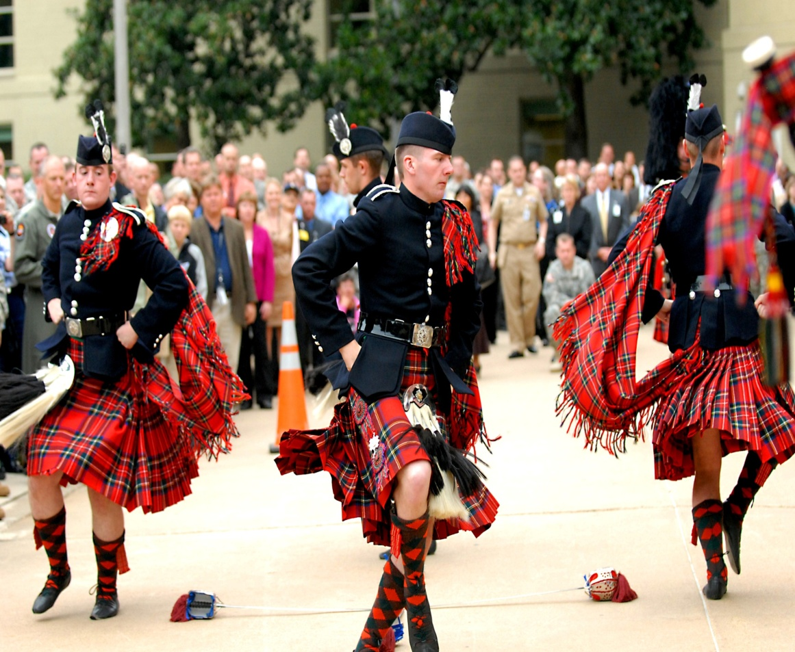
National costumes of Britain
In the mid-19th century Scottish national dress became popular among the nobility. As the military form of the kilt ceased to exist in 1940 though today is sometimes used as ceremonial wear for parades and demonstrations. However, the daily wearing of the kilt in Scotland also withdrew into the background, and now he is considered to be extremely festive clothing.

Slide 7
Тhank you for your attention!

