Slide 1
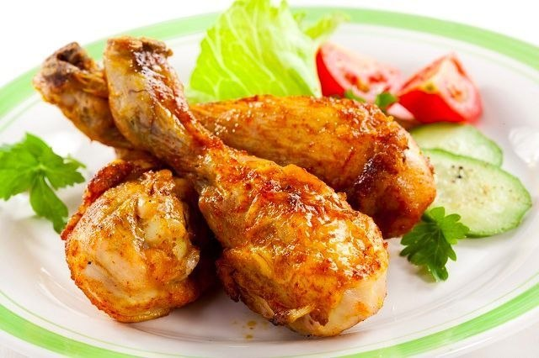
Food and drinks!
['ʧɪkɪn]
chicken

Slide 2
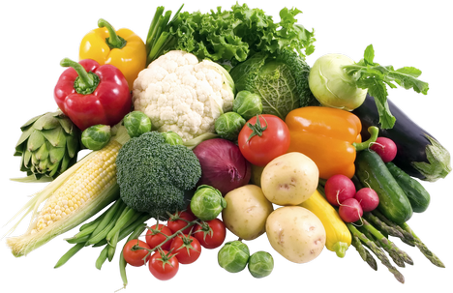
Food and drinks!
['veʤ(ə)təblz]
vegetables

Slide 3
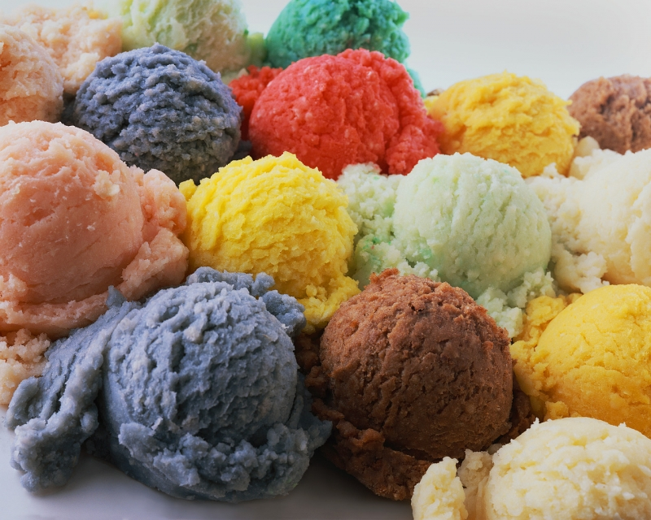
Food and drinks!
[ˌaɪs'kriːm]
ice cream

Slide 4
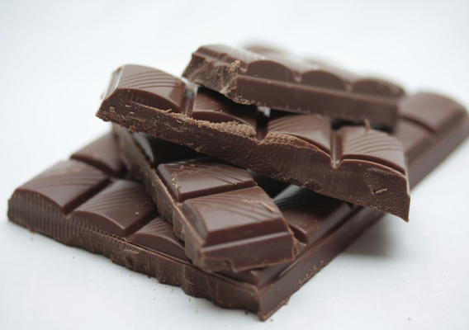
Food and drinks!
['ʧɔklət]
chocolate

Slide 5
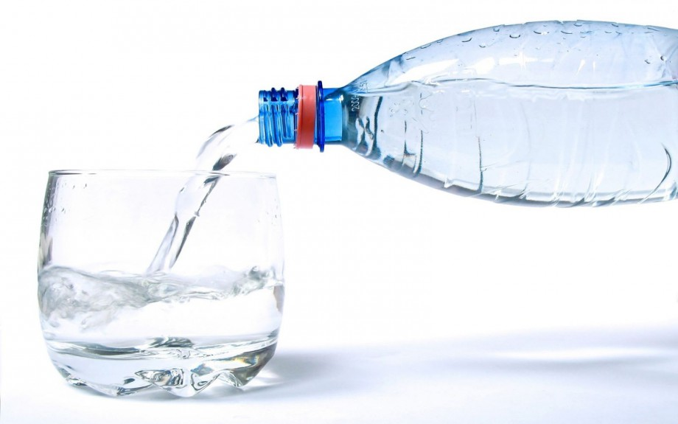
Food and drinks!
['wɔːtə]
water

Slide 6
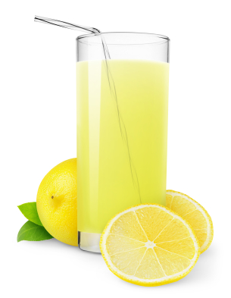
Food and drinks!
[ˌlemə'neɪd]
lemonade

Slide 7
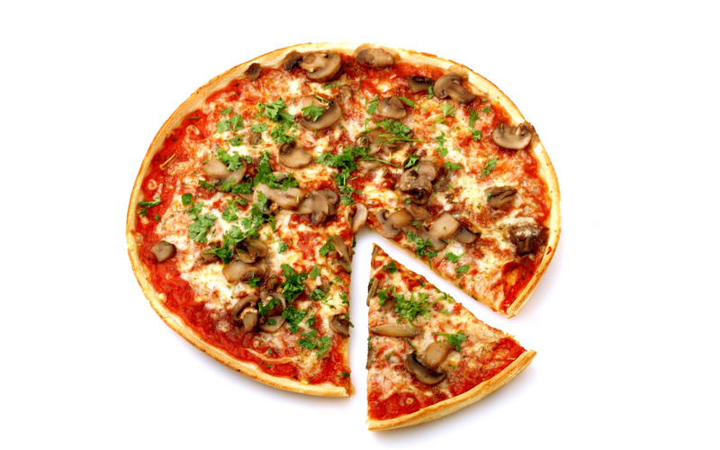
Food and drinks!
['piːtsə]
pizza

Slide 8
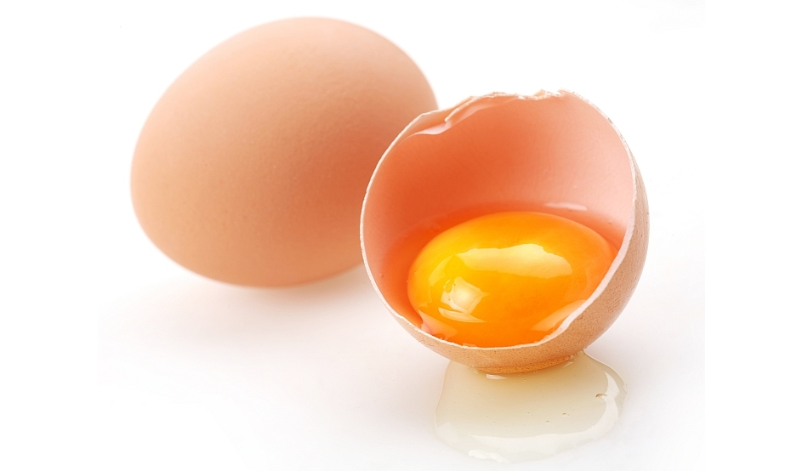
Food and drinks!
[eg]
egg

Slide 9
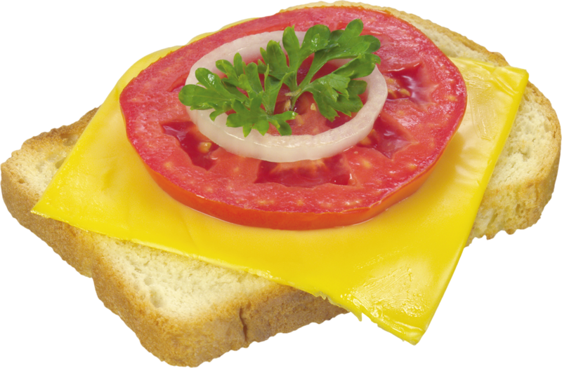
Food and drinks!
['sæn(d)wɪʧ]
sandwich

Slide 10
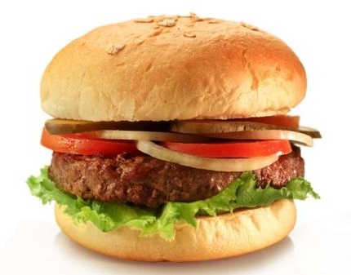
Food and drinks!
['bɜːgə]
burger

Slide 11
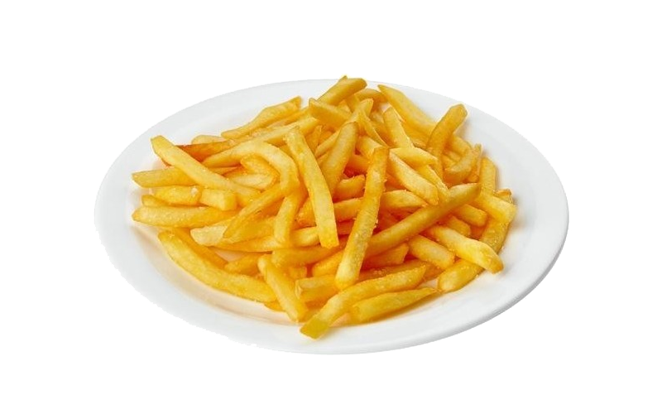
Food and drinks!
[ʧɪps]
chips

Slide 12
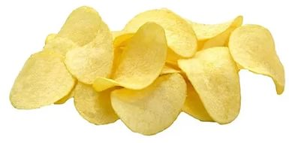
Food and drinks!
[krɪsps]
crisps

Slide 13
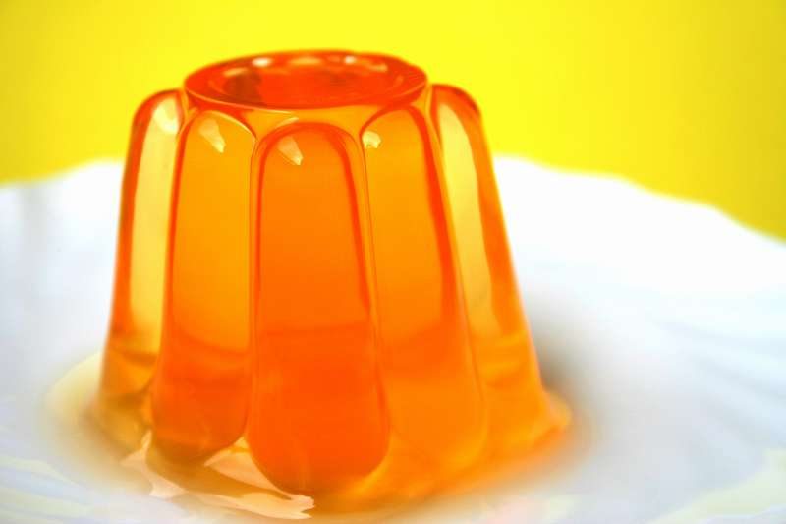
Food and drinks!
['ʤelɪ]
jelly

