Slide 1
Paper VS Plastic
Paper bags vs. plastic bags: which is really better?

Slide 2
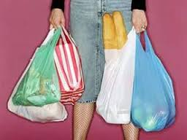
We always ask a question when it comes time to decide what to take with you to the store: paper or plastic bag?

Slide 3
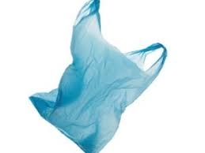
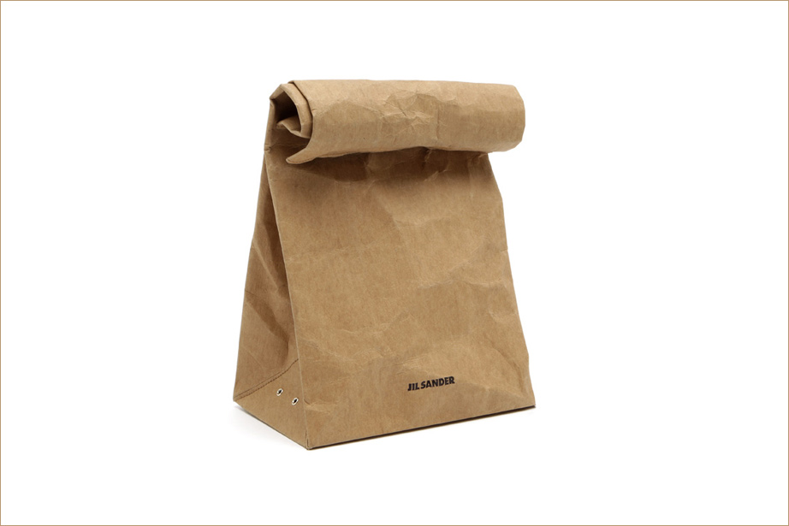
On the one hand it’s a simple choice, but lets think about these two different things. Each has its advantages and disadvantages . Let's look at what they differ.

Slide 4
Paper bags
Paper comes from trees. It takes about three tons of wood to get one ton of paper pulp.

Slide 5
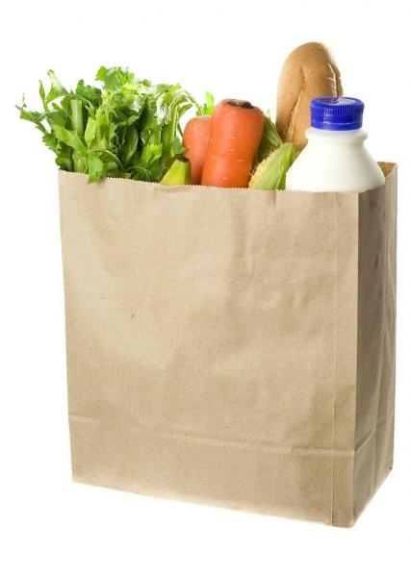
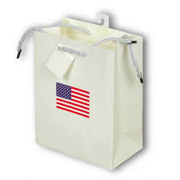
Advantages
Paper bags take less time to decompose.
But paper bags for us, in Russia, are not particularly common, such as in the United States. So that we cherish our forests.

Slide 6
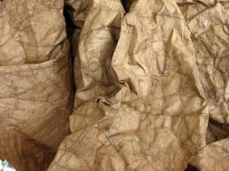
Disadvantages
On the other hand, the paper bags have a number of drawbacks. The main disadvantage of the paper due to the fact that it is afraid of water. Using lamination helps a little.

Slide 7
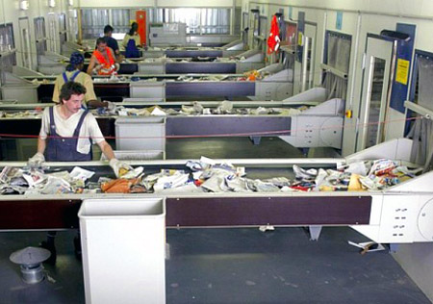
Another and very significant drawback - the high cost of raw materials and ways to improve it. If you take it to a recycling center it means more energy and chemicals are used.

Slide 8
According to the magazine “National Geographic”, in the manufacturing of paper bags more energy, more water than in the production of plastic bags are used.

Slide 9
According Howstuffworks.com, papermaking pollutes air 70% more than the production of plastic bags.

Slide 10
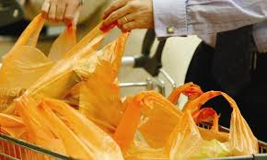
Plastic bags
Plastic comes from oil. Everyone of us uses plastic bags in our everyday life.

Slide 11
Advantages
Advantages of plastic bags are undeniable. They are cheap to produce, well tolerate humidity, strong and durable.
Another advantage of the polyethylene to paper - the possibility of long-term use. Plastic bag, which served as a time, can be used for a long time.

Slide 12
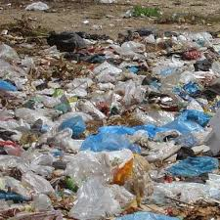
Disadvantages
Plastic is a very useful material, which is very important in modern life, but the problem is that it can lie on the ground or swim in the water for decades.

Slide 13
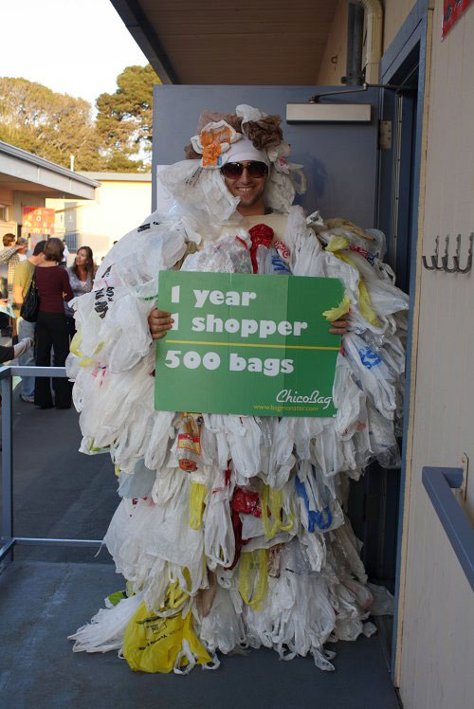
In fact, in the UK,for example,
they recycle only 1
in 200 plastic bags.

Slide 14
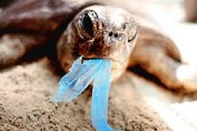
Besides , plastic bags cause over 100,000 sea turtles and other marine animals to die every year, when animals mistake them for food.

Slide 15
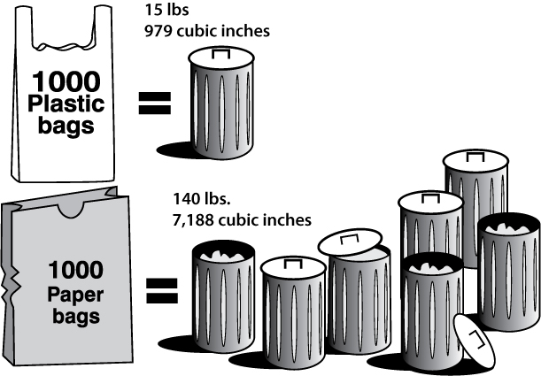
Who is the winner then?

Slide 16
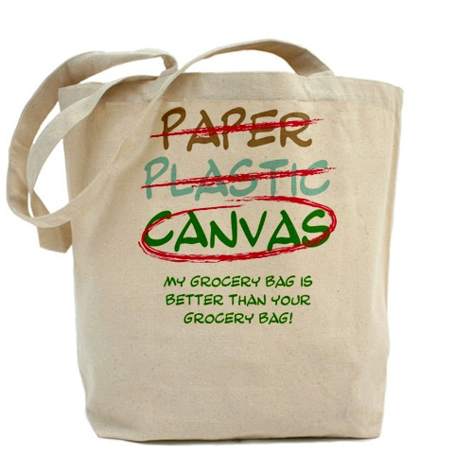
The best way to carry your shopping and protect the environment at the same time is to choose a reusable fabric bag.

Slide 17
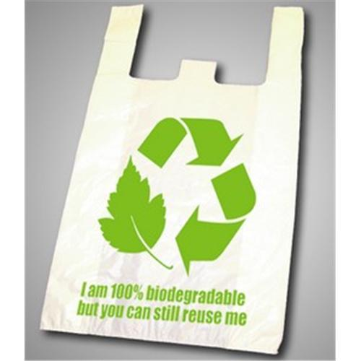
Reusable Bio bag.

Slide 18
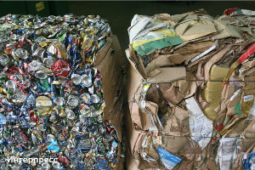
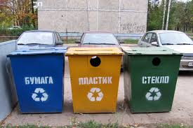
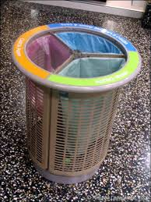
Some steps have been already made

Slide 19
Conclusions.
Both plastic and paper bags are harmful for our environment.
Paper bags are even more unhealthy than plastic ones.
Its preferable to use fabric bags or the so-called Bio bags.

