Slide 1
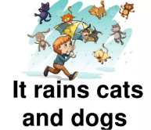
An idiom (Latin: idiomī,), is a phrase or a fixed expression that has a figurative, or sometimes literal, meaning. An idiom's figurative meaning is different from the literal meaning.
PROVERBS & SAYINGS are short statements of wisdom or advice that are transmitted (передаваемый )from generation to generation and have passed into general use.
Quotation is the repetition of someone else's statement or thoughts.

Slide 2
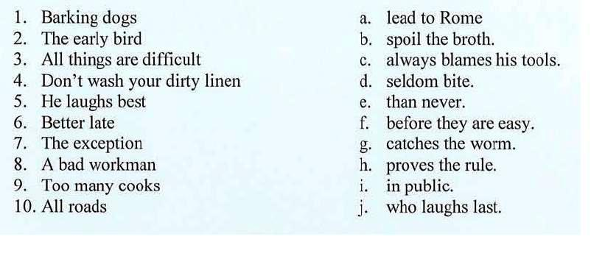
Match the parts to make sayings:

Slide 3
Idioms /sayings about _____
“An army marches on its stomach.” Napoleon (1769-1821)
Good food is all the sweeter when shared with good friends.
English saying
Laughter is brightest where food is best.
Irish Proverb
Ex. 1 b p. 91
Quotes
Saying
Proverbs

Slide 4
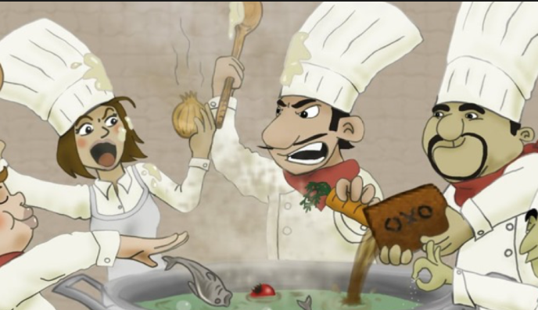
Too many cooks spoil the broth!
Y семи нянек дитя без глазу.

Slide 5
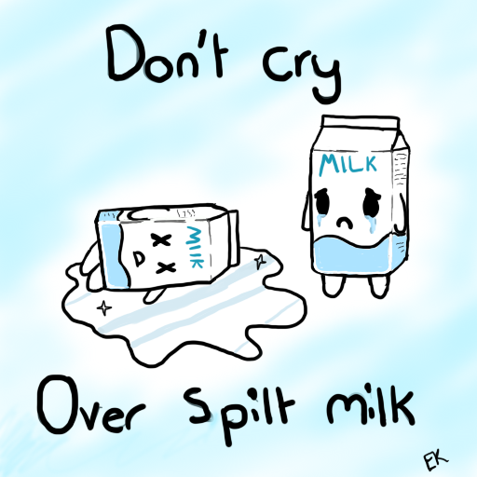
Crying over spilt milk.
Слезами горю не поможешь.
Слезами горю не поможешь.

Slide 6
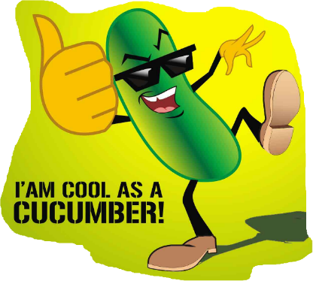
As cool as a cucumber.
Я спокоен (хладнокровен), как удав.
Я спокоен (хладнокровен), как удав.

Slide 7
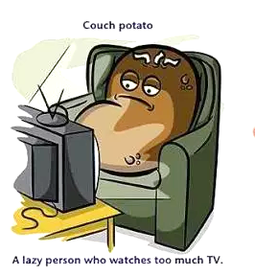
A couch potato
“Повелитель диванов”

Slide 8
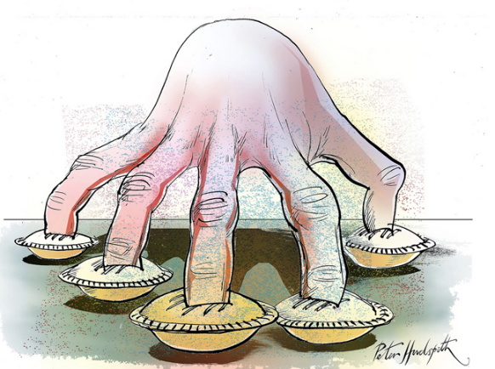
to have a finger in every pie
лезть во все дела

Slide 9
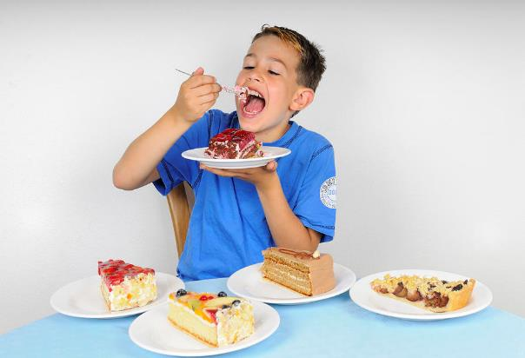
You can`t have your cake and eat it
Hельзя приготовить яичницу, не разбив яйца)!

Slide 10
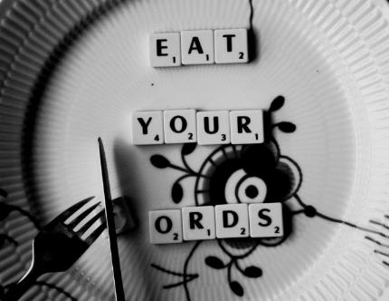
Eat your words!
Идти на попятную

Slide 11
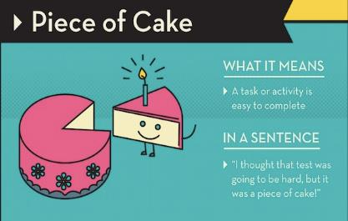
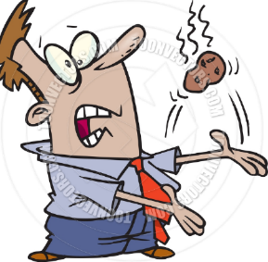
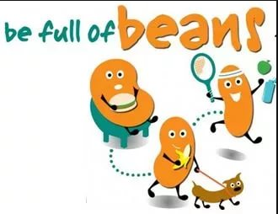
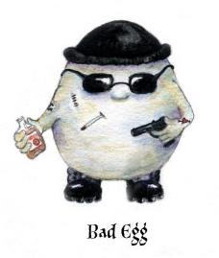
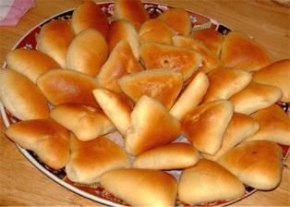
It`s a hot potato
It`s a piece of cake
This is a touchy subject
very easy
Selling like hot
cakes
feel happy
bad idea; the scammer; unlucky person
Ex. 3 p. 91
very popular articles of trade

Slide 12
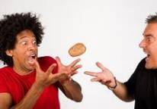
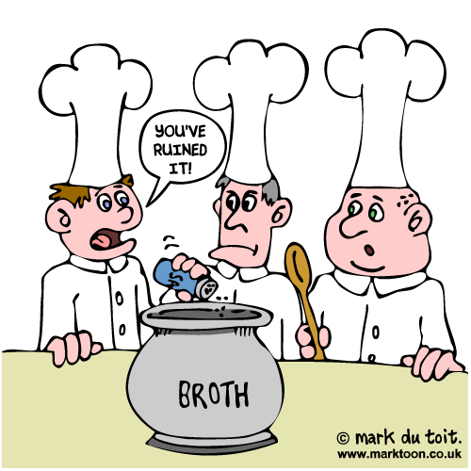
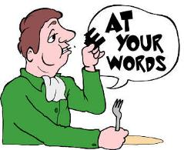
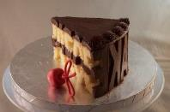
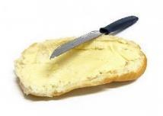
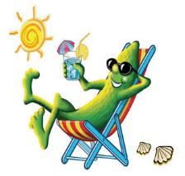
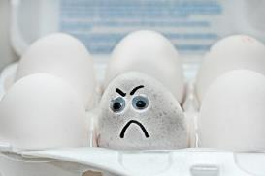
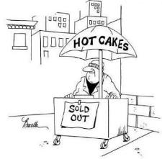
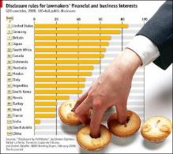
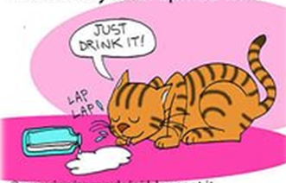
Idioms | sayings Let`s talk food!
1
2
3
4
7
6
5
10
9
8

