Slide 1
Module 2
English in Use

Slide 2
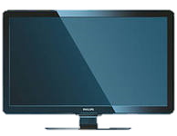
Requiring services
heating
hi:tıŋ
oтопление
electricity
ɪlektrɪ̱sɪti
электричество
plumber
plʌmə
сантехник
electrician
ɪlek'trɪʃən
электрик
TV doesn’t work
tap is leaking

Slide 3
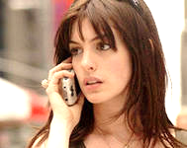
Power Masters
David
Hello, Power Masters
Hello, can I speak to David, please?
Mrs. Brown
Speaking.
David ,hi. This is Helen Brown.
Oh, Hello, Mrs. Brown. What can I do for you?
Well, I have no electricity in my house. I’m in the dark.
Right. I’ll come over and have a look.
Thank you.

Slide 4
Power Masters
Mr. Campbell
Good evening. Could I speak
To Mr. Campbell, please?
Mr. Campbell speaking.
Mr. Campbell, this is Jane
from the Warren Avenue flat.
Jane
Hi, Jane, What’s up?
Well, there’s a problem with the flat.
The heating doesn’t work.
Right. I’ll send the plumber over.
Thank you.

Slide 5
Power Masters
Frank
Nancy
Hello, Frank Howard speaking
Howard, hi. This is Nancy Adams
Hi, Nancy, What can I do for you?
Well, my TV doesn’t work
Right. I’ll come over and have a look then
Thank you

Slide 6
Power Masters
Stacey
Good morning. Could I speak to Mr. Howard, please
Mr. Howard speaking
Hi, Frank, this is Stacey
Oh hello, Stacey. What’s up?
There is a problem in my flat. One of the taps is leaking
OK, I’ll come over right away
Thank you

Slide 7
The End

