Slide 1
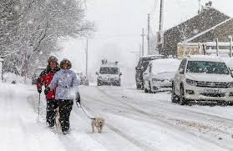
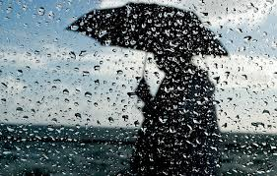
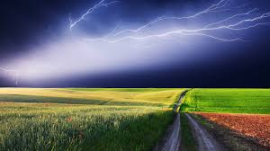
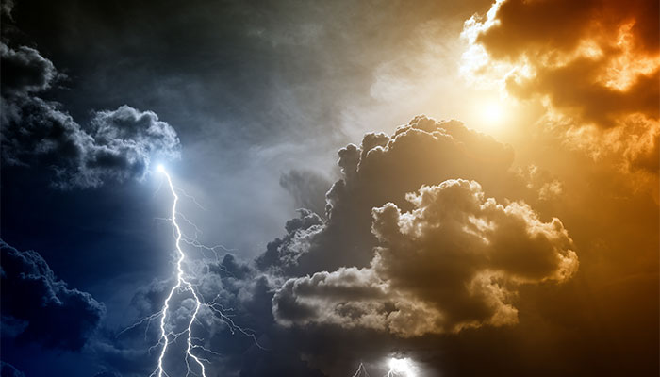

Slide 2
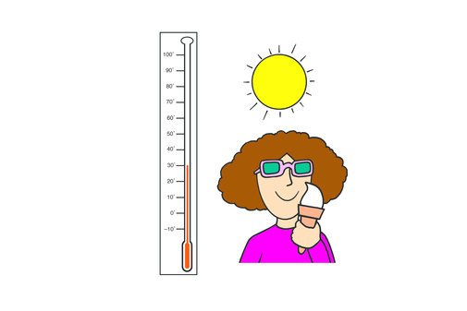
‘ Whether the weather is warm, whether the weather is hot, we have to put up with the weather, whether we like it or not.

Slide 3
ь
June
July
August
It’s very hot and the sun is shining – Очень жарко, светит солнце
It’s warm – Тепло

Slide 4
September
October
November
It’s not very cold – не очень холодно
It isn’t raining at the moment, but sometimes it rains – В данный момент не идет дождь, но иногда дождь идет.

Slide 5
December
January
February
It’s very cold, it’s snowing – очень холодно, идет снег

Slide 6
March
April
May

Slide 7
The weather is cold and windy. It often snows. The sky is blue and grey.. There are many holidays . They are New Years Day, Christmas.

Slide 8
The weather is hot and sunny. The sky is blue. There are many birds in the gardens. The trees are green. There are many flowers in the parks. I like to spend my holidays with my family on the seaside.

Slide 9
The weather is fine and nature is beautiful in. The sky is grey. The trees are green, yellow, brown and red. There are many apples in the apple trees. I like to rake leaves in our garden.

