Slide 1
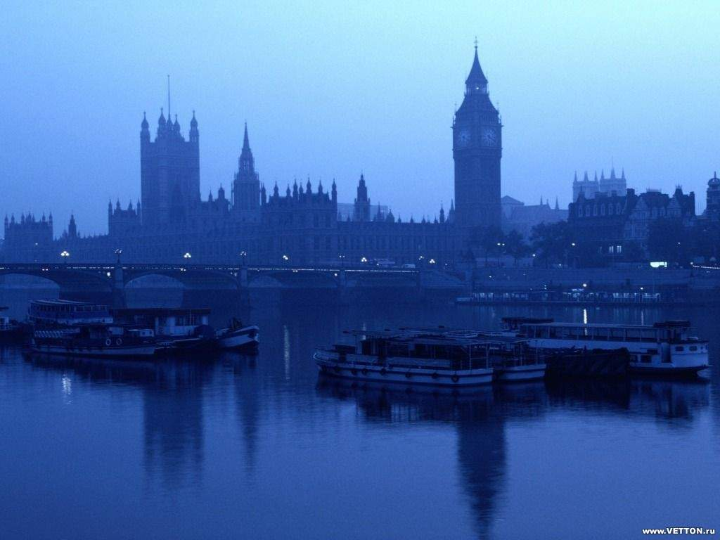
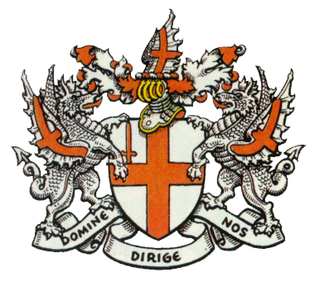
The best place in world!
London

Slide 2
London is the British capital and
one of the biggest cities in the world.

Slide 3
London is situated upon both banks of the
River Thames, it is the largest city in Britain
and one of the largest in the world.
Its population is about
7 million people.

Slide 4
It consists of three parts: the City of London, the West End and the East End.

Slide 5
The West End
The best places of the West End

Slide 7
Buckingham Palace

Slide 8
Kensington Gardens

Slide 9
St.James's Park

Slide 10
Here are the historical places as well
as the famous parks.
Hyde Park with its Speaker's Corner is also here.

Slide 11
The Queen's Residence
The Queen's Residence was built in
1870 for Samuel Barnard, a vice president
of the Paper Company.

Slide 12
The 1700’s
the Queen's Residence was a
gift from Henry Ford.

Slide 13
Big Ben
He name Big Ben actually refers not to the clock-tower
itself, but to the thirteen ton bell hung within.
The bell was named after the first commissioner
of works, Sir Benjamin Hall.

Slide 14
This bell came originally from the old Palace of Westminster,
it was given to the Dean of St. Paul's by William III.
Before returning to Westminster to hang in its
present home, it was refashioned in Whitechapel in 1858.
The BBC first broadcast the chimes on the
31st December 1923 - there is a microphone in the turret
connected to Broadcasting House.

Slide 15
The East End
To the east the large area called the East End.
This is London’s poorest part.
The very large riverside in the East End
make London one of the three largest parts in the world.

Slide 16
Tower of London
Founded nearly a millennium ago and
expanded upon over the centuries since,
the Tower of London has protected the city

Slide 17
It has been the seat of British government
and the living quarters of monarchs,
the site of renown political intrigue,
and the repository of the Crown Jewels.

Slide 18
Tower Bridge

Slide 19
Tower Bridge has stood over the River Thames
in London since 1894 and is one of the finest bridges in the World.

Slide 20
The City of London
The City extends over an area of about
2.6 square kilometres in the heart of London.
It is the financial centre of the UK with many banks,
offices and Stock Exchange. But the City
is also a market for goods of almost every kind,
from all parts of the world.

Slide 21
Museums and art galleries
of London.
Tate Gallery

Slide 22
London is very rich in museums and art galleries. If you are fond of painting you'll go to the Tate Gallery.

Slide 23
A rich sugar manufacturer Henry Tate
founded it in 1897.

Slide 24
There are about 300 oils and
19000 watercolours and drawings.

Slide 25
The British Museum is the largest and richest of its kind in the world. The present building was built in 1852.

Slide 26
By law a copy of every book, periodical
and newspaper, published in Britain
must be presented in the British museum.

Slide 27
This collection is so vast that
only a very small percentage of it is
on show to the public.

Slide 28
The famous places in the London

Slide 29
Globe Theatre
The original Globe Theatre was built
in 1599 by the playing company
to which Shakespeare belonged.

Slide 30
Trafalgar Square

Slide 31
The Cathedral of Saint Paul

Slide 32
Statue on border
the city of London
Piccadilly

Slide 33
Cleopatra's Needle

Slide 34
Queen Victoria Memorial

Slide 35
THE END
Project by Kate Shabalina. 10 - b

