Slide 1
What’s the weather like?
\

Slide 2
Ex. 1, p. 98. Form the adjectives
Rain
Cloud
Wind
Fog
Snow
Sun
Chill
Storm
Rainy
Cloudy
Windy
Foggy
Snowy
Sunny
Chilly
Stormy

Slide 3
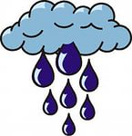
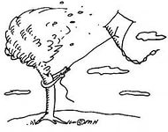
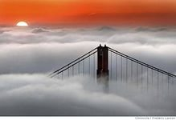
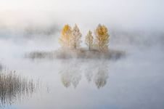
Use appropriate adjectives to complete the expressions
Wet & rainy
Cloudy & windy
Cold & snowy
Hot & sunny
Chilly & foggy

Slide 4
Look at the chart, ask & answer as in the example in your book.
London
Copenhagen
Moscow
Paris
Cairo
10
°c
- 5
°c
5
°c
8
°c
30
°c

Slide 5
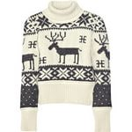
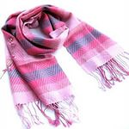
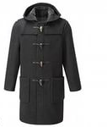
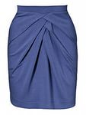
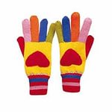
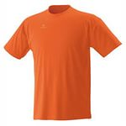
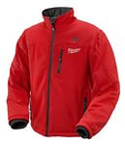
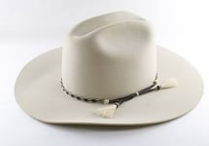
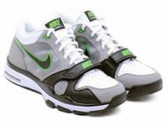
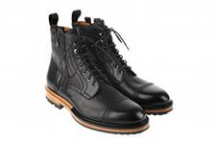
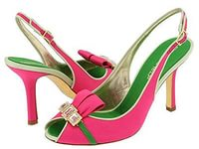
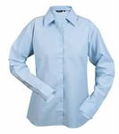
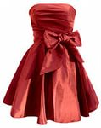
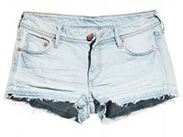
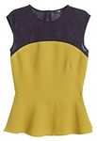
scarf
coat
raincoat
skirt
sweater
gloves
T-shirt
jacket
trainers
hat
dress
boots
shoes
shorts
top
trousers
shirt

Slide 6
It’s going to be rainy today.
I know. I’ll wear my raincoat and boots then.
Sunny
Stormy
Boiling hot
Wet
Sunny
Freezing cold

Slide 7
Kathy is meeting
Kathy is wearing
The weather is
Kathy wants to borrow
Clair wants to go
Helen.
a thin dress and sandals.
wet and cloudy.
an umbrella.
to the shop.

Slide 8
Grammar
Present Continuous (future meaning). For actions we have already arranged in the near future.
I’m flying to Paris tomorrow.
To be going to…. To express plans/predictions. To make predictions based on what we see.
Look out! You are going to fall.
Future Simple (will). For on-the –spot decision.
The phone is ringing. I’ll answer it.

Slide 9
Make up sentences. Use Present Continuous. (future meaning)
What are you doing on Sunday?
Monday?
Tuesday?
Wednesday?
Thursday?
Friday?
Saturday?
EX: I am reading books on Monday.
Go to the movie
Watch TV
Go to the gym
Clean my room
Wash up
Work in the garden
Have a party

Slide 10
Well done!
Thank you for your work!

