Slide 1
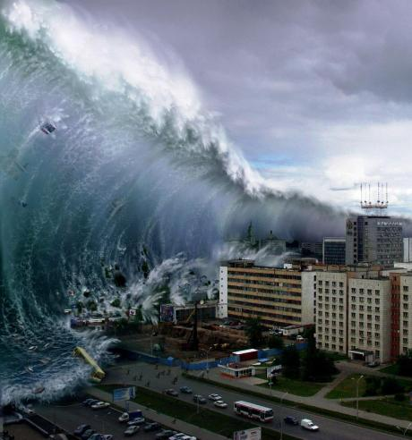
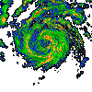
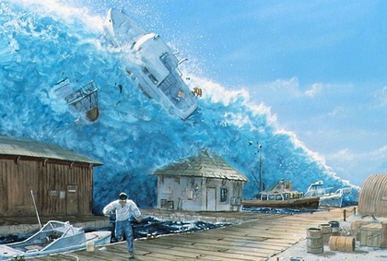
Tsunami disaster
8 form

Slide 2
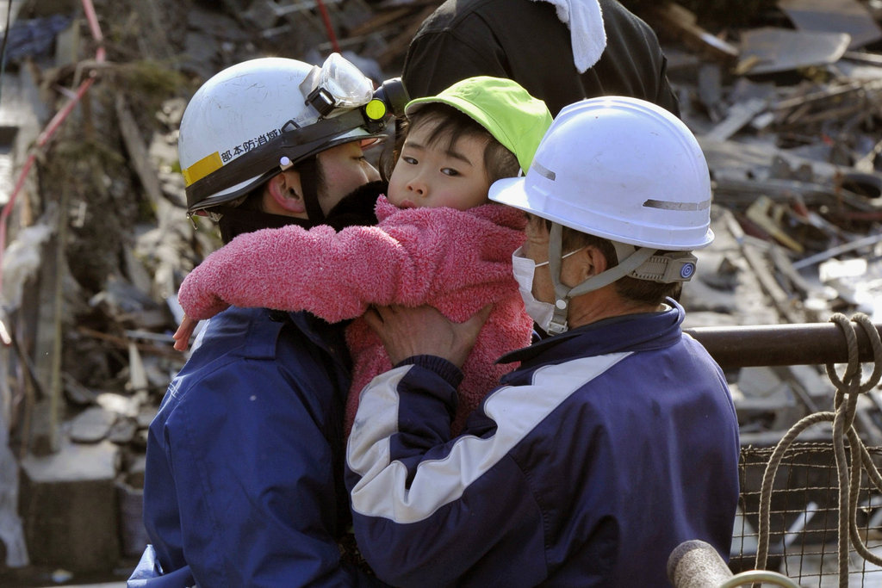
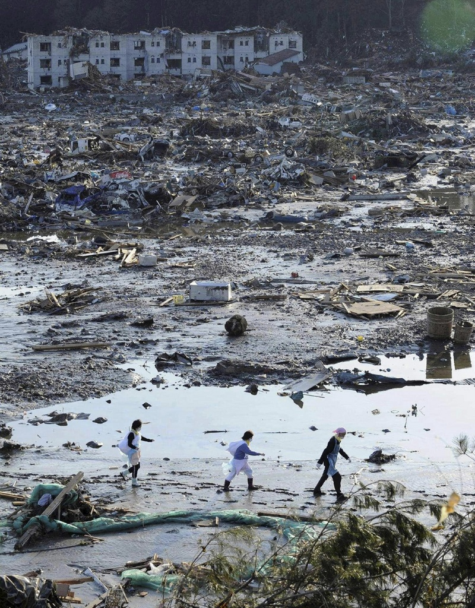
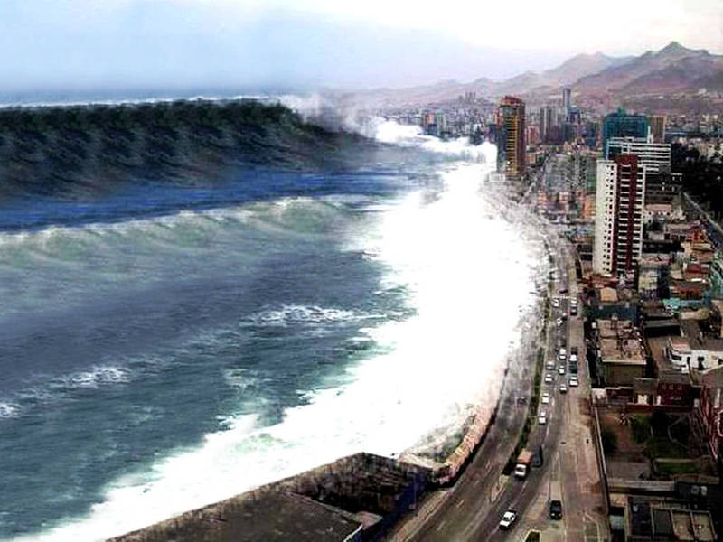
Tsunami is a great waves with destructive and super power, it usually forward to the mainland and the gulf lead to great disaster result.
The great waves formally caused by underwater earthquakes, volcanic eruption, and so on..

Slide 3
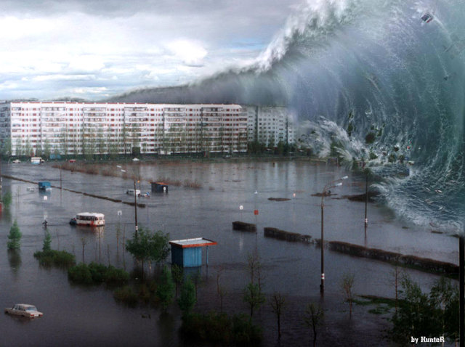
The tsunami would be occur if the Richter scale more than 6.5, the waves wall as tall as scores of meters, with huge power in it. Sweep away all the obstacles when the tsunami passes by, so tsunami can result in an inestimable disaster.

Slide 4
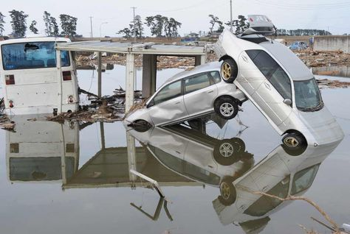
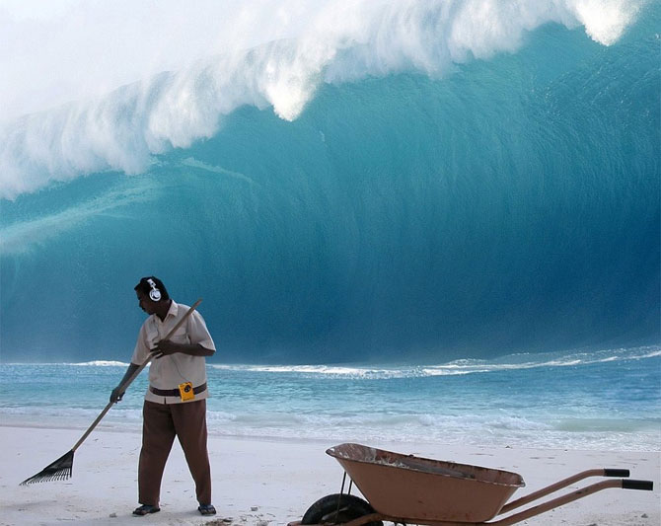
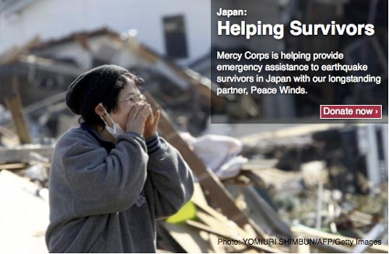
The tsunami of Japan 2011 move forward about thousands of kilometer without any loss power, we can get that tsunami contains endless energy, so we would better learn the basic skill on how to surviving a tsunami disaster.

Slide 5
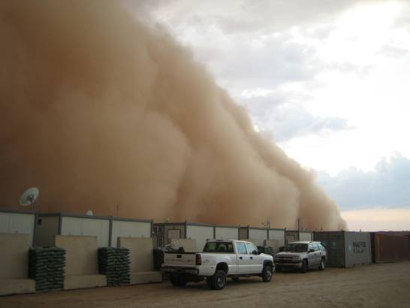
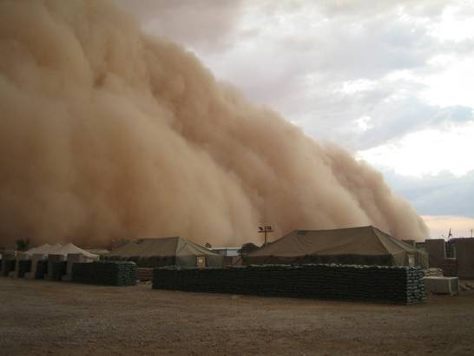
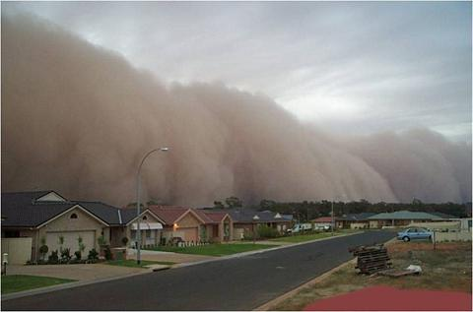
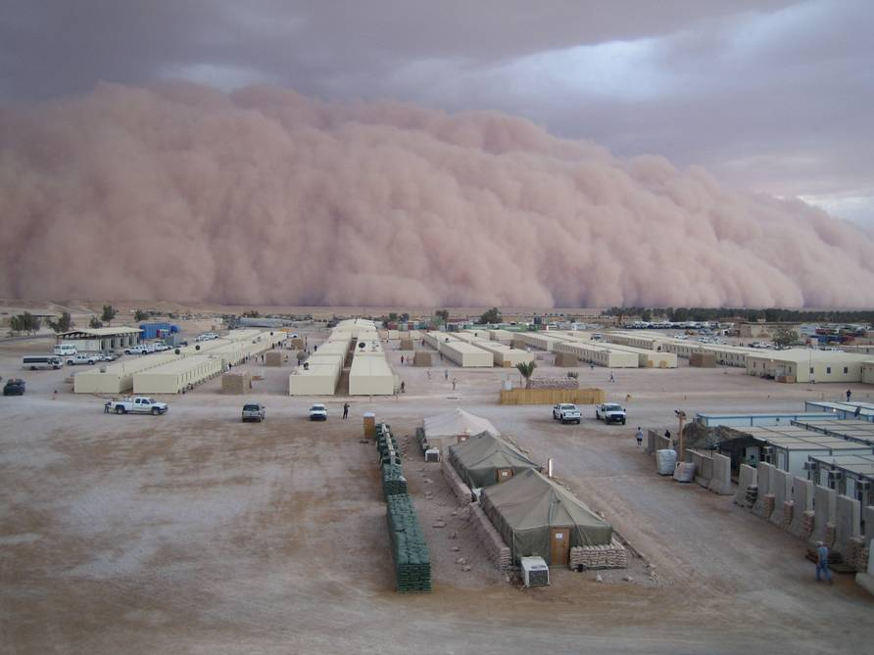

Slide 6
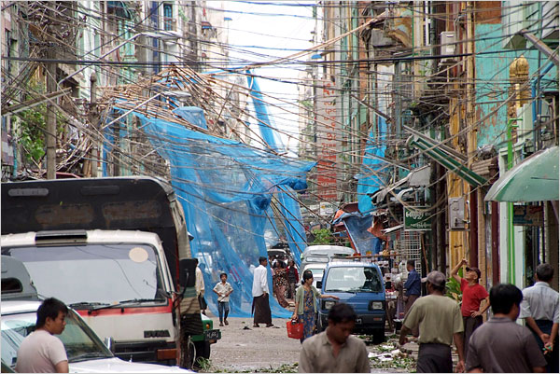
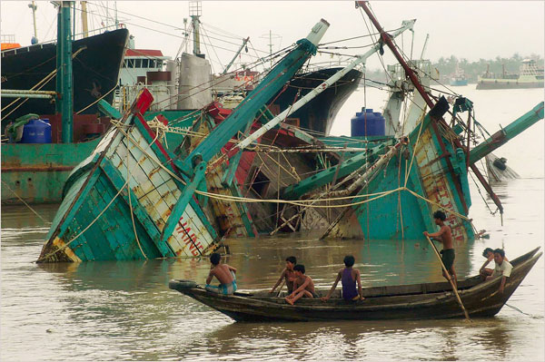
If there is a suddenly tsunami when we near the seaside area, keeping calm and vigilant, take a evacuation plan as soon as possible. Run for the inland the tsunami unreachable or climbing a stable, high building and objects the tsunami can’t flood.
Houses swept out to sea burn following a tsunami and earthquake in Natori City in northeastern Japan March 11, 2011.

Slide 7
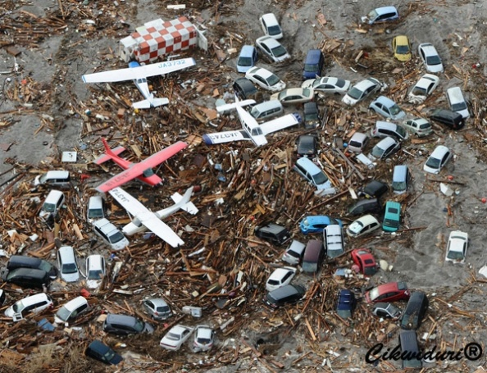
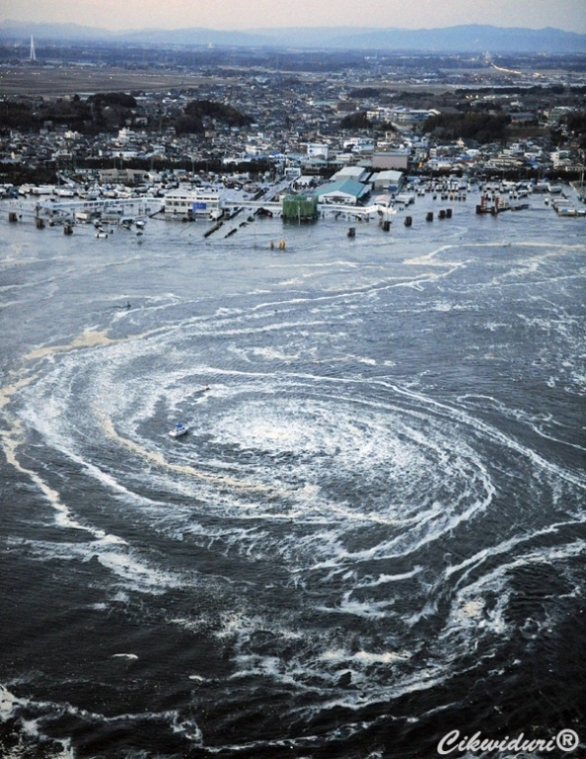
A whirlpool is seen near Oarai City, northeastern Japan, March 11, 2011.
Light planes and vehicles sit among the debris after they were swept by a tsunami that struck Sendai airport in northern Japan on Friday March 11, 2022. A magnitude 8.9 earthquake slammed Japan’s eastern coast Friday, unleashing a 13-foot (4-meter) tsunami that swept boats, cars, buildings and tons of debris miles inland.

Slide 8
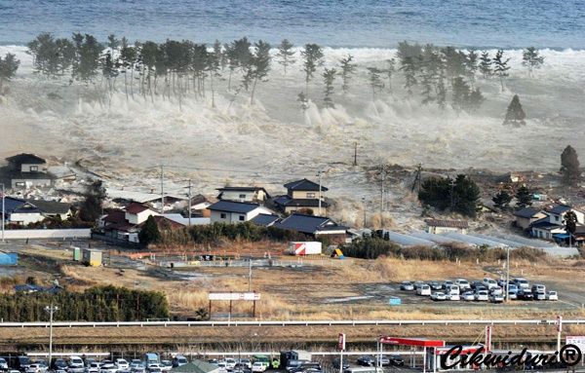
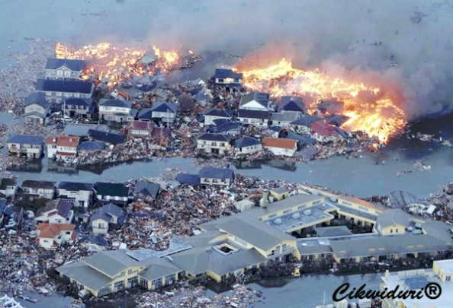
The biggest earthquake hit Japan since records began 140 years ago struck the northeast coast on Friday, March 11, 2011, triggering a 10-metre tsunami that swept away everything in its path, including houses, ships, cars and farm buildings on fire.

Slide 9
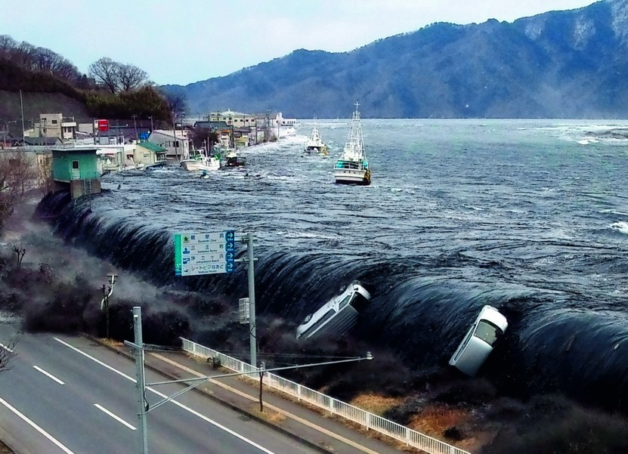
Волна в четыре этажа, Несётся в берег, Всё заливая и круша, Как бритвой бреет. Не предсказать, не отвести Земли волнение. И чьи-то прерваны пути Землетрясением. И не укрыться, не уйти, Лишь взгляд глазами. И к Богу мысли - Нас прости. Идёт цунами.
И кем бы ни был ты в тот миг, Богат ли, беден. Всех одинаково настиг Смертельный бредень. Волна в четыре этажа – Не кадр рекламы. Застыла в ужасе душа ...Идёт цунами...

Slide 10
Vocabulary
earthquake
tsunami
цунами
землетрясение
unleash
volcano
wavelength
wave
выпускать
вулкан
Длина волны
волна
vigilant
flood
epicenter
seismicity
бдительный
наводнение
эпицентр
calm
сейсмичность
lava
спокойный
whirlpool
obstacles
лава
водоворот
tremor
препятствия
Richter scale
колебание
debris
trigger
Шкала Рихтера
occur
вызывать
мусор
вызывать
gulf
destruction
eruption
mainland
пропасть
извержение
разрушение
материк

Slide 11
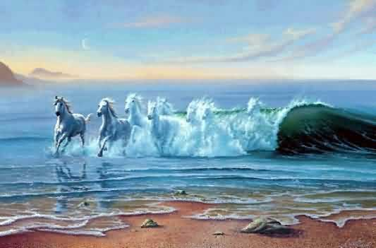
Thanks a lot
for your attention!!! ☺

