Slide 2
EATING HABITS
“Live not to eat but eat to live”

Slide 3
Betty Botter bought some butter, "But," she said, "this butter's bitter. If I bake this bitter butter, It will make my batter bitter. But a bit of better butter - That would make my batter better." So she bought a bit of butter, Better than her bitter butter, And she baked it in her batter, And the batter was not bitter. So 'twas better Betty Botter Bought a bit of better butter.

Slide 4
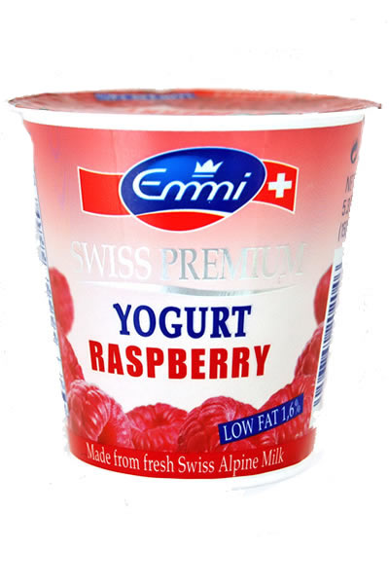
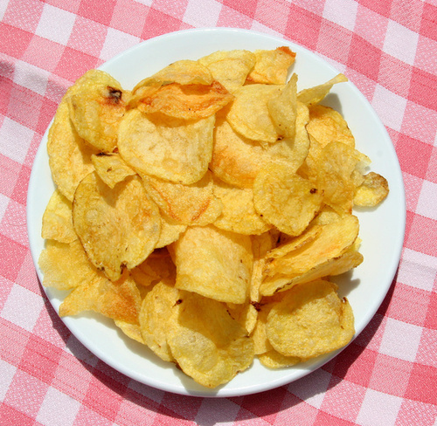
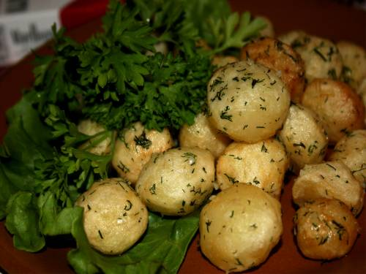

Slide 5
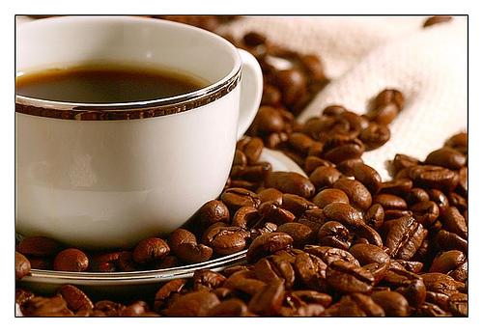
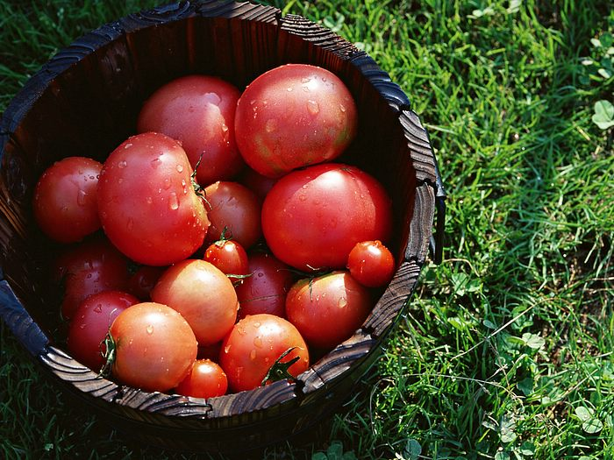
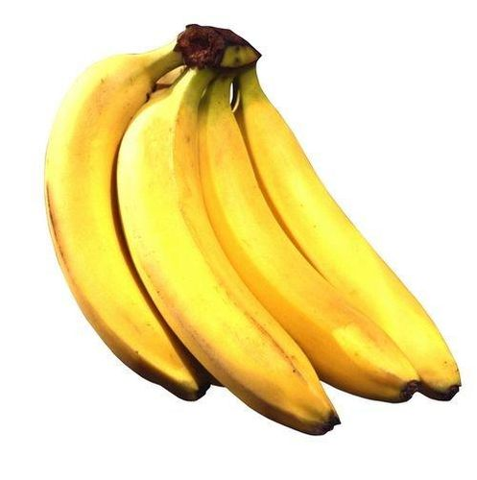

Slide 6
Divide food products into 4 categories
Fruit
Vegetables
Junk food
Diary products

Slide 7
Eating habits
Pinch chocolate
Bar sugar
Slice of bread
Teaspoon cheese
Loaf milk
Litre salt

Slide 8
Food preparation
Slice нарезать ломтиками
Peel срезать кожицу
Pour наливать
Chop рубить
Grate тереть на терке
Beat взбивать
Melt таять

Slide 9
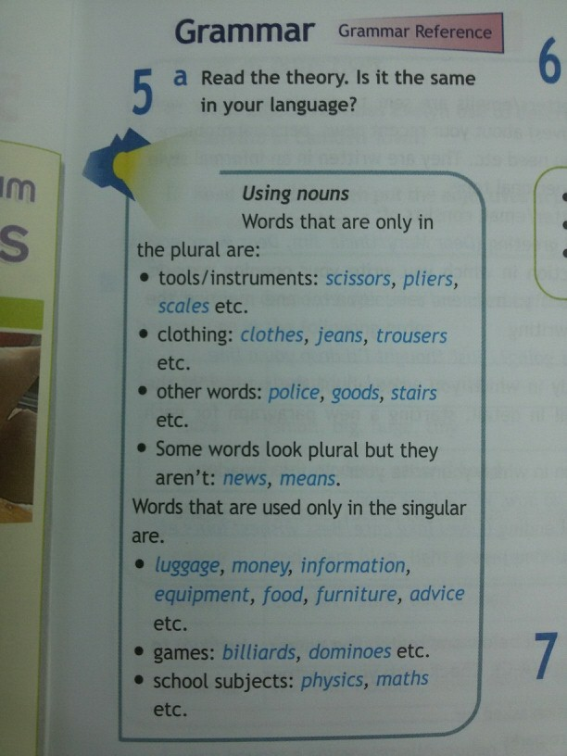

Slide 10
slice peel chop grate beat pour melt
potatoes butter chocolate
eggs cream sauce
onions bread vegetables
cake coffee carrots
bananas cheese
juice

Slide 11
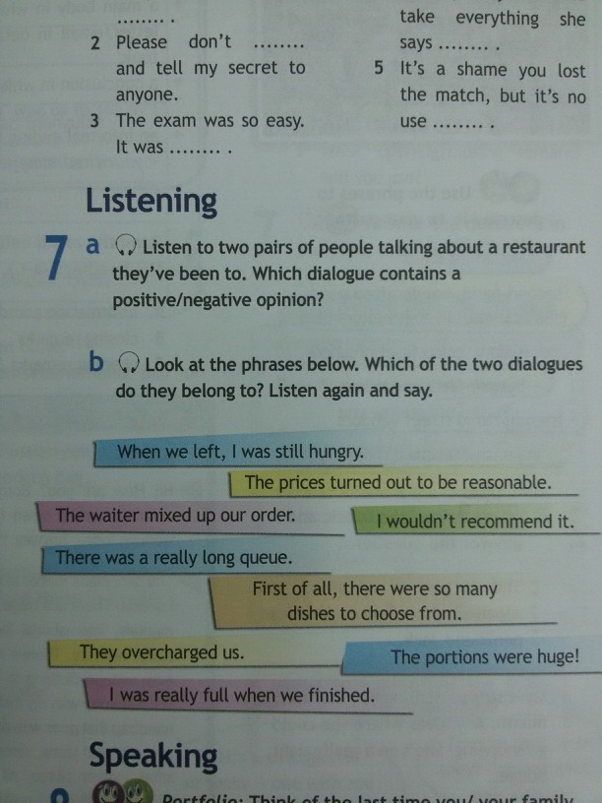

Slide 12
Find the odd words.
carrot, onion, cabbage, potato, strawberry
bacon, beef, turkey, pork
beer, lemonade, tea, sugar, coffee, juice
grapes, apple, pear, ice-cream
butter, cheese, yoghurt, bread, milk

Slide 13
“At the restaurant”
Waiter: Good evening, sir. May I take your order?
Tim: Yes, please. I’ll have the vegetable soup to start with.
Waiter: And for the main course?
Tim: I’m not sure. What’s today special?
Waiter: It’s grilled fish with carrots.
Tim: That’s sounds nice. I’ll have that, please.
Waiter: Would you like anything to drink?
Tim: A large glass of mineral water, please.
Waiter: Thank you.

Slide 15
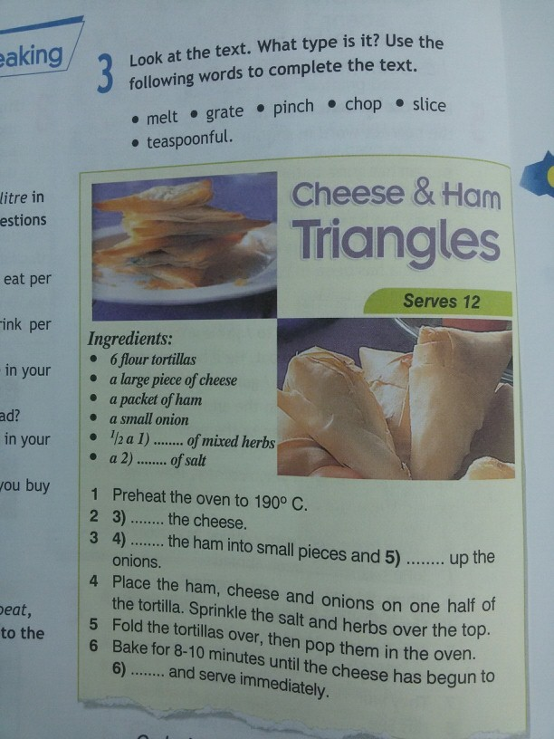

Slide 16
For your homework:
make up a story about your latest visit of a café or restaurant.

