Slide 1
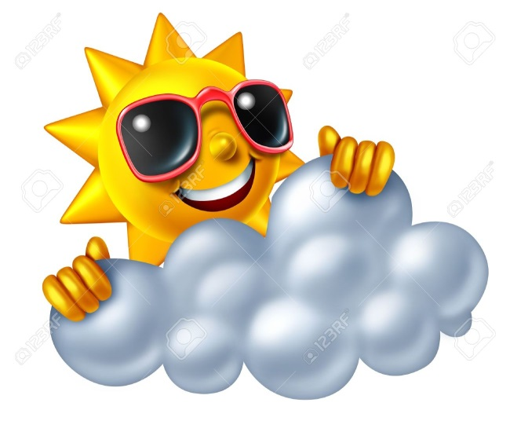
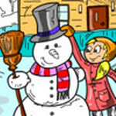
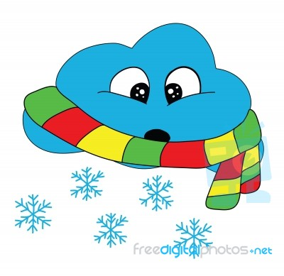
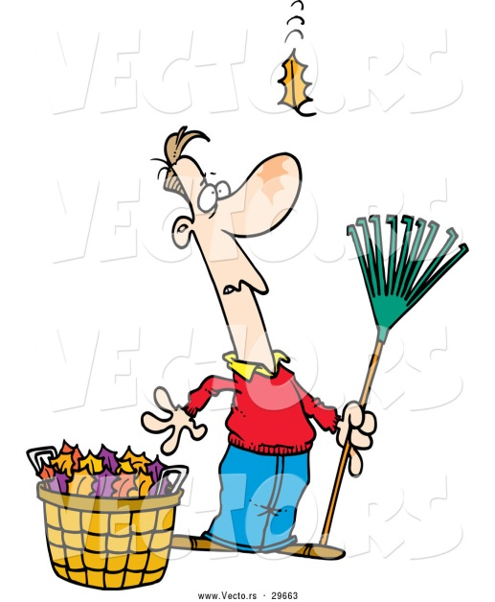
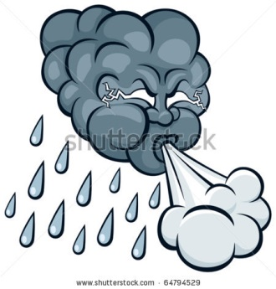
1.Everything is good in its season.
2. It’s raining cats and dogs.
3. After rain comes fair weather.
We are going to talk about…

Slide 2
What is your favorite season and month? My favorite season(s) is/are … my favorite month(s) is/are …

Slide 3
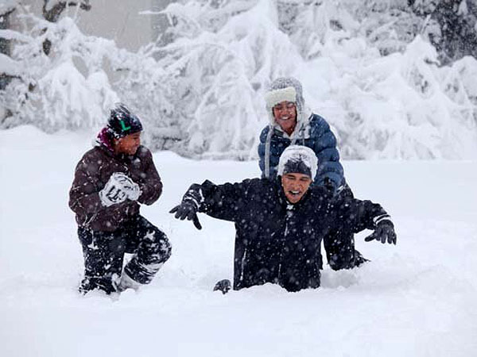
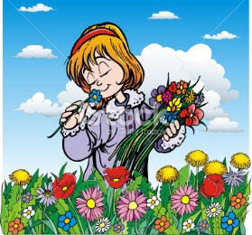
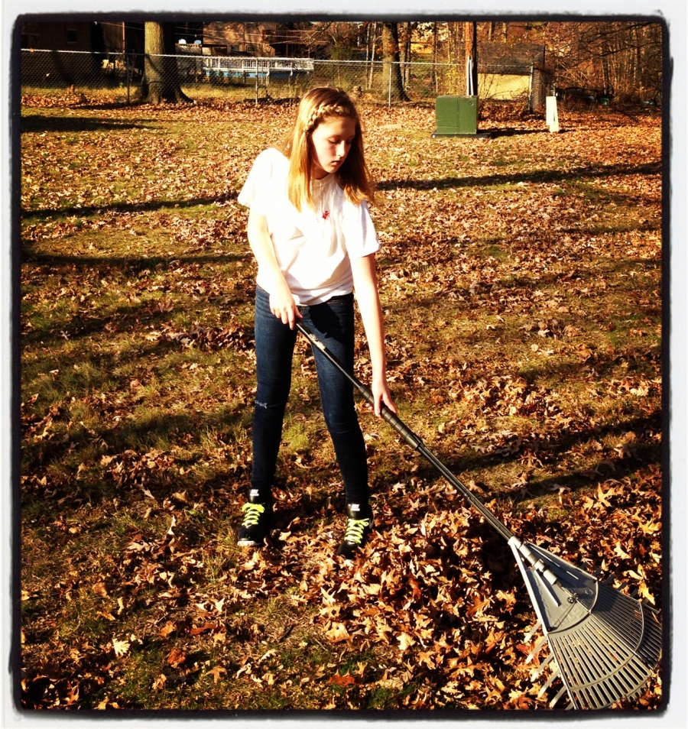
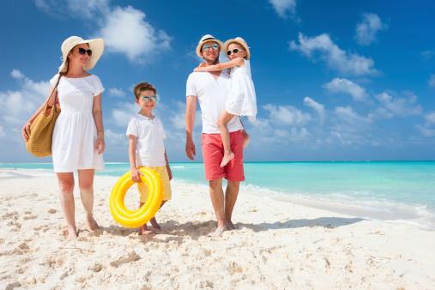
Let’s describe the pictures! WHAT ARE PEOPLE DOING?
PICK FLOWERS
PLAY IN THE SNOW
RAKE LEAVES
GO SWIMMING

Slide 4
Match the sentences to the pictures. Work in pairs.

Slide 5
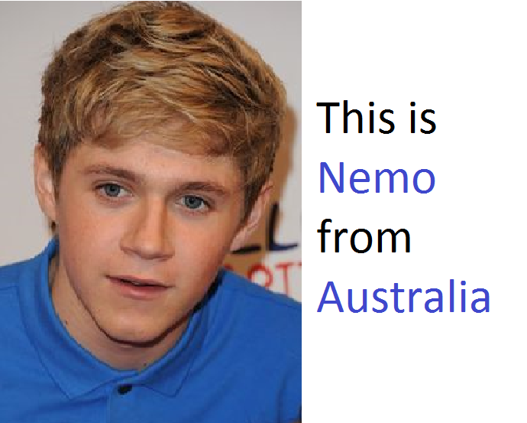

Slide 6
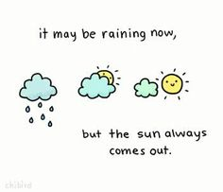
As they say after rain comes fair weather!
Thank you for the lesson!

