Slide 1
Traditional Costumes in the British Isles
8 class

Slide 2
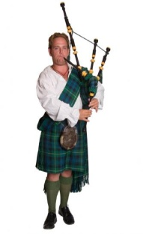
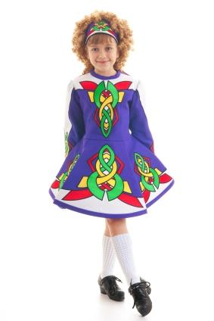
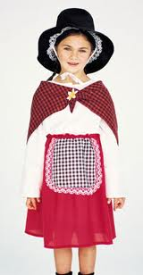
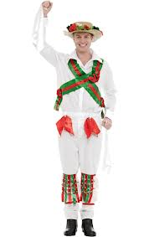

Slide 3
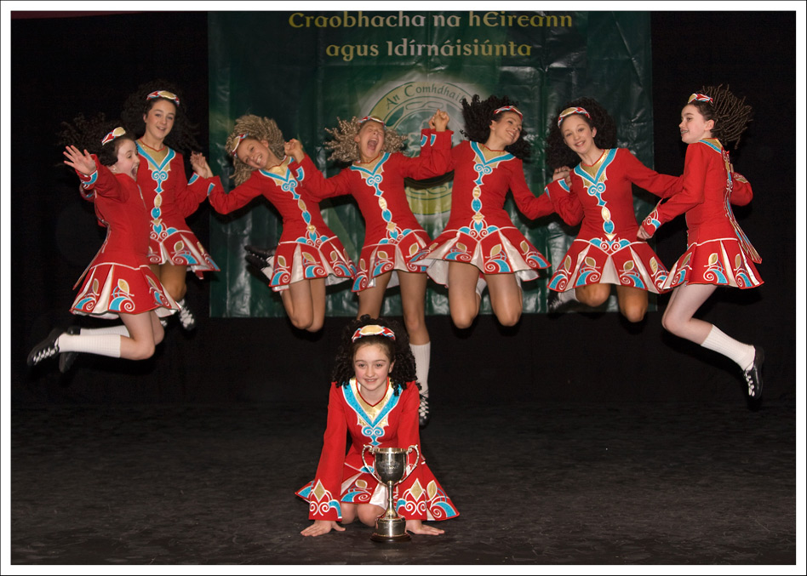
Irish Traditional costume

Slide 4
Irish Traditional costume
It makes you think of Irish
folk dancing. Female dancers
wear a long-sleeved dress,
knee-high white socks and
black shoes. The colourful
patterns on the dresses are
based on Celtic designs.

Slide 5
Scottish Traditional costume

Slide 6
Probably the best known traditional costume in the UK is the Scottish kilt with its distinctive tartan pattern.
Kilts were pleated woolen skirts, worn only by men, and fastened in front with a special pin. A goatskin bag called sporran was worn around the waist and a cloak was draped over one shoulder. Each clan or family had its own tartan design. The kilt is still worn on special occasions today.

Slide 7
Pin, pleated woolen skirt, sporran, cloak
cloak
pin
Pleated woolen skirt
sporran

Slide 8
Welsh Traditional costume

Slide 9
What everyone recognise about the Welsh costume is its tall black hat or “beaver hat” worn over a lace cap.
beaver hat
lace cap

Slide 10
Women in the past wore it with a long full skirt ad a white apron. A shawl, usually red, was worn around the shoulders. The outfit was complete with black shoes and stockings, and ladies carried a basket.

Slide 11
England: Morris Dancing

Slide 12
Morris dancing with its traditional costumes is a familiar sight in England.
These dance are performed outdoors in country villages during the summer. The dancers wear white trousers, a loose white shirt and a pad of bells around the bottom half of the leg. Their hats are decorated with ribbons and flowers, and they wave handkerchiefs in the air as they dance.

Slide 13
White trousers, loose white shirt, pad of bells, hats decorated with ribbons and flowers, handkerchiefs
handkerchief
hat with ribbons and flowers
Pad with bells

Slide 14
THANKS A LOT FOR YOUR ATTANTION!

