Slide 1
.
Adjectives. Degrees of comparison.

Slide 2
English Proverbs
Better late than never.
From bad to worse.
East or West home is best.

Slide 3
Правила правописания
односложные и двусложные прилагательные образуют сравнительную и превосходную степень путём добавления –er, -est.
Многосложные и некоторые двусложные прилагательные образуют сравнительную и превосходную степень при помощи more, most.

Slide 4
“ Three Bears”

Slide 6
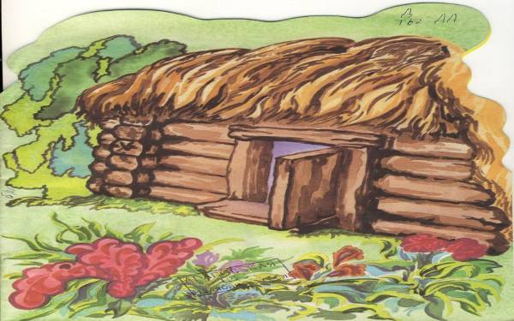
The bears’ house

Slide 7
Three bears live in the house in the forest. Their names are Michail Ivanovich, Nastasya Petrovna and Mishutka. Their house is big.

Slide 8
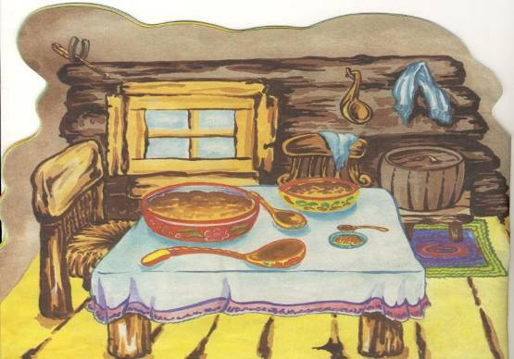
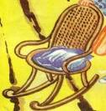
This is a dining room.

Slide 9
There is a table and three chairs. Mishutka’s chair is high. Nastasya Petrovna’s chair is (high) than Mishutka’s chair.Michail Ivanovich’s chair is the (high).
On the table you can see three bowls. Mishutka’s bowl is big. Nastasya Petrovna’s bowl is (big) than Mishutka’s bowl.Michail Ivanovich’s bowl is the (big).
There is porridge in the bowls. Porridge in Michail Ivanovich’s bowl is tasty. Nastasya Petrovna’s porridge is (tasty) than Michail Ivanovich’s porridge But Mishutka’s porridge is the (tasty).

Slide 10
There is a table and three chairs. Mishutka’s chair is high. Nastasya Petrovna’s chair is higher than Mishutka’s chair.Michail Ivanovich’s chair is the (high).
On the table you can see three bowls. Mishutka’s bowl is big. Nastasya Petrovna’s bowl is (big) than Mishutka’s bowl.Michail Ivanovich’s bowl is the (big).
There is porridge in the bowls. Porridge in Michail Ivanovich’s bowl is tasty. Nastasya Petrovna’s porridge is (tasty) than Michail Ivanovich’s porridge But Mishutka’s porridge is the (tasty).

Slide 11
There is a table and three chairs. Mishutka’s chair is high. Nastasya Petrovna’s chair is higher than Mishutka’s chair.Michail Ivanovich’s chair is the highest.
On the table you can see three bowls. Mishutka’s bowl is big. Nastasya Petrovna’s bowl is (big) than Mishutka’s bowl.Michail Ivanovich’s bowl is the (big).
There is porridge in the bowls. Porridge in Michail Ivanovich’s bowl is tasty. Nastasya Petrovna’s porridge is (tasty) than Michail Ivanovich’s porridge But Mishutka’s porridge is the (tasty).

Slide 12
There is a table and three chairs. Mishutka’s chair is high. Nastasya Petrovna’s chair is higher than Mishutka’s chair.Michail Ivanovich’s chair is the highest.
On the table you can see three bowls. Mishutka’s bowl is big. Nastasya Petrovna’s bowl is bigger than Mishutka’s bowl. Michail Ivanovich’s bowl is the (big).
There is porridge in the bowls. Porridge in Michail Ivanovich’s bowl is tasty. Nastasya Petrovna’s porridge is (tasty) than Michail Ivanovich’s porridge But Mishutka’s porridge is the (tasty).

Slide 13
There is a table and three chairs. Mishutka’s chair is high. Nastasya Petrovna’s chair is higher than Mishutka’s chair.Michail Ivanovich’s chair is the highest.
On the table you can see three bowls. Mishutka’s bowl is big. Nastasya Petrovna’s bowl is bigger than Mishutka’s bowl. Michail Ivanovich’s bowl is the biggest.
There is porridge in the bowls. Porridge in Michail Ivanovich’s bowl is tasty. Nastasya Petrovna’s porridge is (tasty) than Michail Ivanovich’s porridge But Mishutka’s porridge is the (tasty).

Slide 14
There is a table and three chairs. Mishutka’s chair is high. Nastasya Petrovna’s chair is higher than Mishutka’s chair.Michail Ivanovich’s chair is the highest.
On the table you can see three bowls. Mishutka’s bowl is big. Nastasya Petrovna’s bowl is bigger than Mishutka’s bowl. Michail Ivanovich’s bowl is the biggest.
There is porridge in the bowls. Porridge in Michail Ivanovich’s bowl is tasty. Nastasya Petrovna’s porridge is tastier than Michail Ivanovich’s porridge. But Mishutka’s porridge is the (tasty).

Slide 15
There is a table and three chairs. Mishutka’s chair is high. Nastasya Petrovna’s chair is higher than Mishutka’s chair.Michail Ivanovich’s chair is the highest.
On the table you can see three bowls. Mishutka’s bowl is big. Nastasya Petrovna’s bowl is bigger than Mishutka’s bowl. Michail Ivanovich’s bowl is the biggest.
There is porridge in the bowls. Porridge in Michail Ivanovich’s bowl is tasty. Nastasya Petrovna’s porridge is tastier than Michail Ivanovich’s porridge. But Mishutka’s porridge is the tastiest.

Slide 16
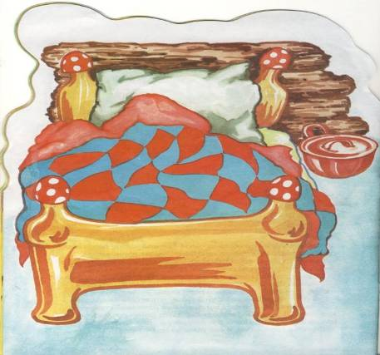
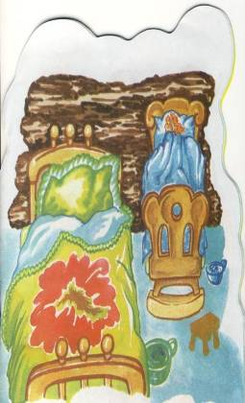
In the bedroom there are three beds.

Slide 17
Mishutka’s bed is large.
Nastasya Petrovna’s bed is (large) than Mishutka’s bed.
Michail Ivanovich’s bed is the (large).

Slide 18
Mishutka’s bed is large.
Nastasya Petrovna’s bed is larger than Mishutka’s bed.
Michail Ivanovich’s bed is the (large).

Slide 19
Mishutka’s bed is large.
Nastasya Petrovna’s bed is larger than Mishutka’s bed.
Michail Ivanovich’s bed is the largest.

Slide 20
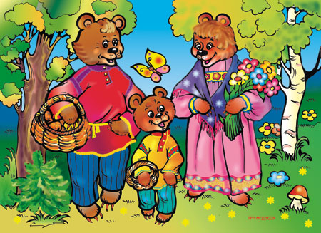
Who is the kindest person in this family?
Who is the strongest person in this family?
Who is the loudest person in this family?

Slide 21
Степени сравнения прилагательных. Degrees of comparison.
положительная сравнительная превосходная
high …… the highest
big bigger ……
tasty ……. the tastiest
large larger ……..

Slide 22
Good for you
Ты знаешь степени сравнения прилагательных
Ты умеешь сравнивать предметы, животных.
It was the most interesting fairy tale!!!

