Slide 1
Days of the week

Slide 2
Put the letters in right order
yadnoM
esTuyad
nesddWeny
Synaud
driFya
hyauTrsd
rdSauaty

Slide 3
Days of the week
Monday
Tuesday
Wednesday
Thursday
Friday
Saturday
Sunday

Slide 4
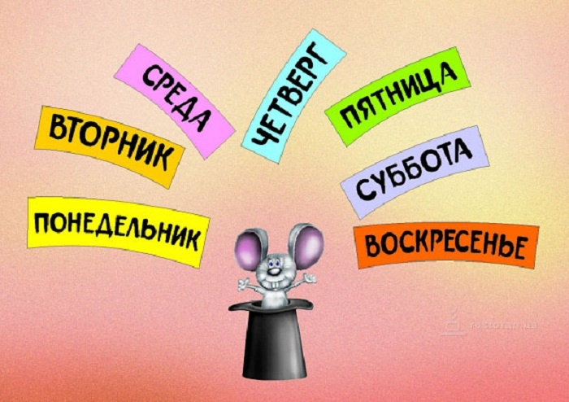

Slide 5
Ordinal numbers
One
Two
Three
First
Second
Third

Slide 6
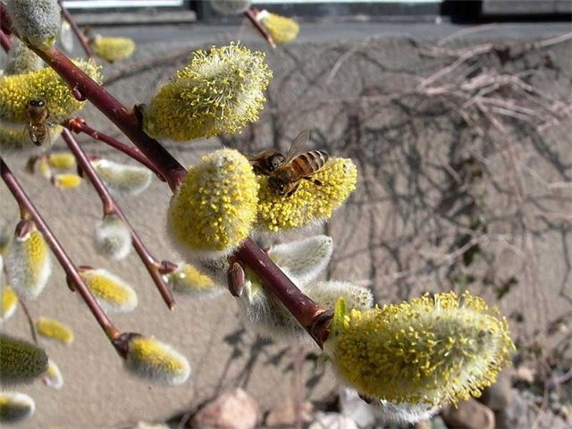
Spring
March
April
May

Slide 7
Autumn
September
October
November

Slide 8
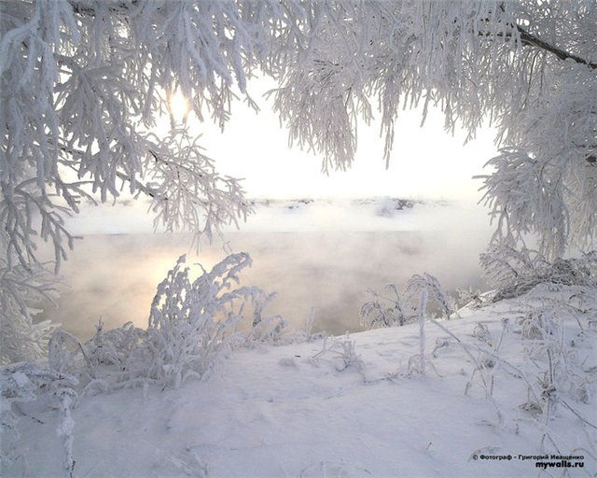
Winter
December
January
February

Slide 9
Summer
June
July
August

Slide 10
Guess
The second month of the year
The Christmas month
The month before May
The month after October
The ninth month
The fifth month
The month after June
The month before April
The beginning of the year
The eighth month
The month before November
The sixth month

Slide 11
What's the date?
17/08
02/12
03/06
01/01
29/10
01/01
05/11
12/03
14/02
23/08
02/06
13/03

Slide 12
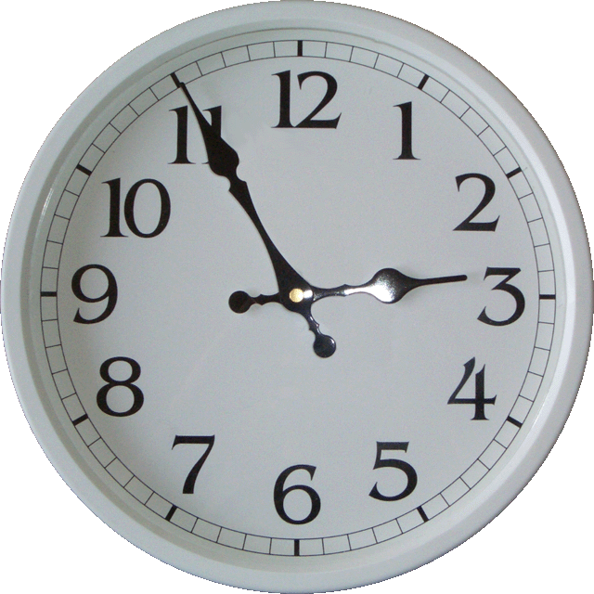
What time is it?

Slide 13
What time is it?
O'clock
To
Past
Half
A quarter
Час
Соответствует «без»
После
Половина
четверть

Slide 14
Рrepositions of time
At 3 o'clock
At night
At the weekend
On Monday
On the 6th of June
In April
In Summer
In 1923
In the morning, in the evening, in the afternoon.

Slide 15
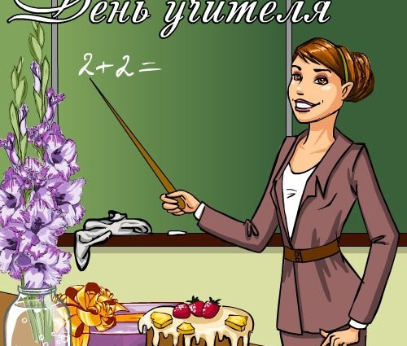
Homework
W.b. p.11 ex. 3,5.
Words module 2a

