Slide 1
IT’S FUN!
Module 7с

Slide 2
Warm-up
PRONUNCIATION:
/Ow/, /uo/- brown, blouse, down,now, out.

Slide 3
Warm-up
Whether the weather be fine, Or whether the weather be not, Whether the weather be cold, Or whether the weather be hot, We'll weather the weather Whatever the weather, Whether we like it or not!

Slide 4
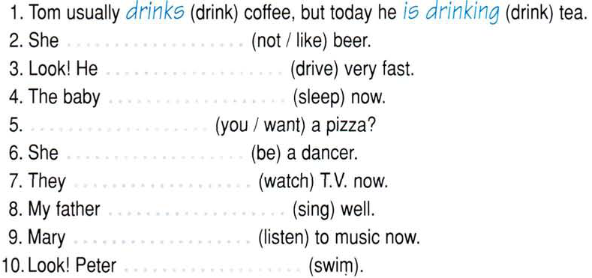

Slide 5
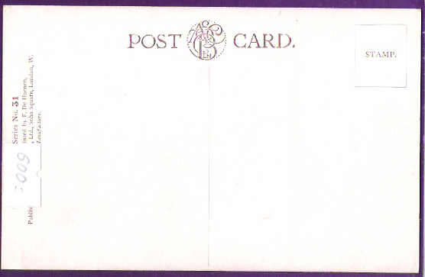
Dear Anna,
How are you?
I’m having …… here in sunny Anapa. The …… is lovely. The beach is …… but crowded. I go …… every day. My mum and aunt Larisa wake up early ……, have breakfast and …… all day. …… we go to performances or stay at …… . Then I play with other …… in the yard. …….! I really ……!.......
Love,
Lena.
Anna May
5, Tolstoy Str
Kazan
Russia

Slide 6
Exercise 2
Look at the picture on the right and complete the sentences (Simple Present or Present Progressive).
This (be) __________ Marc.
He (wear) __________ a t-shirt and shorts today.
He (eat) _________ an apple at the moment.
Marc (like) __________ fruits and vegetables.
He (eat) __________ some every day.
Marc (know) __________ that apples (be)__________ good for his health.

Slide 7
Self-preparation:
WB, ex.1,2 page 55.
Написать открытку по образцу SB ex.5 page 90.
Thank you!
See you later!

