Slide 1
The 22nd of January.
Thursday.

Slide 2
Environmental problems.
Today we are going to:
1. develop the skills of speaking, listening and writing;
2. speak about environmental problems;
3. work with a videofilm;
4. learn new idioms.

Slide 3
Read and translate into Russian
to pollute the environment
to cut down forests
without water or food
toxic waste
to pour into the rivers
dangerous to breathe
a town dump
floods and drought
endangered species
greenhouse gases,
to save energy.

Slide 4
Translate into English
вырубать леса,
вырубка лесов,
без еды или воды,
красивая природа,
природный газ,
загрязнять воду (воздух, почву),
загрязнение воды (воздуха),
городская свалка,
большая опасность,
сливать отходы в реки,
природная катастрофа,
глобальное потепление.

Slide 5
Fill in gaps:
clean and beautiful
toxic waste
plants and animals
Animals’ habitats
endangered species
greenhouse gases
1.We can’t live without ____________________.
2.We want to see our planet _________________.
3. Factories often pour ___________into our rivers, seas and oceans.
4. The Amur tiger is an ____________________.
5. _______________ are being destroyed.
6.We should reduce the ________________ which make the Earth warmer.

Slide 6
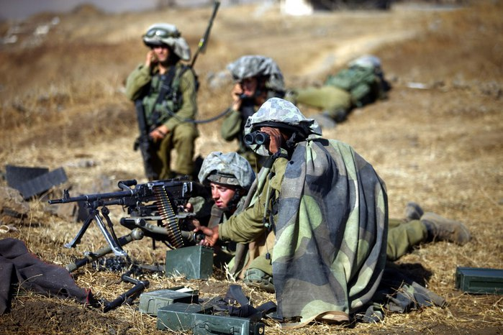
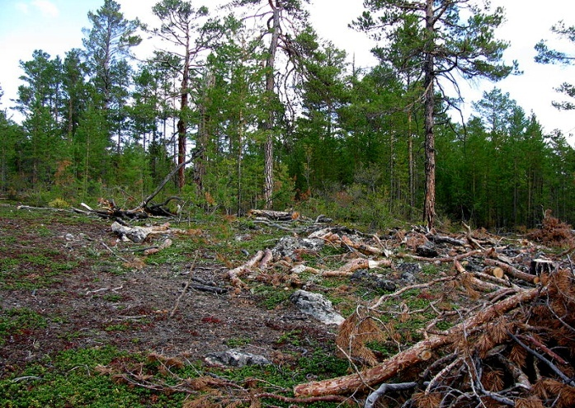
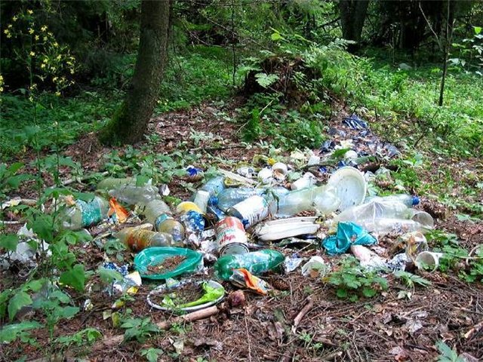
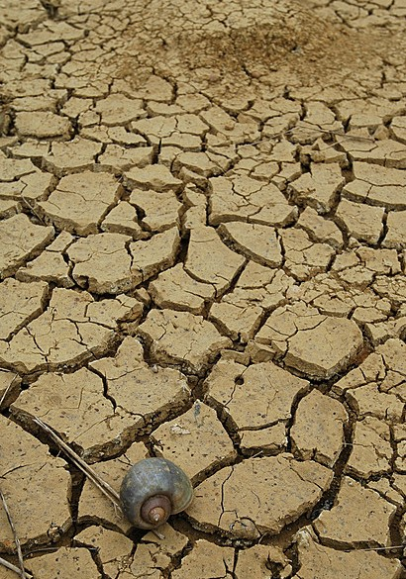
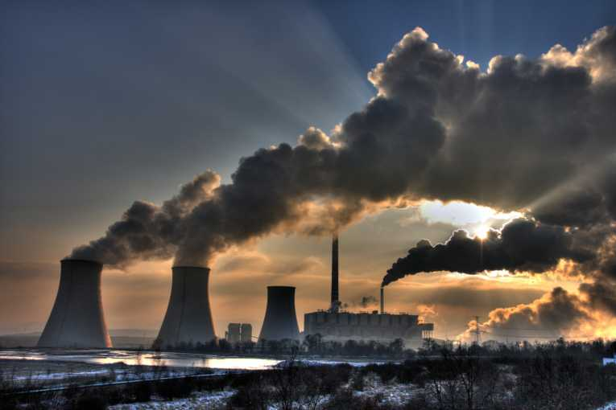
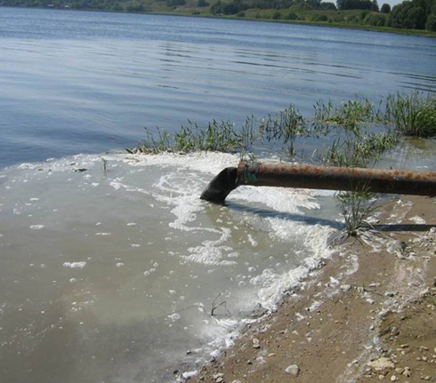
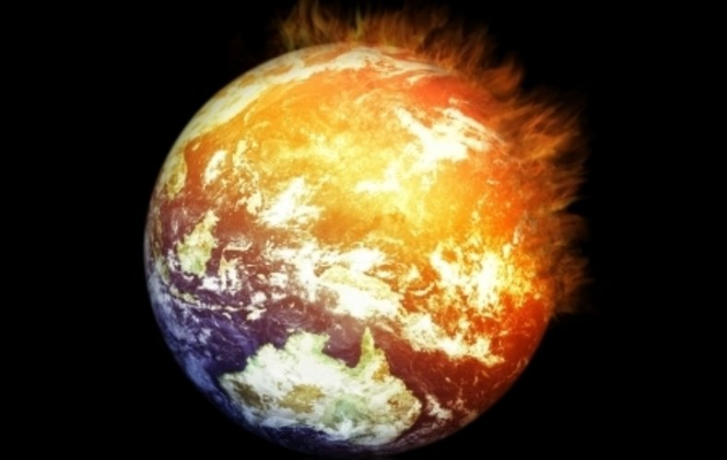
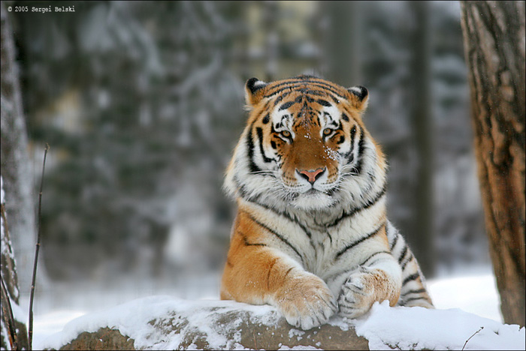
Ecological
problems

Slide 7
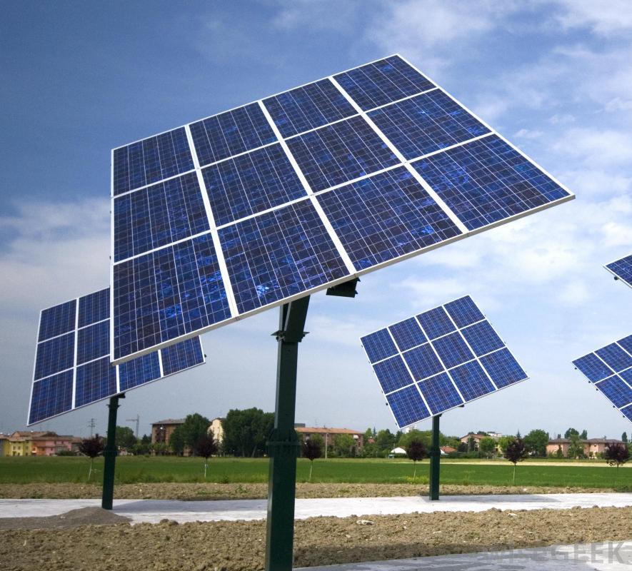
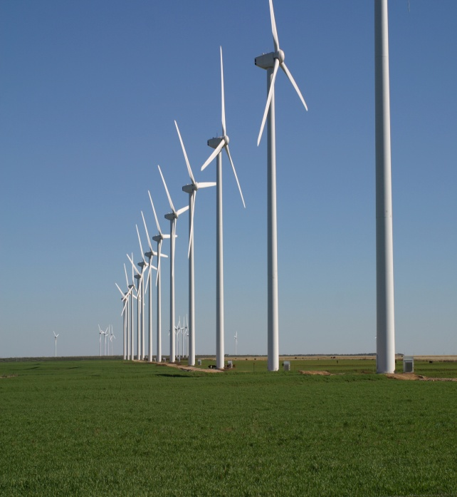
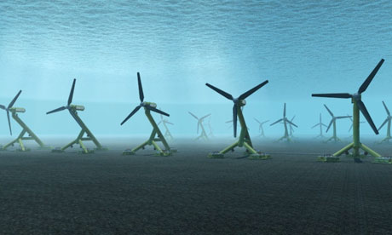
Look and guess
solar panels wind farms underwater turbines
[ˈtɜːbaɪnz]

Slide 8
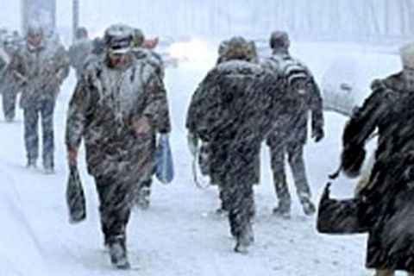
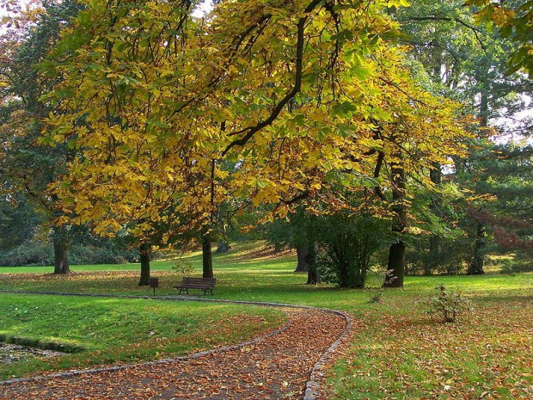
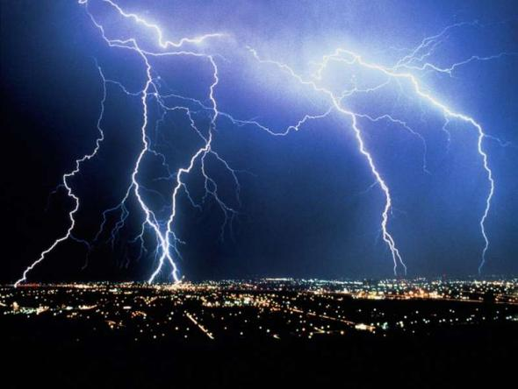
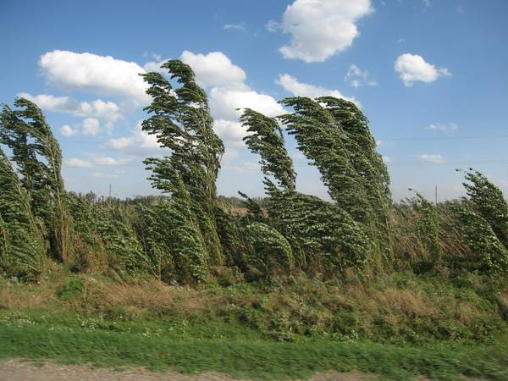
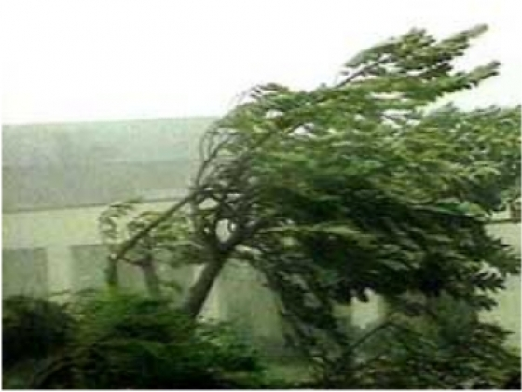
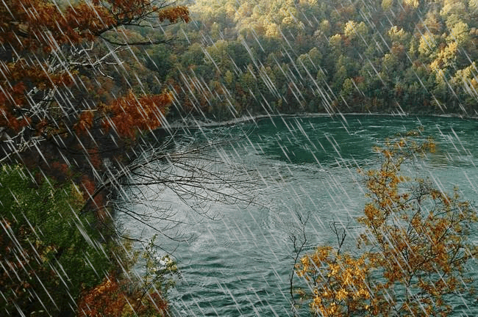
Weather

Slide 9
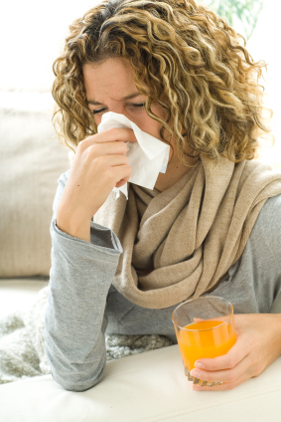
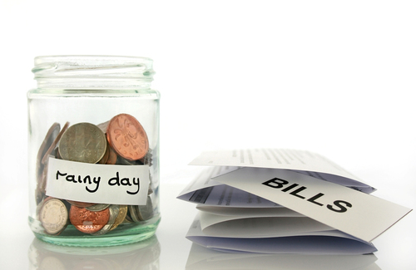
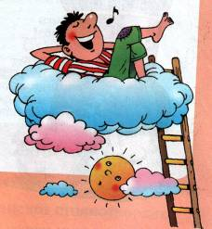
Learn new idioms
1.to feel under the weather-
to be or feel ill
2.to save up for a rainy day-
to keep some money for a time in
the future when it might be needed
3.to be on cloud nine-
to be very happy

Slide 10
Learn new idioms
4.to see which way the wind blows-
to see how a situation is
developing
5.to be a bolt from the blue-
to be a great surprise

Slide 11
Fill in gaps
cloud nine
rainy day
bolt from the blue
under the weather
wind blows
1. "Was Helen happy about buying a new car?" “Happy? She was on ___________!“
2. The news of his marriage was a ____________________.
3. He is feeling ________________so he is going to bed early tonight.
4.Let's see which way the ___________ before we decide.
5. She has a thousand pounds which she's
saving for a _________.

Slide 12
About our lesson….
It was difficult …
It was interesting….
Now I know…
Now I can….

Slide 13
Learn the idioms,
Ex.4 p.47 (WB)

